Slide 1
Municipal Board Empowerment Series Workshop #4 NH Coastal Viewer 101 for Land Conservation
Exercises September 6, 2017

Slide 2
A few preliminary words:
The steps presented here are one approach to complete each task. Often, there are multiple ways to accomplish a task.
The site is dynamic – data sets are added/updated and tools are added/modified regularly.
Feel free to explore other tools as you work through the exercises.
If you get stuck, discuss with your neighbor or ask Fay, David, or Kirsten for assistance.

Slide 3
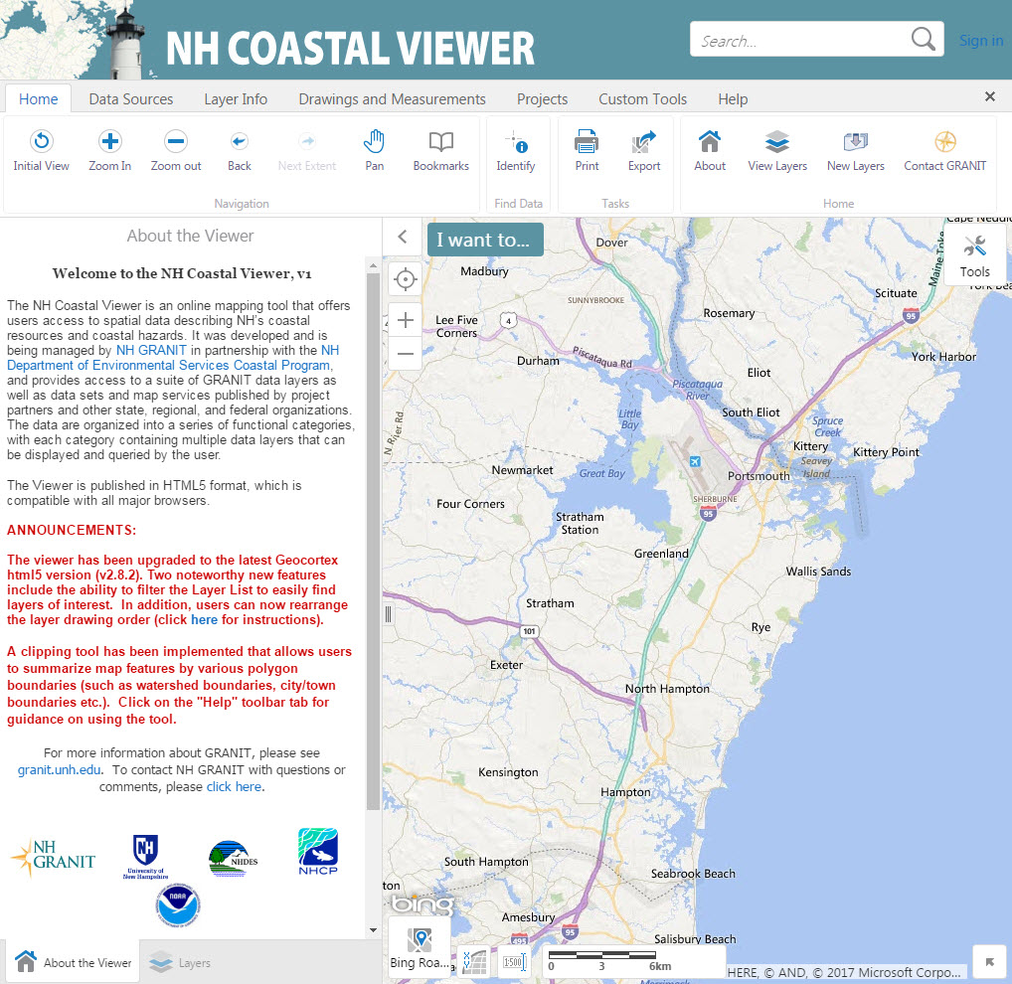
Training Exercise 1:
Explore the Coastal Viewer
The Coastal Viewer allows users to view and manipulate data online, with a focus on coastal data and hazards
Exercise 1 will present an overview of the Coastal Viewer and introduce its basic functions

Slide 4
Training Exercise 1 – Explore the Coastal Viewer Topics in this Exercise:
Get to know the Interface
Turn on Data Layers
Navigate within the Map Area (Zoom, Pan, etc)
Change the Base Map/Background Image
Filter Data in the Table of Contents
Access Layer Actions
Turn On/Off Layer Visualizations
Use the Identify Tool to View Data Attributes
Read Metadata
Access Help documents

Slide 5
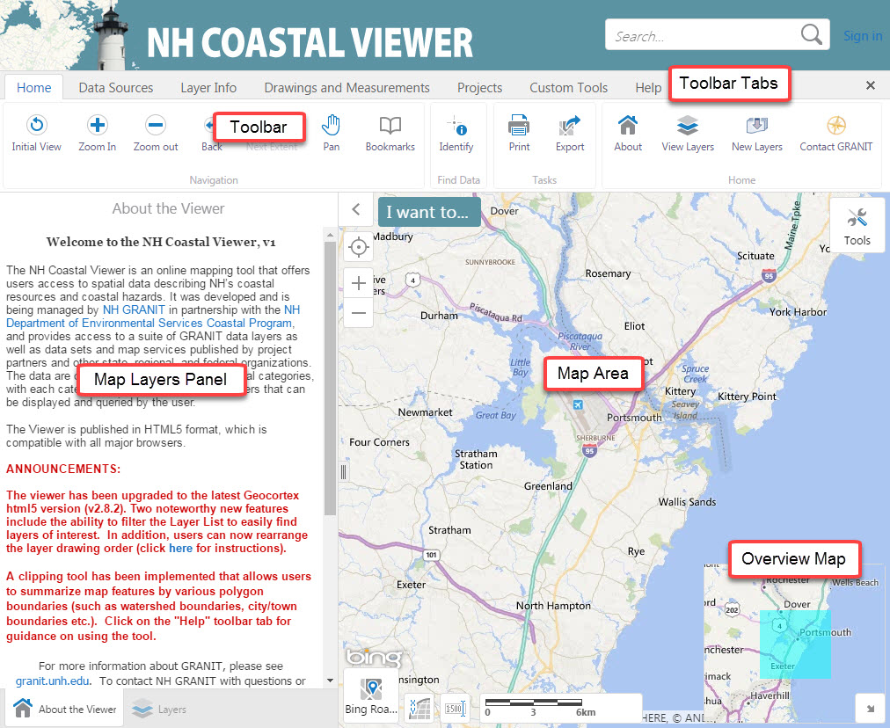
Training Exercise 1 – Explore the Coastal Viewer 1. Get to Know the Interface
The Toolbar buttons allow you to manipulate the map
Toolbars are arranged in Tabs
Table of Contents will be displayed in the Map Layers Panel
Turn on and off the Overview Map by clicking the arrow in the lower right corner

Slide 6
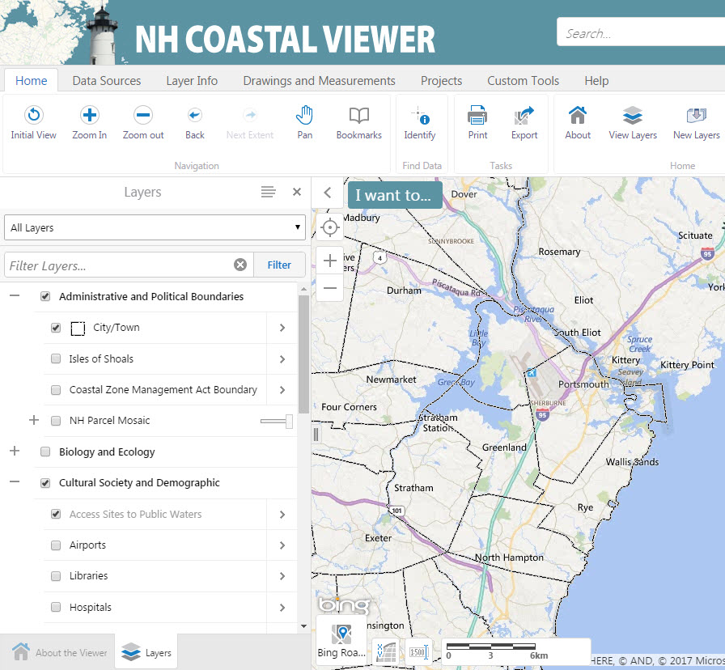
Training Exercise 1 – Explore the Coastal Viewer 2. Turn on Data Layers
Click Layers to view Table of Contents
Turn layers on and off by checking the boxes
Expand and collapse data categories by clicking the +/- symbols
All levels of the hierarchy must be checked for data to be visible

Slide 7
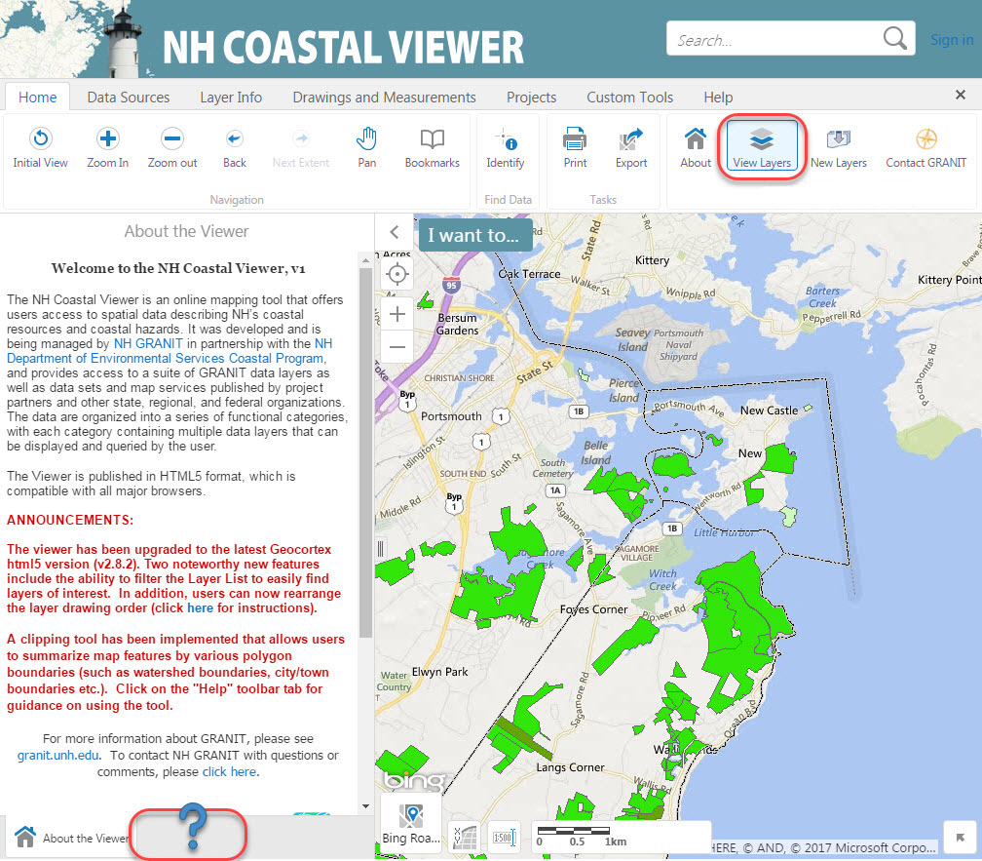
Training Exercise 1 – Explore the Coastal Viewer 2. Turn on Data Layers
If you accidentally close the Map Layers Panel (the Table of Contents), you can open it again by clicking View Layers

Slide 8
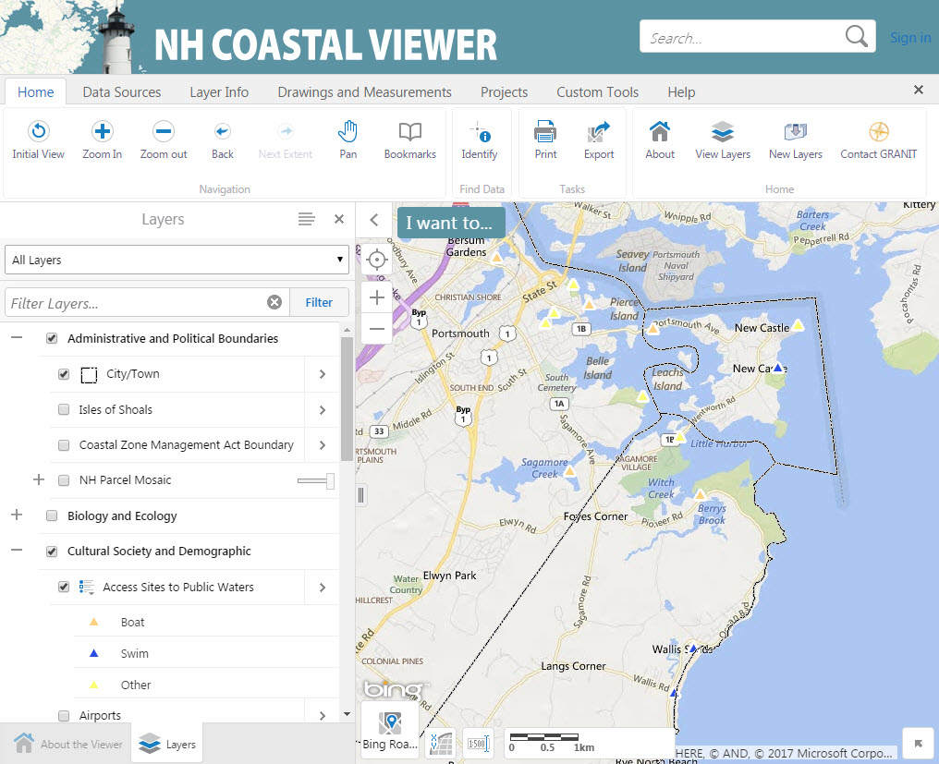
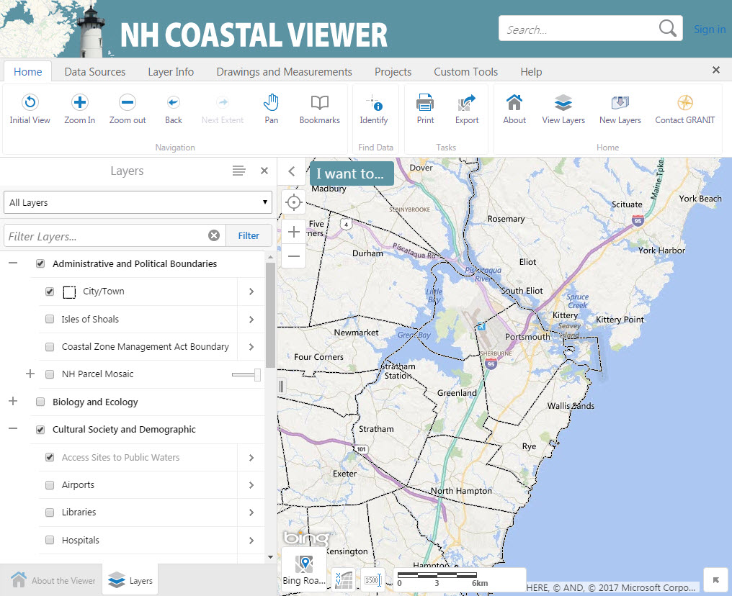
Training Exercise 1 – Explore the Coastal Viewer 3. Navigate within the Map Area
To Zoom In/Out, click the Zoom In or Zoom Out button, then drag a box in the map area
Each time you want to zoom, you must re-click the appropriate Navigation button
Layers that appear in gray font are scale-dependent. Notice “Access Sites to Public Waters” draws after we zoom in.

Slide 9
Training Exercise 1 – Explore the Coastal Viewer 3. Navigate within the Map Area
Click the hand icon to Pan
Click Back to return to previous extent
Initial View returns the map to the default extent

Slide 10
Training Exercise 1 – Explore the Coastal Viewer 3. Navigate within the Map Area
You can also zoom using +/- buttons in the map area or by using your mouse wheel

Slide 11
Training Exercise 1 – Explore the Coastal Viewer 4. Filter Data in the Table of Contents
Filter allows you to search for a specific layer by name
Type a keyword into the Filter box, and the Layers List will display only those layers that match your search criteria
Filter searches based on the title of the layer, so try other keywords if you don’t see what you want
Click the x to go back to the full Layers List

Slide 12
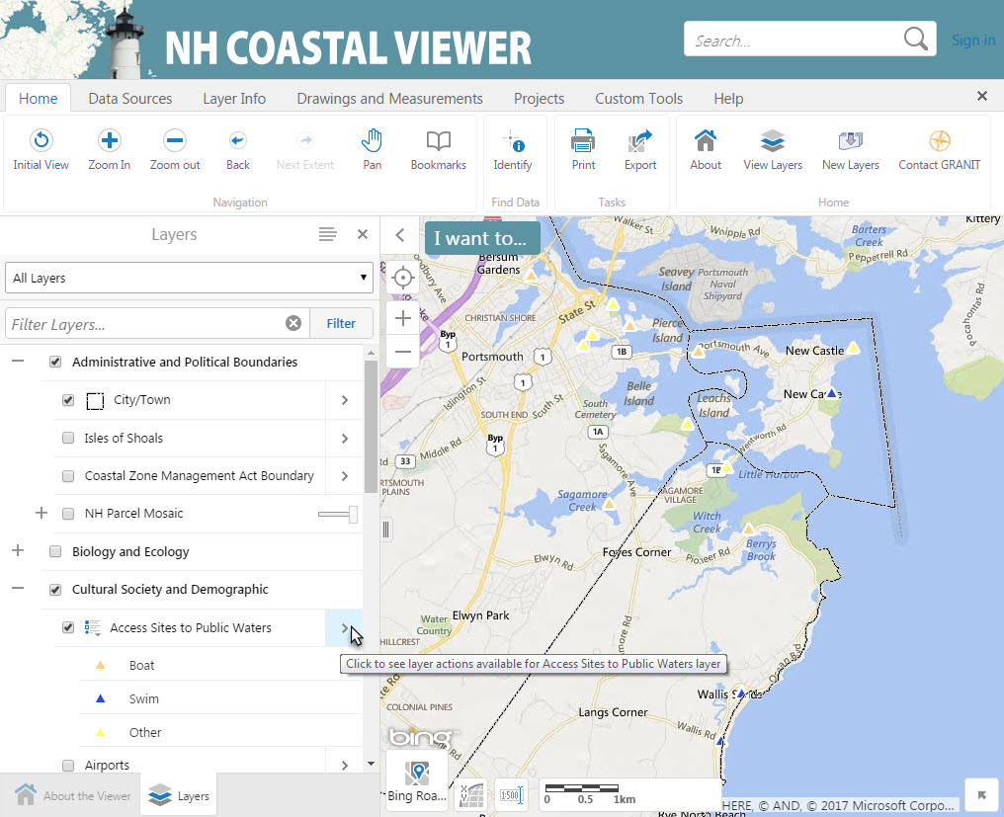
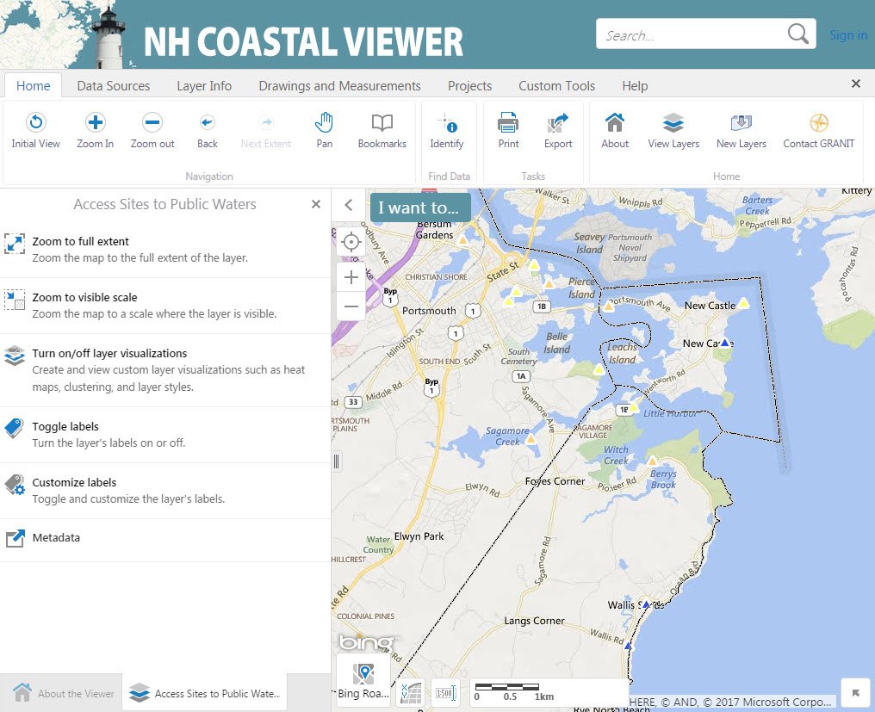
Training Exercise 1 – Explore the Coastal Viewer 5. Access Layer Actions
Click the arrow next to “Access to Public Waters” to view Layer Actions for this layer
Layer actions include
Zoom options
Visualizations (symbology)
Labels
Metadata
All actions are not available for every data layer

Slide 13
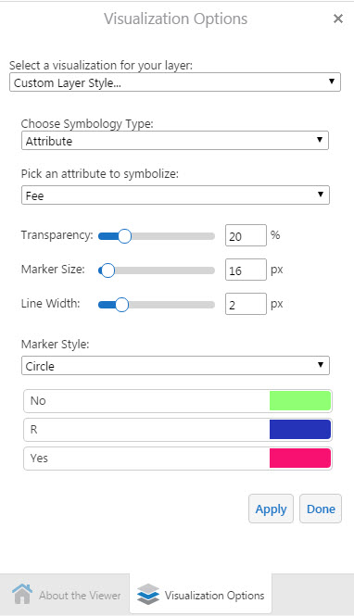
Training Exercise 1 – Explore the Coastal Viewer 6. Turn On/Off Layer Visualizations
To change the way a layer is displayed, click “Turn on/off layer visualizations”
Choose “Custom Layer Style…”
Symbology Type can be Simple (all one symbol), or by Attribute

Slide 14
Training Exercise 1 – Explore the Coastal Viewer 6. Turn On/Off Layer Visualizations
Use sliders to adjust Transparency, etc.
Click color swatches to adjust
To return to defaults, select “None” under “Select a visualization for your layer”
When finished, click Done

Slide 15
Training Exercise 1 – Explore the Coastal Viewer 7. Read Metadata
We selected “Fee” as the attribute field to symbolize. How do we find out what the Fee code “R” stands for?
Read the Metadata to learn Attribute definitions and other information about a dataset
In the Layer Actions menu, click Metadata (this will open a new browser tab)

Slide 16
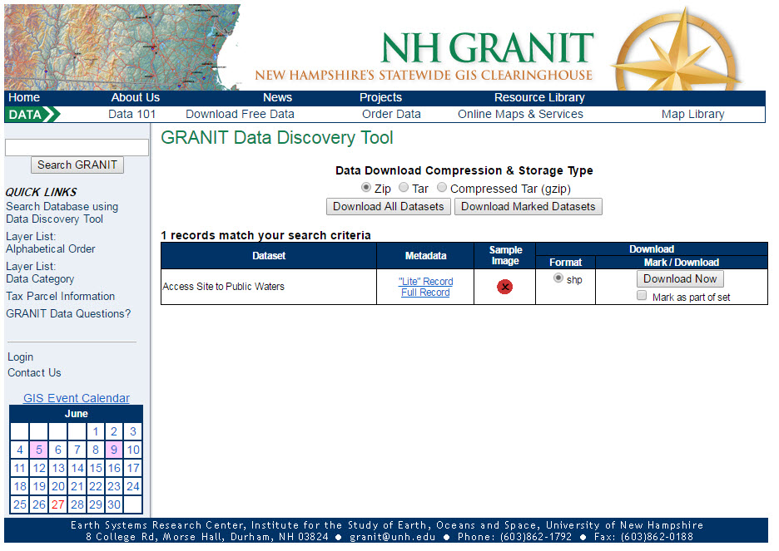
Training Exercise 1 – Explore the Coastal Viewer 7. Read Metadata
Click Full Metadata and Data Download
Then click Full Record to view Attribute Information

Slide 17
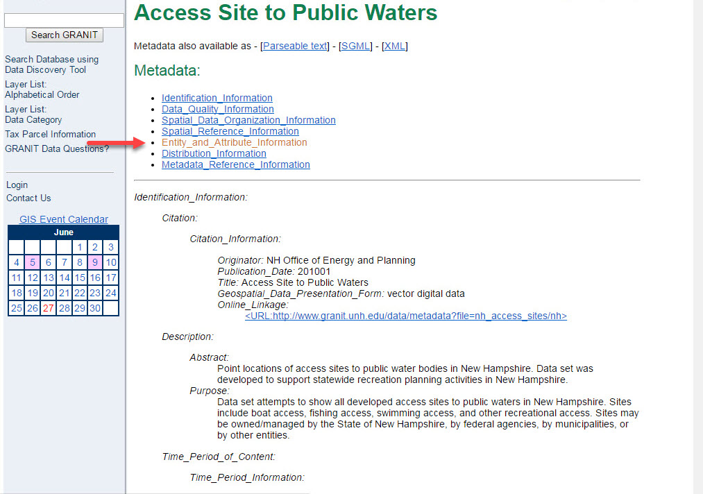
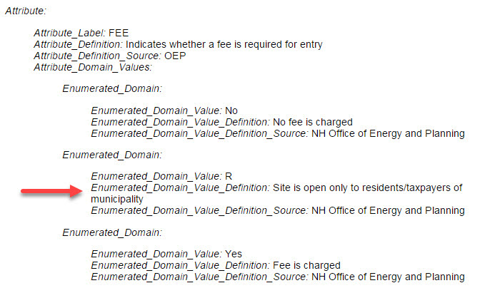
Training Exercise 1 – Explore the Coastal Viewer 7. Read Metadata
Click Entity_and_Attribute_Information to scroll to this section
Scroll down to the Attribute FEE and find the Definition of the Domain Value “R”

Slide 18
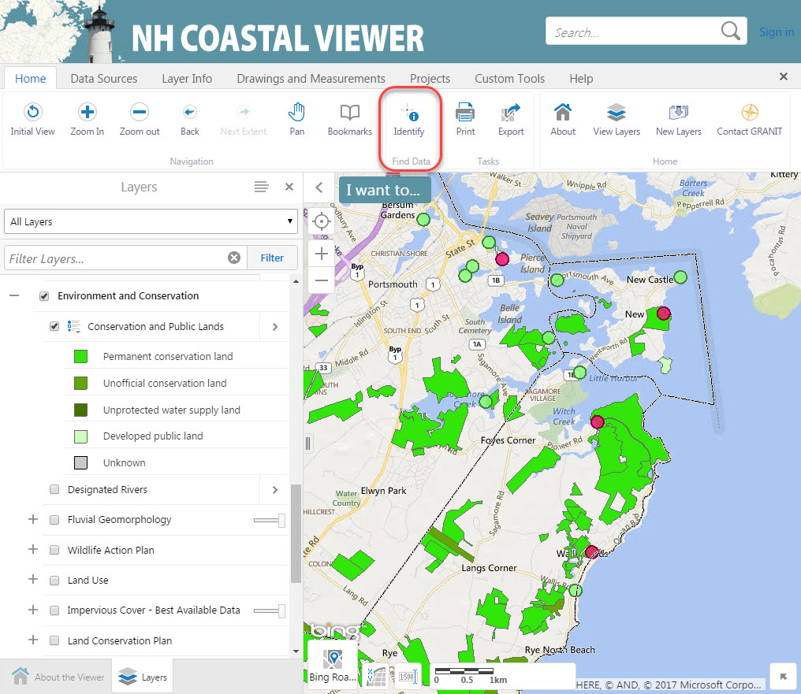
Training Exercise 1 – Explore the Coastal Viewer 8. Explore Data Attributes with Identify Tool
Now find and turn on the Conservation and Public Lands data layer (you can use the Filter tool)
We will explore the attribute information for this layer using the Identify Tool
Click Identify in the Toolbar

Slide 19
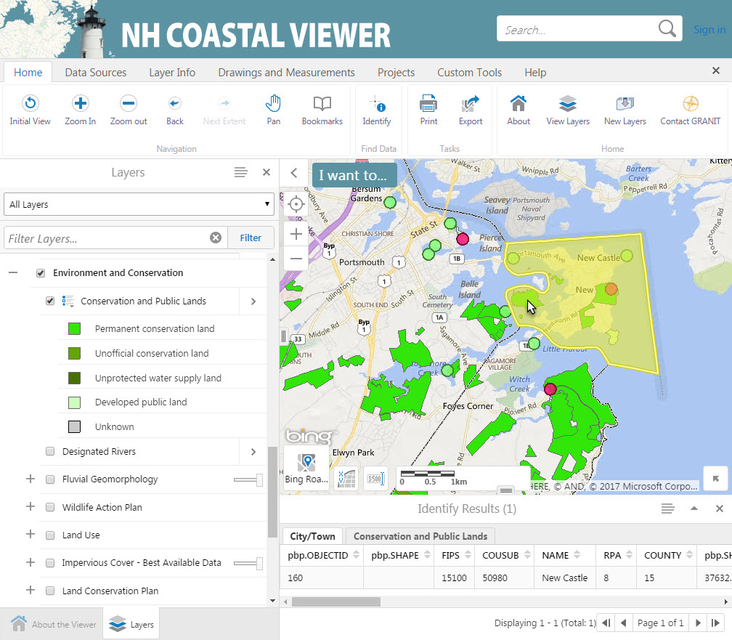
Training Exercise 1 – Explore the Coastal Viewer 8. Explore Data Attributes with Identify Tool
Click on a polygon
Results will be displayed in the Identify Results window at the bottom of the map area
Results may be displayed for multiple overlapping data layers

Slide 20
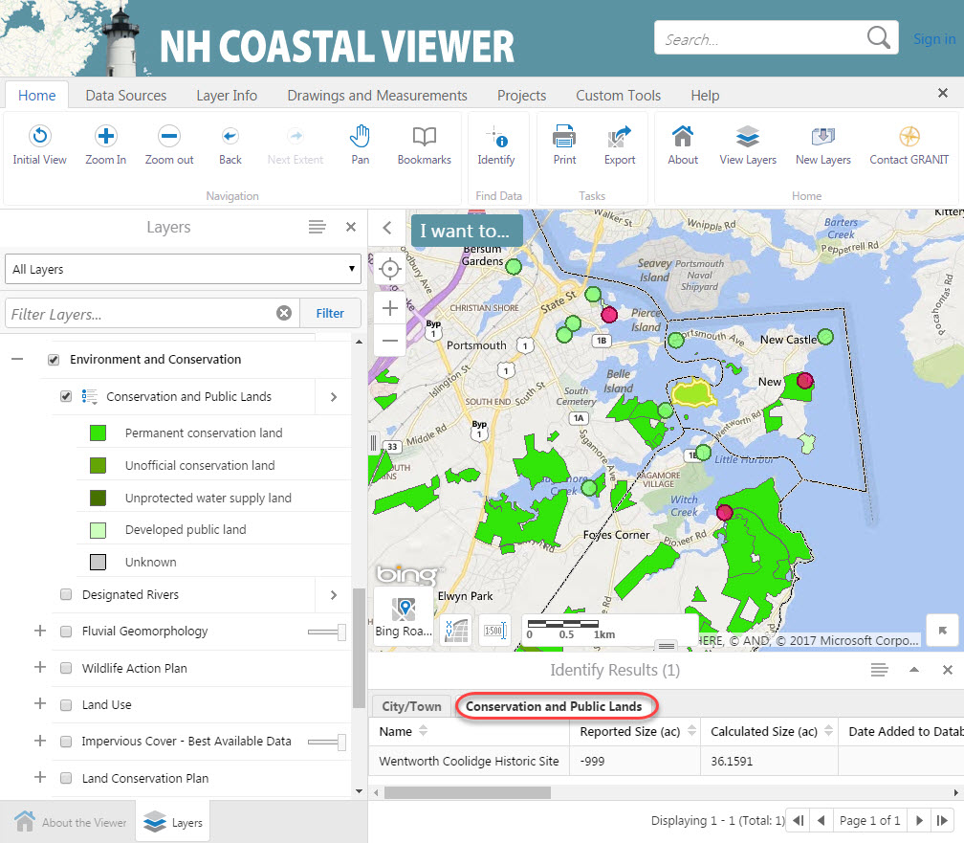
Training Exercise 1 – Explore the Coastal Viewer 8. Explore Data Attributes with Identify Tool
To view results for overlapping layers, click on the tabs in the Identify Results window
The corresponding polygon will be highlighted in the map

Slide 21
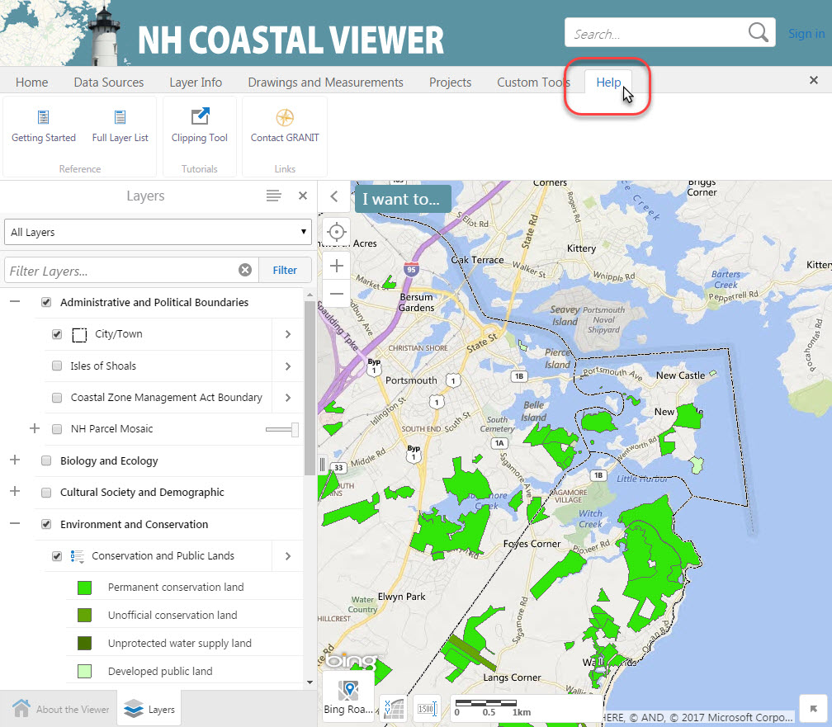
Training Exercise 1 – Explore the Coastal Viewer 9. Access Help Documents
Find Help with the Coastal Viewer in the Help Tab
“Getting Started” provides general information
“Clipping Tool” provides help with a specific tool
(more on this in our third exercise)

Slide 22
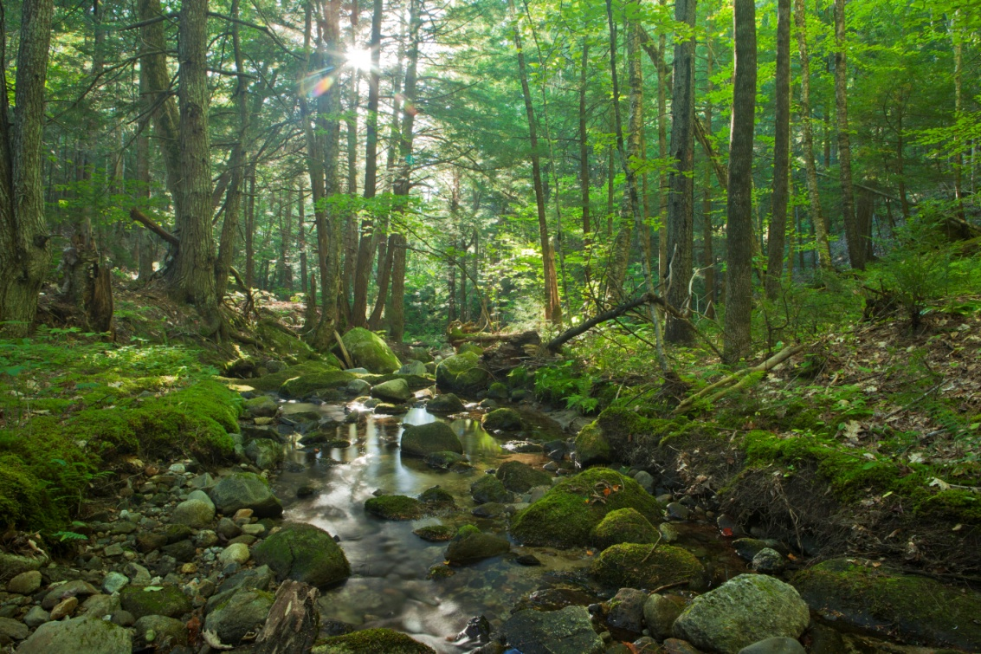
Training Exercise 2:
Using the Coastal Viewer to Develop Strategies for Drinking Water Protection

Slide 23
Training Exercise 2 – Drinking Water Protection
This exercise will use tools available in the Coastal Viewer to explore strategic land conservation for the protection of drinking water
Our focus area is the vicinity of a public water supply intake in Somersworth
A public water supply intake is a drinking water source where water is extracted for treatment and distribution
Our goal is to find and label parcels not currently in conservation that could provide multiple water resource protection benefits

Slide 24
Training Exercise 2 – Drinking Water Protection Tasks in this Exercise:
Turn on Data Layers
Zoom to 9 Wells St, Somersworth, NH
Consider parcels that could be of interest to extend or connect existing conservation lands within Public Water Supply Tier 1 and Tier 2 areas
Consider parcels within Conservation Focus Areas that are “Likely to Provide Multiple Benefits”
Change the Drawing Order so that parcel boundaries are not hidden by other data layers
Mark parcels of interest for conservation by adding a drawing
Export your drawing as a shapefile for use outside the Coastal Viewer

Slide 25
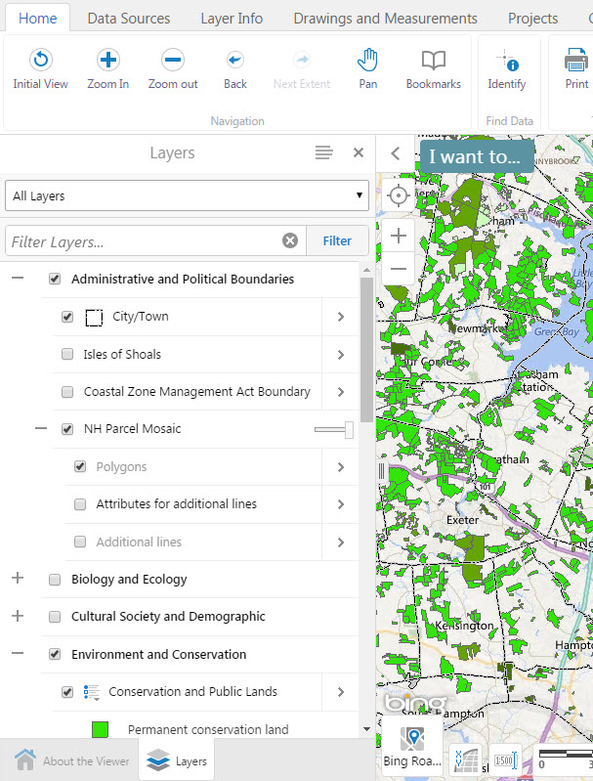
Training Exercise 2 – Drinking Water Protection 1. Turn on Data Layers
Click Initial View to return to the default map extent
Turn on Parcel Boundaries
Turn on Conservation and Public Lands
Turn on Public Water Supply, found under
Environment and Conservation >
Land Conservation Plan >
Water Resources Conservation- Focus Areas – 2016 update

Slide 26
Training Exercise 2 – Drinking Water Protection 1. Turn on Data Layers
Things to keep in mind:
Each level of the hierarchy must be checked
NH Parcel Mosaic - Polygons is a scale-dependent layer, and will not draw until you zoom in to an area of interest

Slide 27
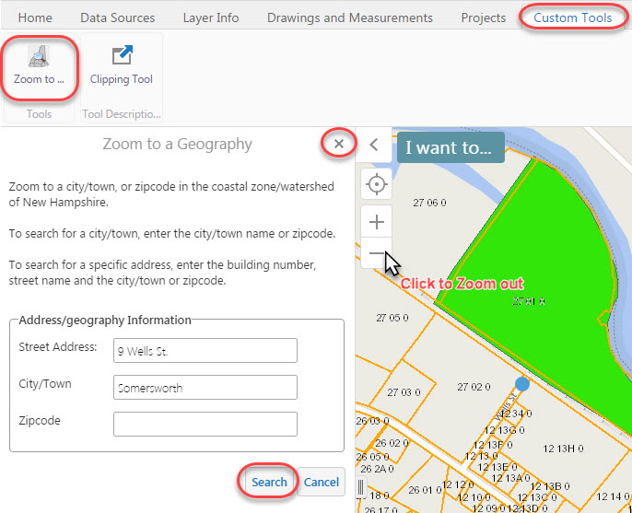
Training Exercise 2 – Drinking Water Protection 2. Zoom to 9 Wells St, Somersworth, NH
Click on the Custom Tools tab, then click the Zoom to… tool
Enter the address “9 Wells St, Somersworth, NH”. Click Search. This address is near a water supply intake.
Zoom out slightly to view parcels surrounding this address.
Click the “x” to close the Zoom to a Geography dialogue box.

Slide 28
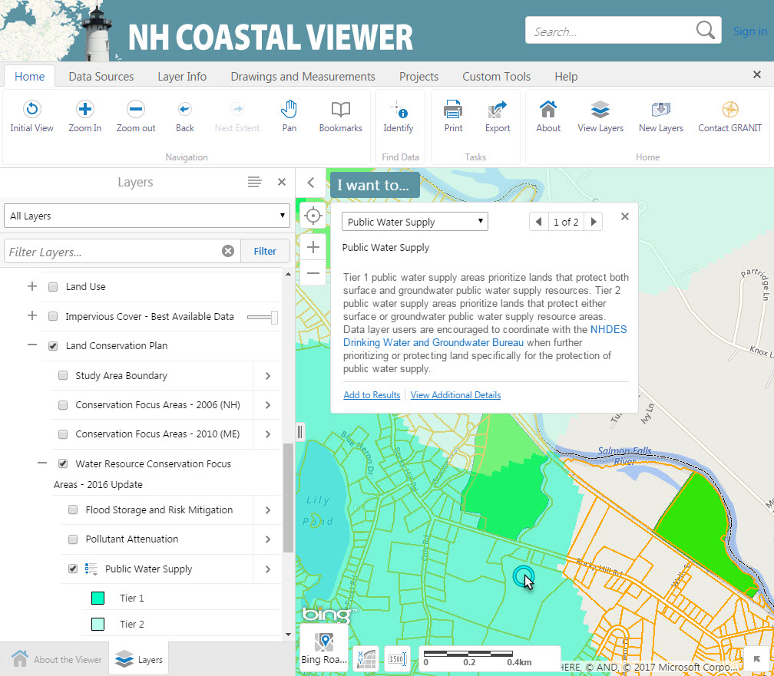
Training Exercise 2 – Drinking Water Protection
3. Consider parcels that could be of interest to extend or connect existing conservation lands within Tier 1 and Tier 2 areas
Click on a Public Water Supply polygon to view a description of Tier 1 and Tier 2 designations

Slide 29
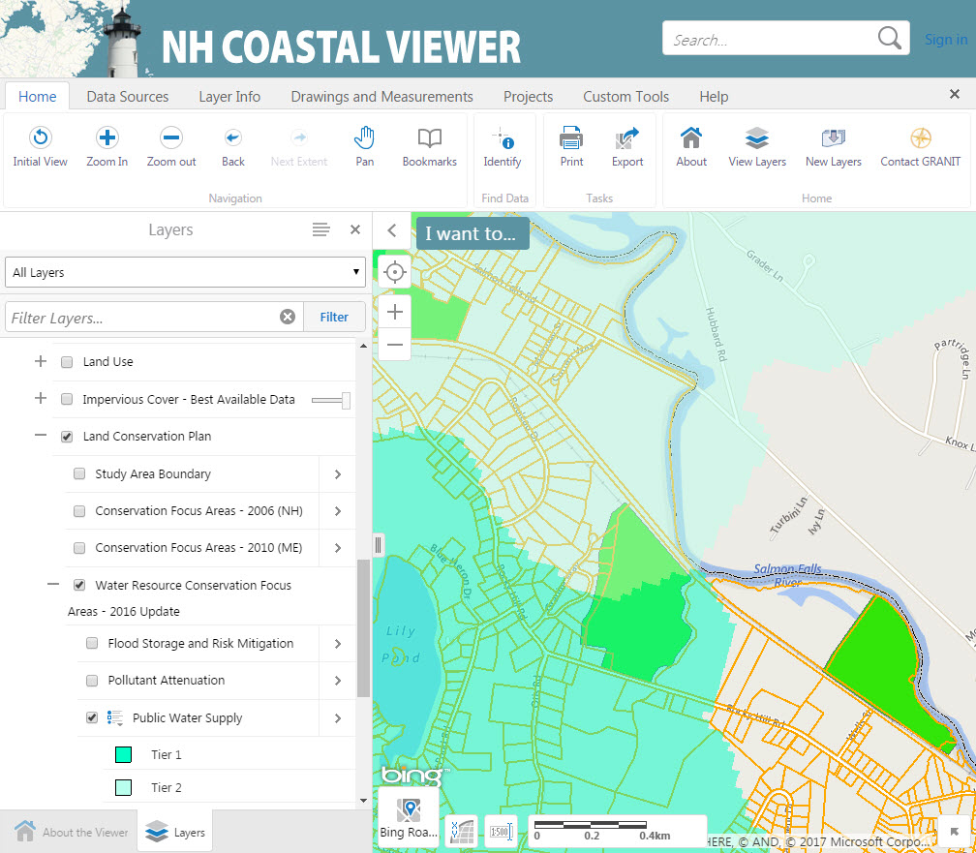
Training Exercise 2 – Drinking Water Protection
3. Consider parcels that could be of interest to extend or connect existing conservation lands within Tier 1 and Tier 2 areas
Observe parcels already in conservation that are within Public Water Supply Tier 1 or Tier 2 areas
Consider additional parcels that could be of interest for conservation
When you are ready to move on, turn off the Public Water Supply Layer

Slide 30
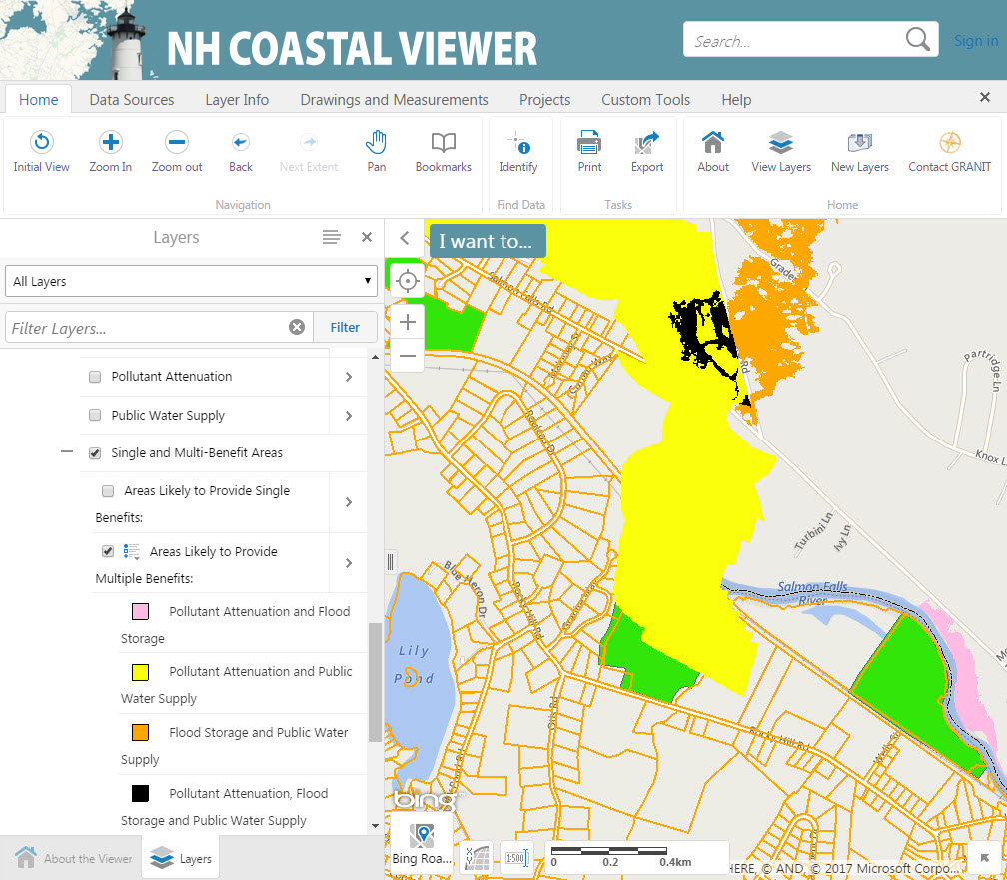
Training Exercise 2 – Drinking Water Protection
4. Consider parcels within Conservation Focus Areas that are “Likely to Provide Multiple Benefits”
Under Water Resources Conservation-Focus Areas-2016 update, click Single and Multi-Benefit Areas.
Turn OFF “Areas Likely to Provide Single Benefits”
Turn ON “Areas Likely to Provide Multiple Benefits”.
Water resource benefits include Pollutant Attenuation, Flood Mitigation and Public Water Supply

Slide 31
Training Exercise 2 – Drinking Water Protection
4. Consider parcels within Conservation Focus Areas that are “Likely to Provide Multiple Benefits”
Which parcels not currently in conservation could provide multiple water resource benefits?
Currently, the Parcel layer is covered up by other layers of data
We can use the Change Layer Drawing Order tool to move Parcel lines over the Multi-Benefit Areas

Slide 32
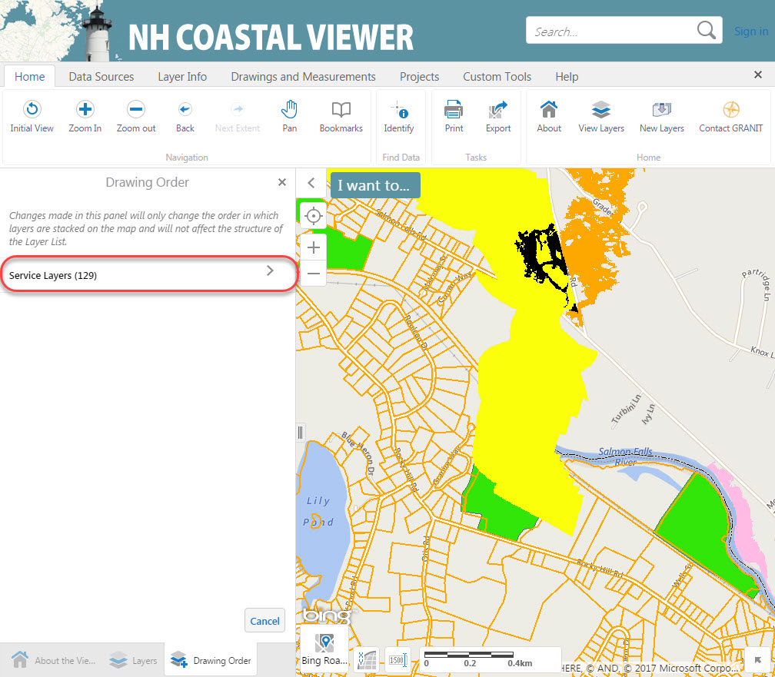
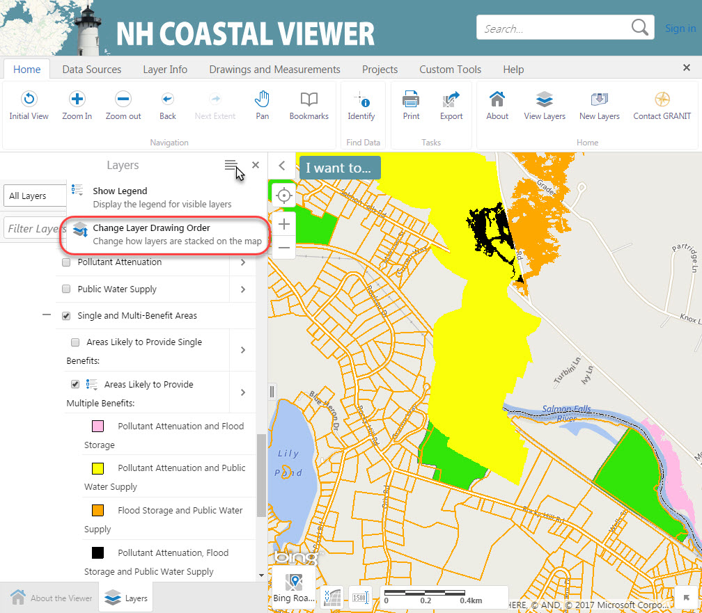
Training Exercise 2 – Drinking Water Protection
5. Change the Drawing Order so that parcel boundaries are not hidden by other data layers
Click the Panel Actions Menu
Select Change Layer Drawing Order
Click Service Layers

Slide 33
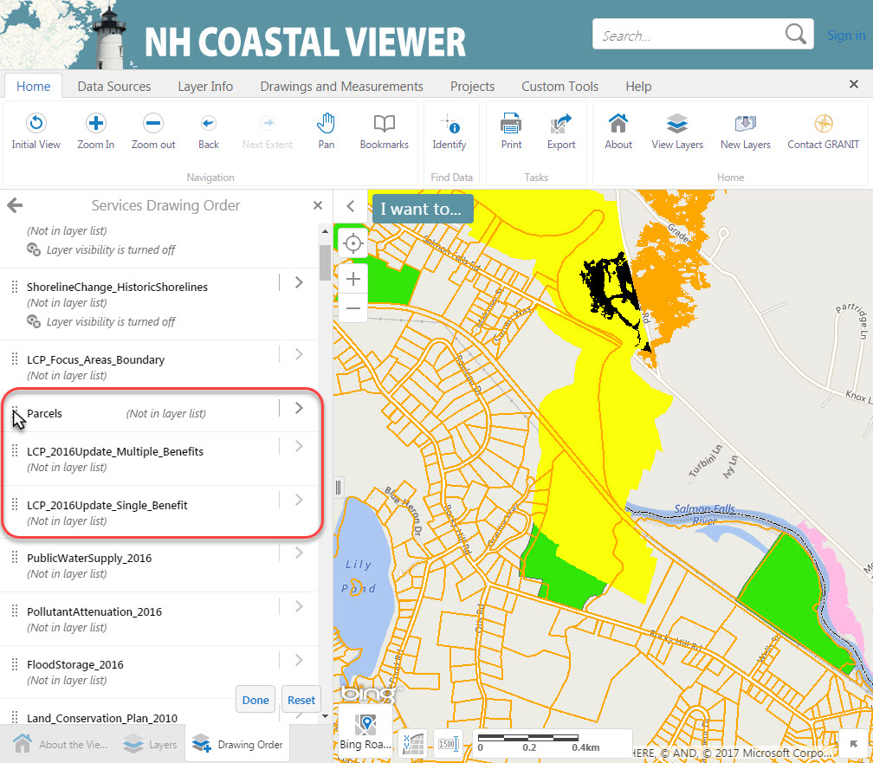
Training Exercise 2 – Drinking Water Protection
5. Change the Drawing Order so that parcel boundaries are not hidden by other data layers
Scroll down and find Parcels
Click the dots to the left of the layer name and drag the Parcels layer up the list
Drop Parcels above the Multiple Benefits layer (LCP_2016Update_Multiple_Benefits)
Layer names in the Drawing Order list may not be identical to names in the Table of Contents of the map
Click Done

Slide 34
Training Exercise 2 – Drinking Water Protection
6. Mark parcels of interest for conservation by adding a drawing
Which parcels that overlap the “Pollutant Attenuation and Public Water Supply” area would be of interest for conservation?
You can use the Drawings and Measurements tools to place points to mark individual parcels

Slide 35
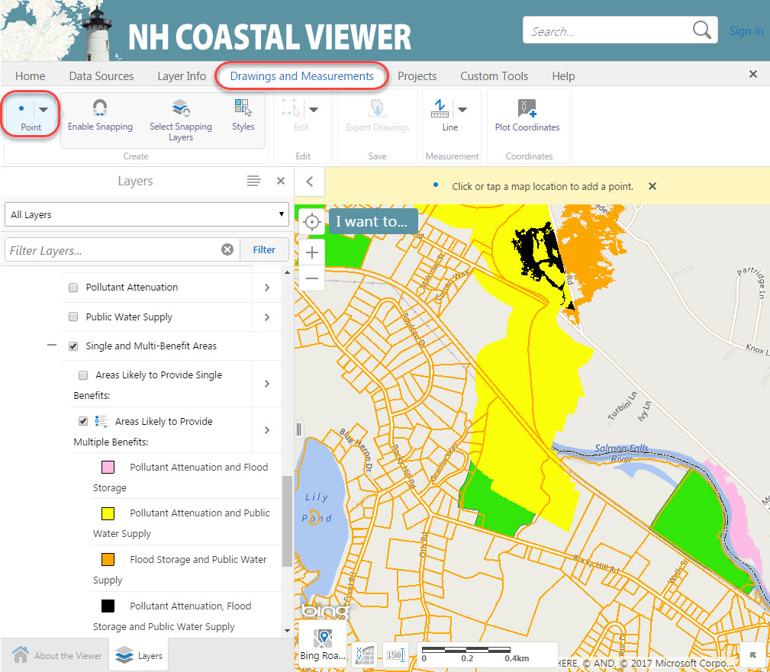
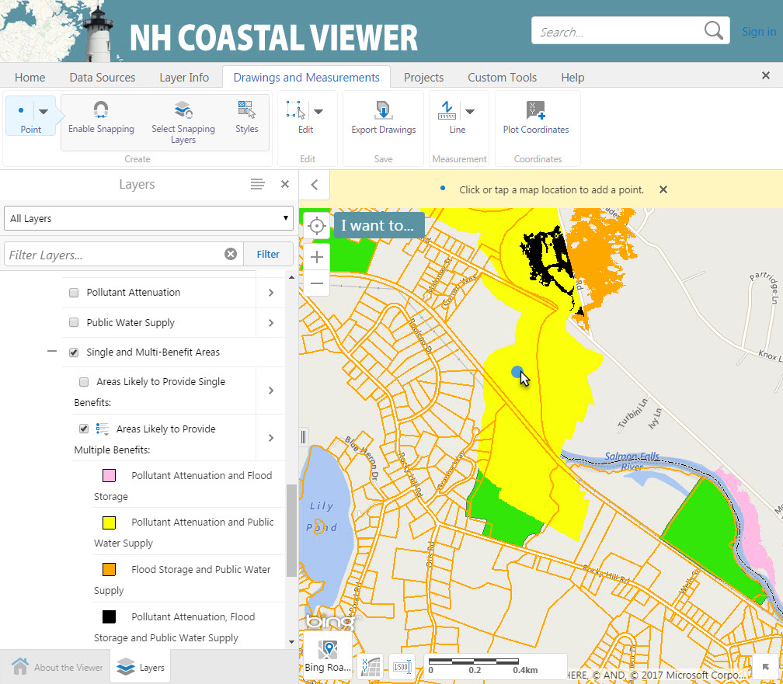
Training Exercise 2 – Drinking Water Protection
6. Mark parcels of interest for conservation by adding a drawing
Mark 3 parcels of interest in the map by adding drawings
Click the Drawings and Measurements tab
Click the Create button
The default drawing shape is Point
Click in the map to place points

Slide 36
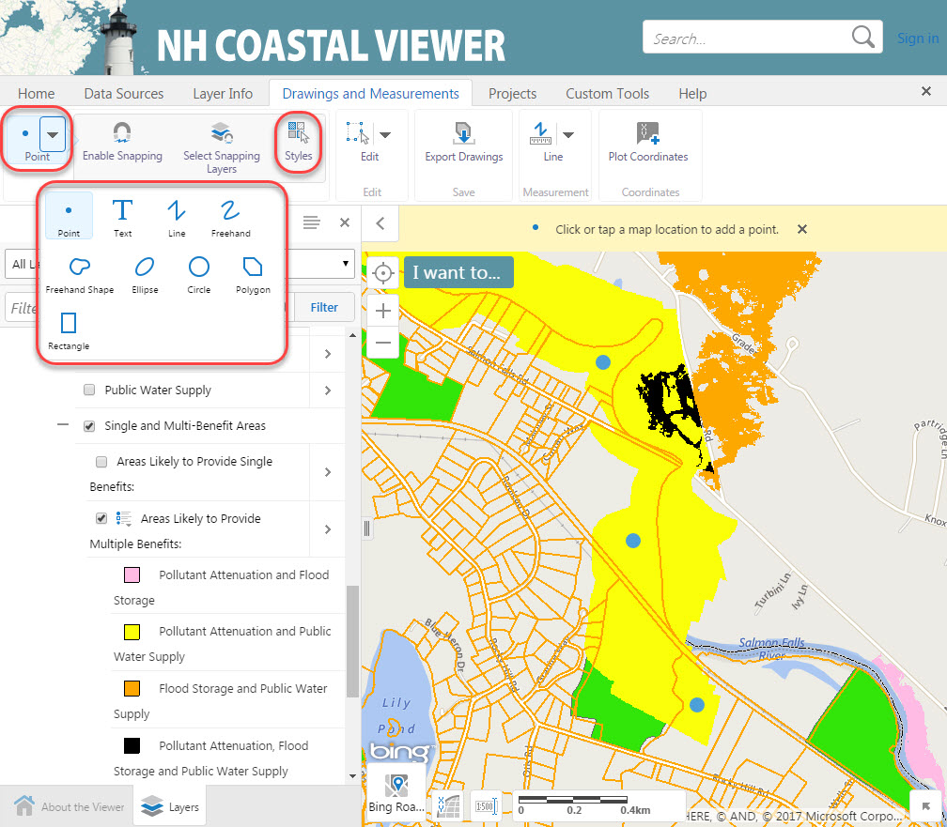
Training Exercise 2 – Drinking Water Protection
6. Mark parcels of interest for conservation by adding a drawing
Other drawing types are available
Click the arrow next to Point to change the drawing type
You can adjust symbols and lines using the Styles button

Slide 37
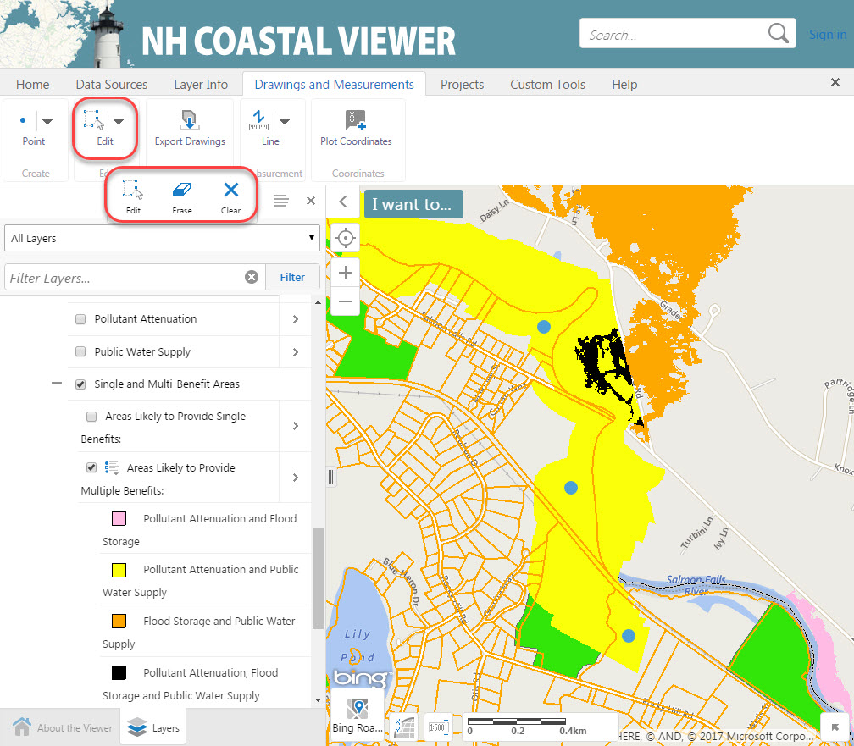
Training Exercise 2 – Drinking Water Protection
6. Mark parcels of interest for conservation by adding a drawing
To edit or remove drawings, click the Edit button
Edit allows you to move or change the shape of a drawing
Erase allows you to delete individual drawings
If you click overlapping drawings, both will be erased
Clear will permanently delete all drawings in the map
There is no Undo feature for the Edit tools

Slide 38
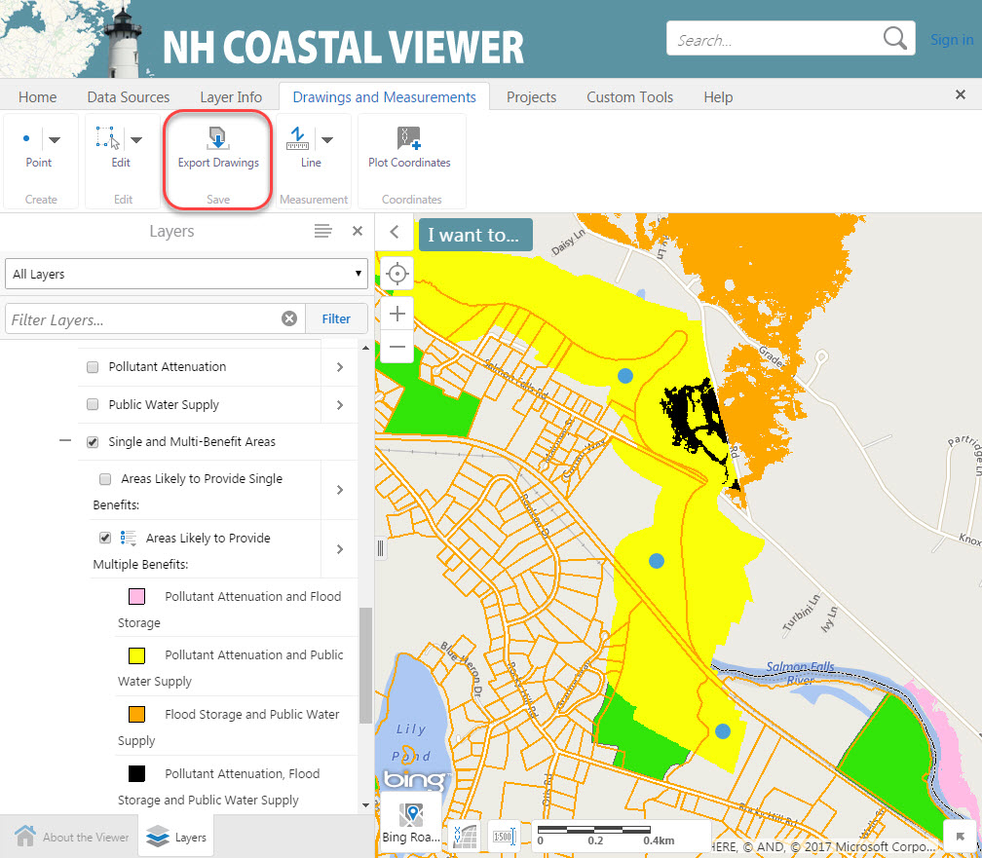
Training Exercise 2 – Drinking Water Protection
7. Export your drawing as a shapefile for use outside the Coastal Viewer
Export Drawings will convert all drawings in the map to shapefiles for download to your computer
The output is a .zip file called Export.zip
Each feature type (point, polygon, line) will be saved in its own shapefile within the .zip file (i.e., Point.shp, Polygon.shp, Polyline.shp)

Slide 39
Training Exercise 3:
Tools for Assessing Land Conservation in NH

Slide 40
Training Exercise 3 – Tools for Assessing Conservation
GRANIT Conservation/Public Lands provides a record of parcels that are mostly undeveloped and protected from future development
Dataset initially published 1995, and updated most recently in June 2017
Dataset includes information such as Protecting Agency, Type and Level of legal protection, acreage, etc.
Exercise 3 will use Conservation/Public Lands, Conservation Core Focus Areas, and other data to explore land conservation in the Seacoast region
This exercise will introduce the Clipping Tool, Projects, and Print Map features of the Coastal Viewer

Slide 41
Training Exercise 3 – Tools for Assessing Conservation Tasks in this Exercise:
Sign In to ArcGIS Online.
Turn on conservation data layers and adjust colors and transparency.
Use the Clipping Tool to determine how much of the Creek Pond Marsh CFA is already in conservation.
Use the Data Query Tool to find the LaRoche and Woodman Brooks Core Focus Area in Durham.
Use the Clipping Tool to summarize the Core Focus Area and Supporting Area polygons by conservation land Protection Level. How much of the LaRoche and Woodman Brooks CFA is protected at each Level?
Middle Little River CFA in North Hampton does not currently contain many protected parcels. Identify potential high-value parcels for conservation of wetlands and wildlife habitat in this CFA.
Save your work as a Project.
Produce a printable map that identifies a few key parcels in North Hampton that could be targeted for conservation.

Slide 42
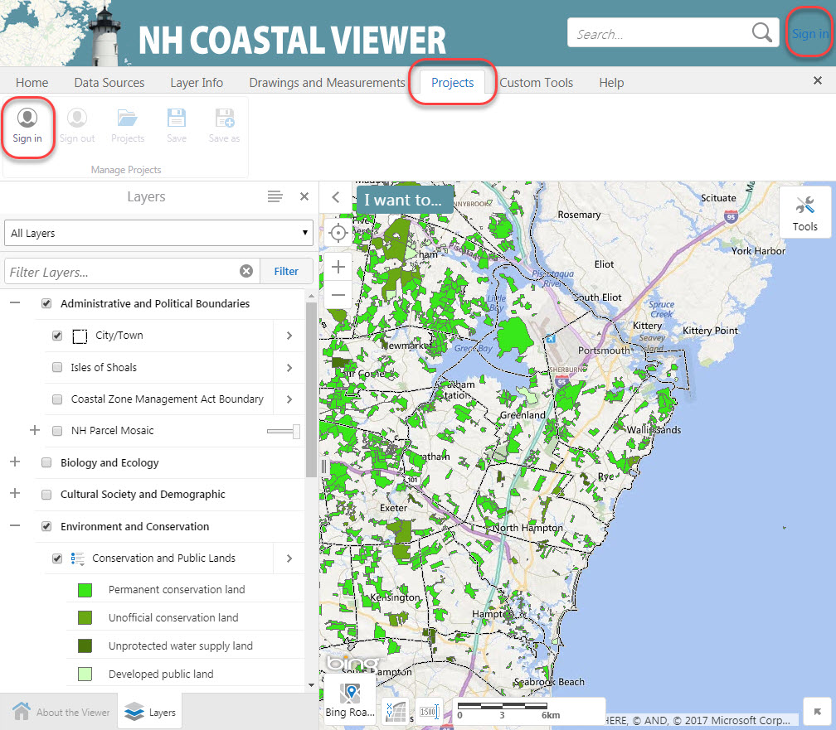
Training Exercise 3 – Tools for Assessing Conservation
1. Sign In to ArcGIS Online
You can save your current map as a Project
You must Sign In to ArcGIS Online to save a new Project or open an existing one
When you Sign In, the Coastal Viewer will refresh and you will lose any changes you have made to your map

Slide 43
Training Exercise 3 – Tools for Assessing Conservation
2. Turn on data layers and adjust colors and transparency.
Data layers for this exercise:
City/Town Boundaries
Conservation/Public Lands
Conservation Focus Areas
Conservation/ Public Lands and Conservation Focus Areas – 2006 (NH) are found in the Environment and Conservation section of the Layers list.
Adjust the transparency of Conservation/Public Lands so that the CFAs layer is visible underneath.

Slide 44
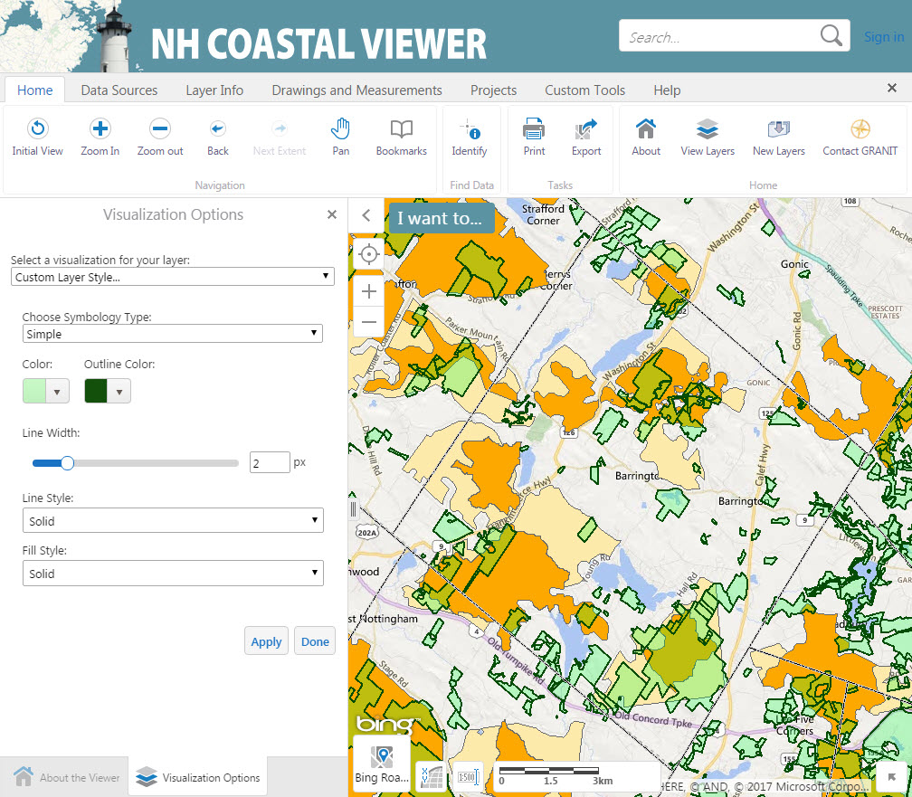
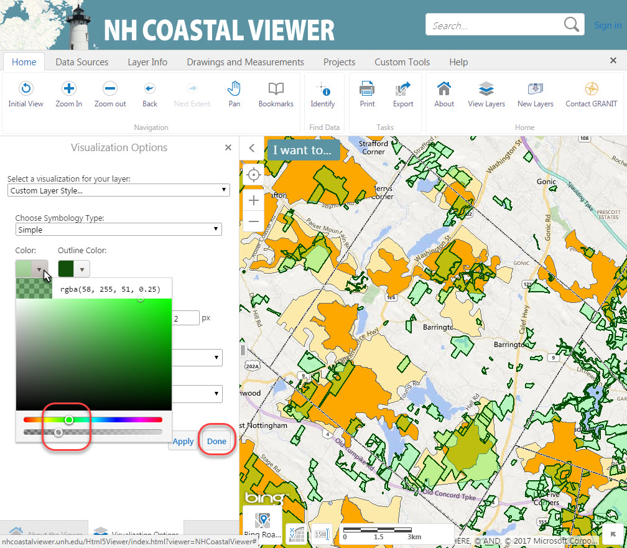
Training Exercise 3 – Tools for Assessing Conservation
2. Turn on data layers and adjust colors and transparency.
To adjust the transparency and color of Conservation/ Public Lands, turn on visualizations
Click the color swatch arrow
Drag upper slider or click in color gradient to select color
Drag lower slider to adjust transparency
Click Apply to view changes; click Done when finished

Slide 45
Training Exercise 3 – Tools for Assessing Conservation
3. Use the Clipping Tool to determine how much of the Creek Pond Marsh CFA Core Area is already in conservation.
Zoom to Barrington
Near the intersection of Rte 125 and Rte 4, find the Creek Pond Marsh CFA Core Area (orange polygon marked in the image with a star)

Slide 46
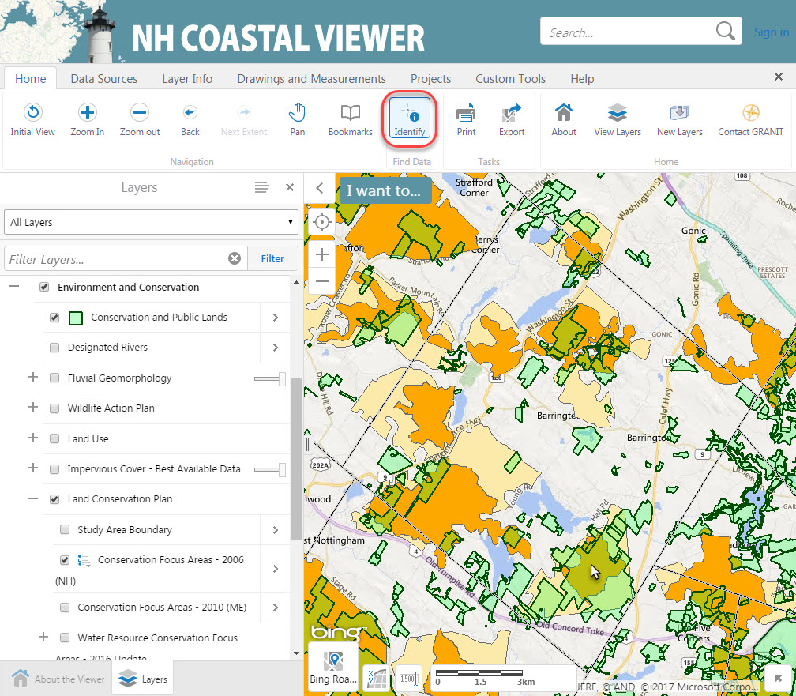
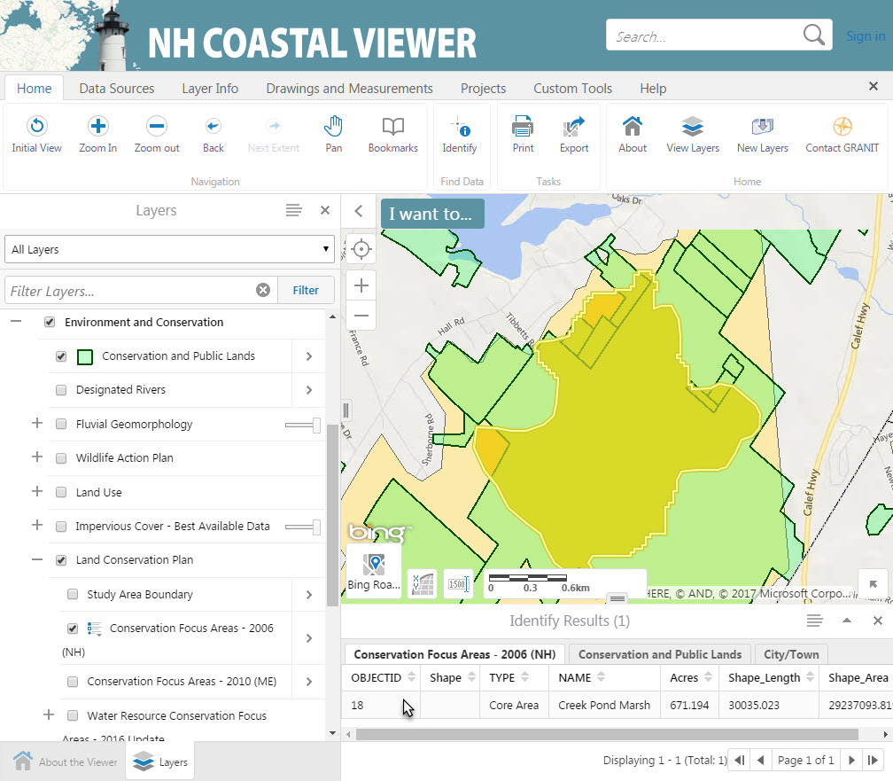
Training Exercise 3 – Tools for Assessing Conservation
3. Use the Clipping Tool to determine how much of the Creek Pond Marsh CFA Core Area is already in conservation.
Use the Identify Tool to select the Creek Pond Marsh CFA Core Area polygon
Click on the record in the Identify Results to zoom in

Slide 47
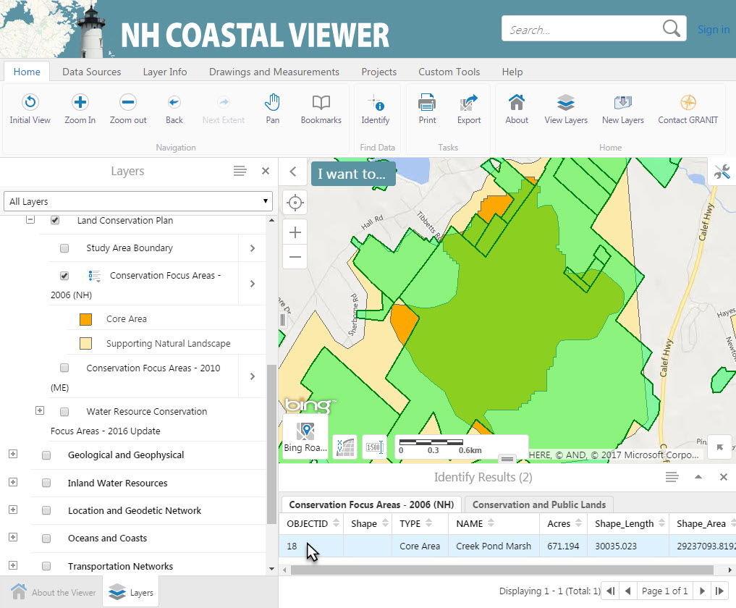
Training Exercise 3 – Tools for Assessing Conservation
3. Use the Clipping Tool to determine how much of the Creek Pond Marsh CFA Core Area is already in conservation
The Clipping Tool allows you to summarize a point, line, or polygon dataset within the boundary of a polygon dataset.

Slide 48
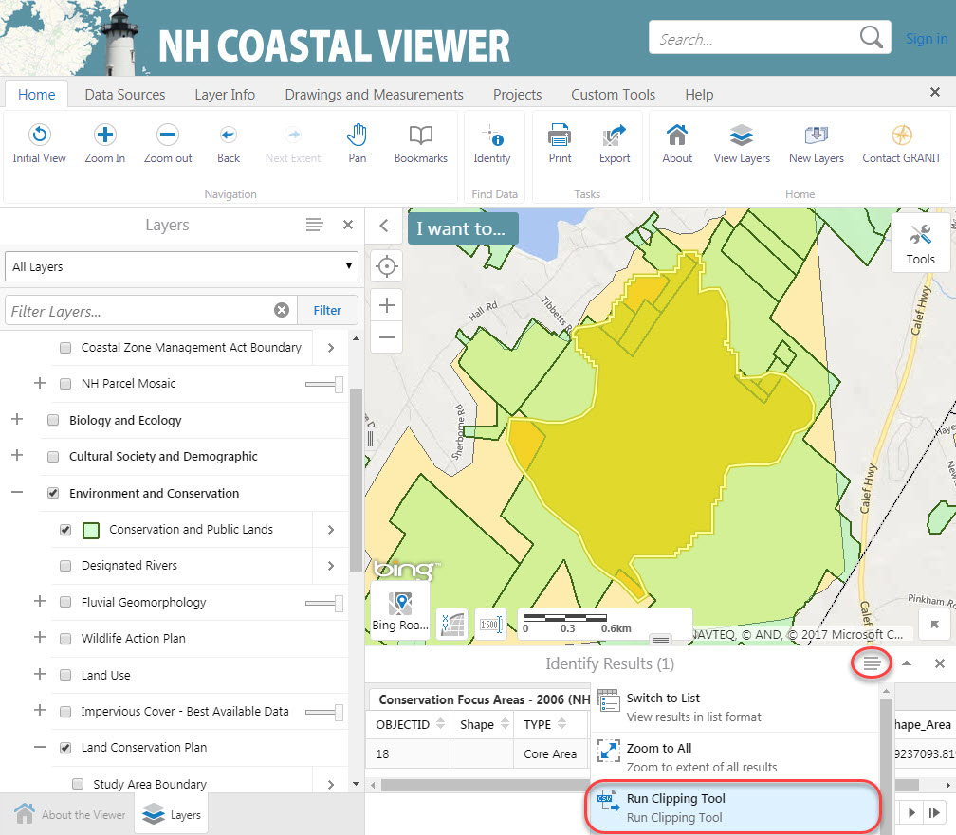
Training Exercise 3 – Tools for Assessing Conservation
3. Use the Clipping Tool to determine how much of the Creek Pond Marsh CFA Core Area is already in conservation
The first step in using the Clipping Tool is to select a polygon to clip to, which we have already done using the Identify Tool
Next click the Panel Actions Menu
Click Run Clipping Tool

Slide 49
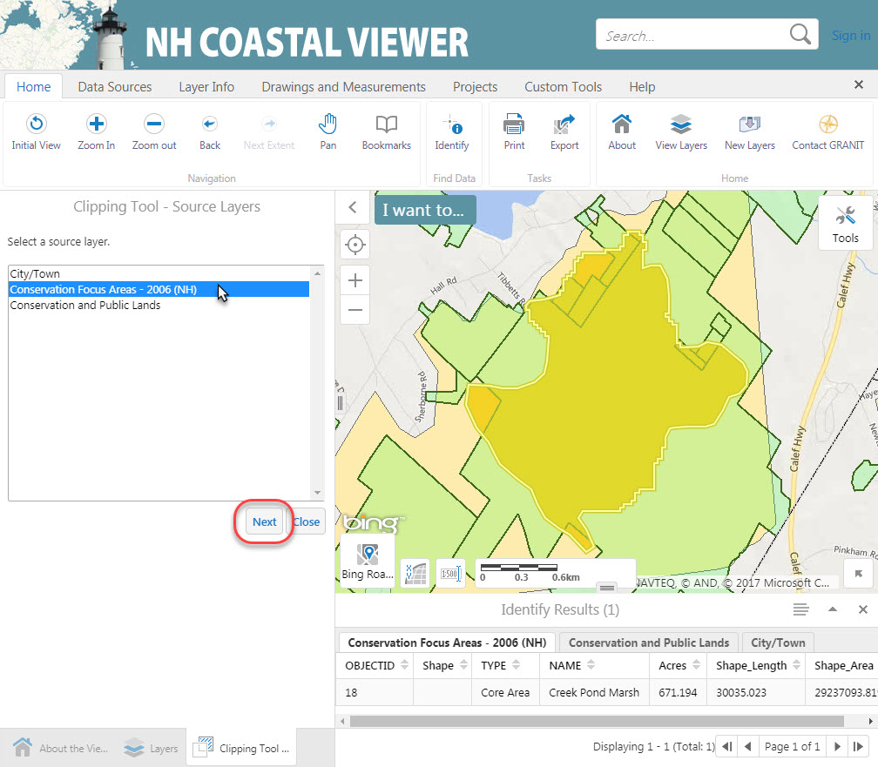
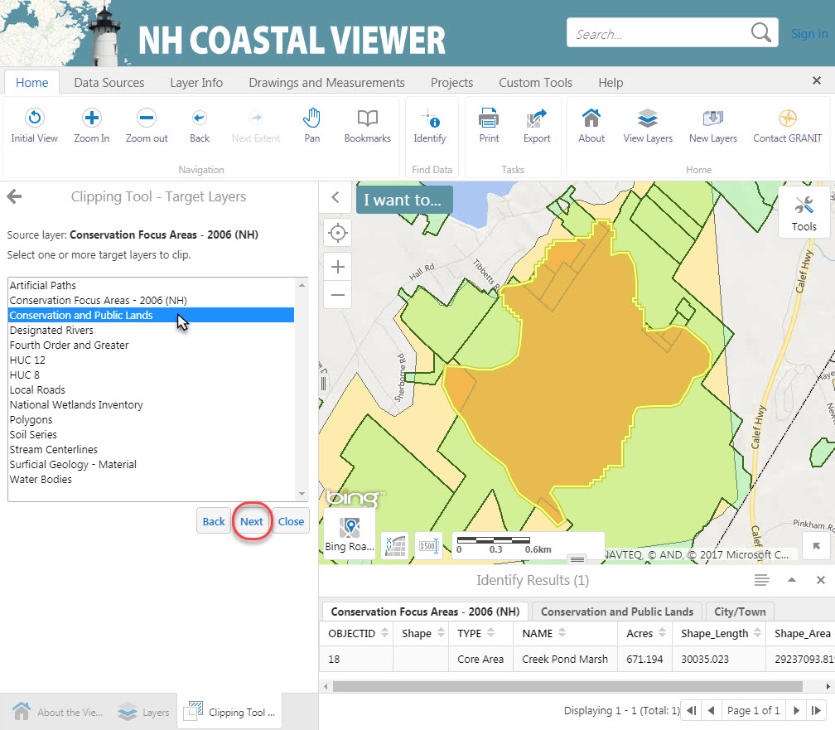
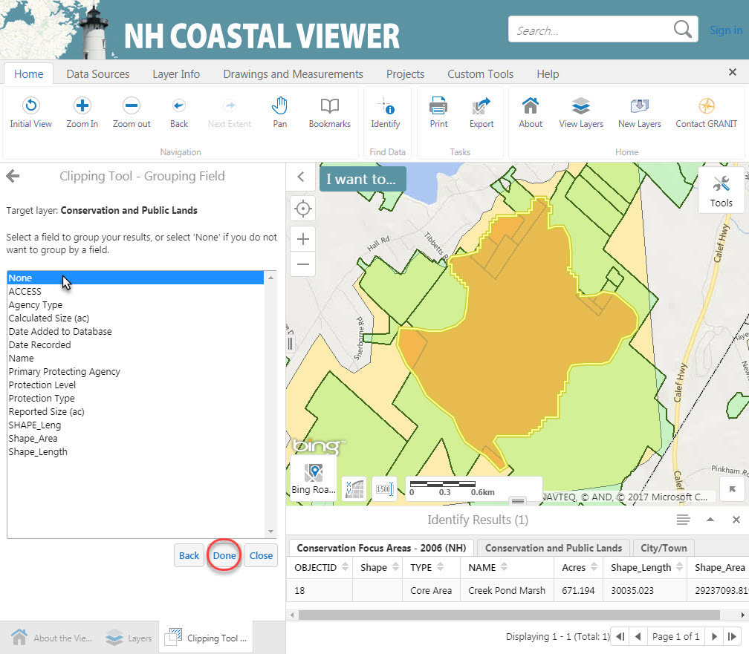
Training Exercise 3 – Tools for Assessing Conservation
3. Use the Clipping Tool to determine how much of the Creek Pond Marsh CFA Core Area is already in conservation
Select Conservation Focus Areas – 2006 (NH) as the Source Layer
Click Next
Choose Conservation and Public Lands as the Target Layer to clip
Click Next
Choose None as the Grouping Field (we will not further group these results)
Click Done

Slide 50
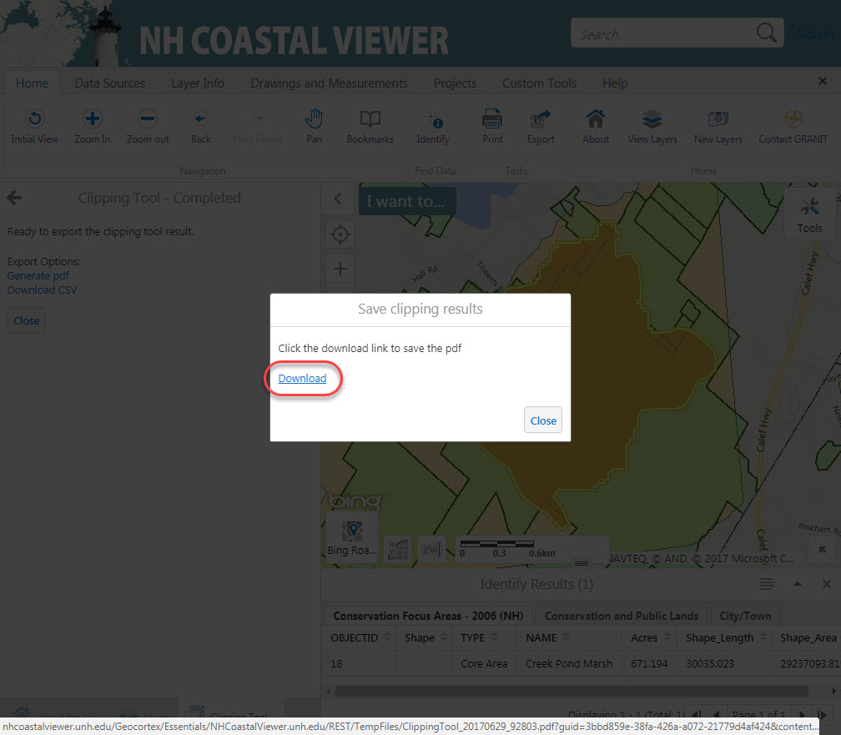
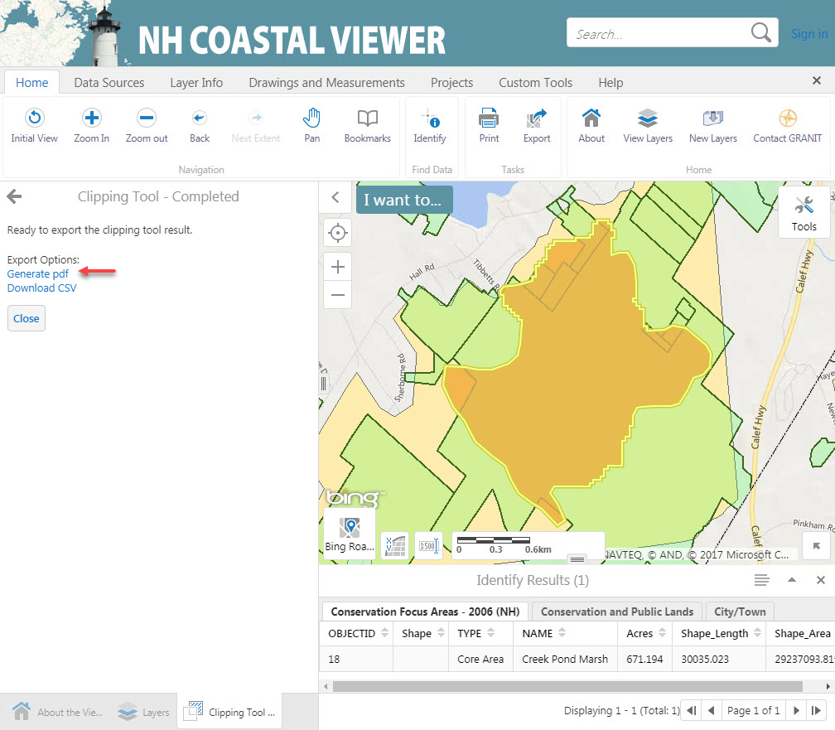
Training Exercise 3 – Tools for Assessing Conservation
3. Use the Clipping Tool to determine how much of the Creek Pond Marsh CFA Core Area is already in conservation
Click Generate pdf
Click Download
Downloading procedure may vary depending on your web browser
Open the resulting pdf to view your Clipping Tool results

Slide 51
Training Exercise 3 – Tools for Assessing Conservation
The Report gives the area (in ft²) of Conservation/Public Lands within the Creek Pond Marsh CFA
Find the Shape_Area (in ft²) of the Creek Pond Marsh CFA in the Coastal Viewer Identify Results
You can use your computer’s calculator to find that 94% of the Creek Pond Marsh CFA is in some form of conservation

Slide 52
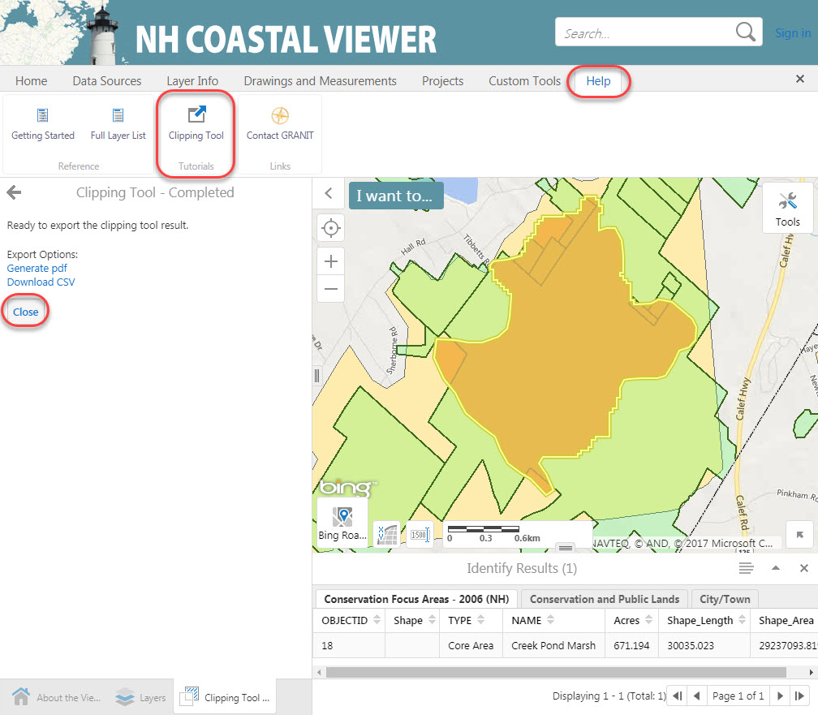
Training Exercise 3 – Tools for Assessing Conservation
Click Close to leave the Clipping Tool
A Help document for the Clipping Tool is available in the Help Tab

Slide 53
Training Exercise 3 – Tools for Assessing Conservation
4. Use the Data Query Tool to find the LaRoche and Woodman Brooks CFA in Durham
The LaRoche and Woodman Brooks CFA in Durham contains parcels with a variety of Protection Levels
To view Conservation Lands by Level, go to Turn on/off layer visualizations and select None as the visualization. This restores the default visualization for this layer.
We will use the Data Query Tool to find the LaRoche and Woodman Brooks CFA

Slide 54
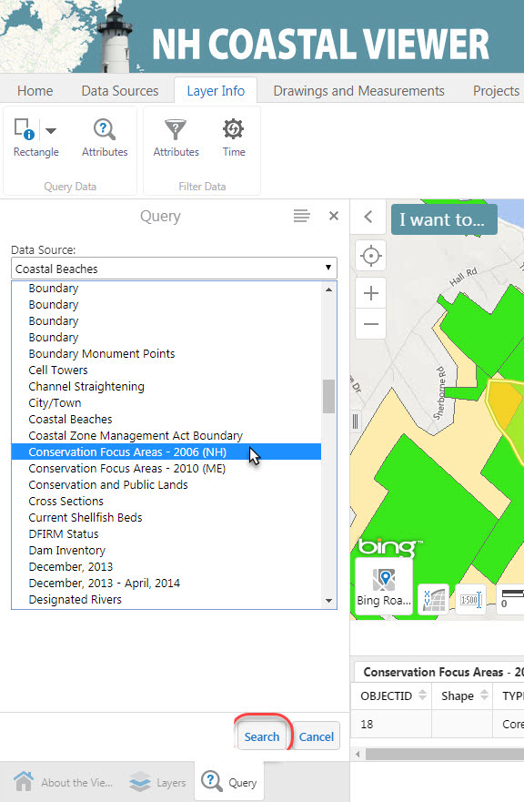
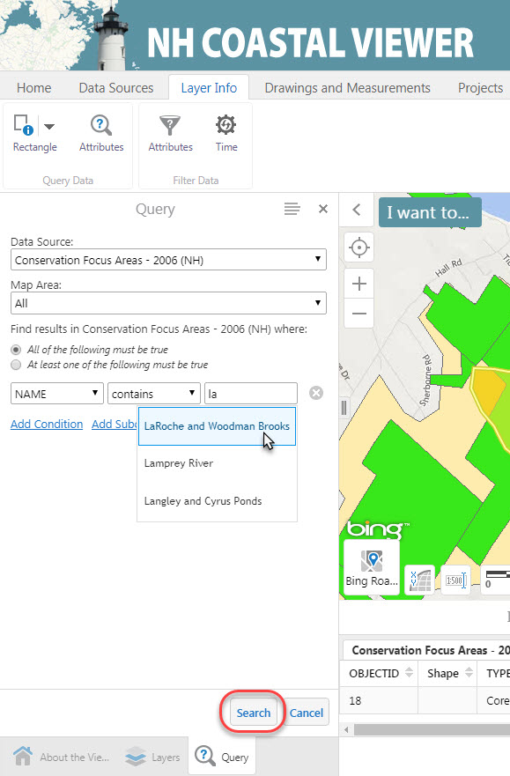
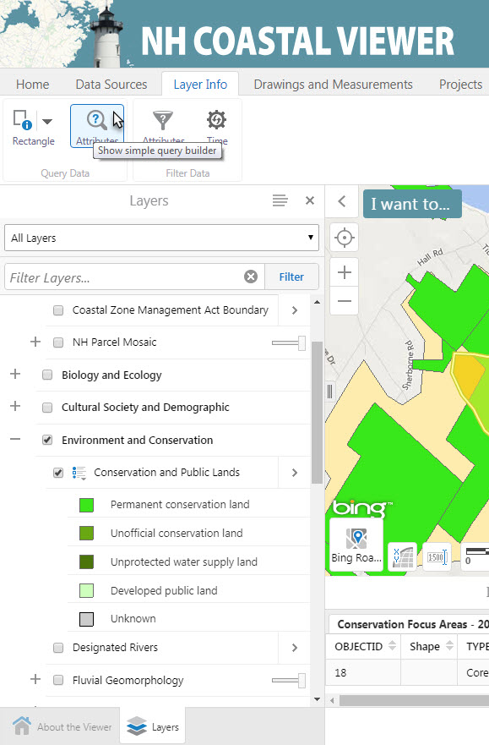
Training Exercise 3 – Tools for Assessing Conservation
4. Use the Data Query Tool to find the LaRoche and Woodman Brooks CFA in Durham
To use the Query Tool, click the Layer Info Tab
Click Attributes
Choose Conservation Focus Areas – 2006 (NH) as the Data Source
Use the boxes to enter the parameters “Name” contains “LaRoche and Woodman Brooks” (as you begin to type “LaRoche”, a drop-down menu will appear)
Click Search

Slide 55
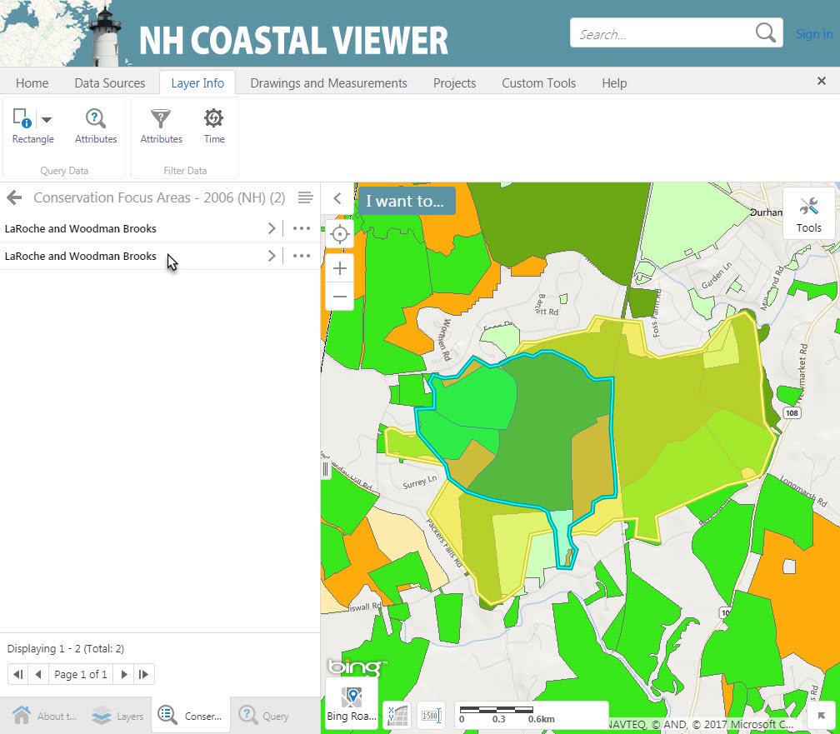
Training Exercise 3 – Tools for Assessing Conservation
4. Use the Data Query Tool to find the LaRoche and Woodman Brooks CFA in Durham
The Query Results window will show two results – the Core Area and Supporting Area
Click the second choice, which will be the Supporting Area polygon
The map will zoom to the polygon you have selected
Close out of the Query dialogue boxes

Slide 56
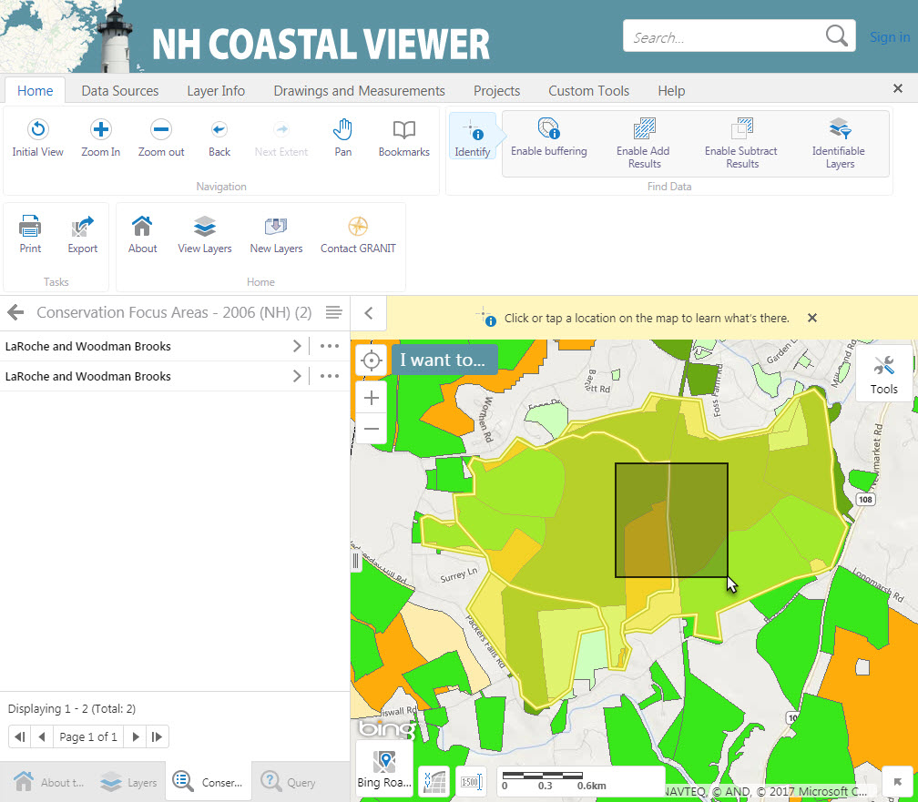
Training Exercise 3 – Tools for Assessing Conservation
5. How much of the LaRoche and Woodman Brooks CFA Core and Supporting Areas is protected at each Level?
The Clipping Tool can also be used to summarize data within multiple polygons
Start by using the Identify Tool to select both the Core Area and Supporting Area of the LaRoche and Woodman Brooks CFA.
Click the Home Tab
Click the Identify Tool
Drag a box in the Map Area that covers both CFA polygons

Slide 57
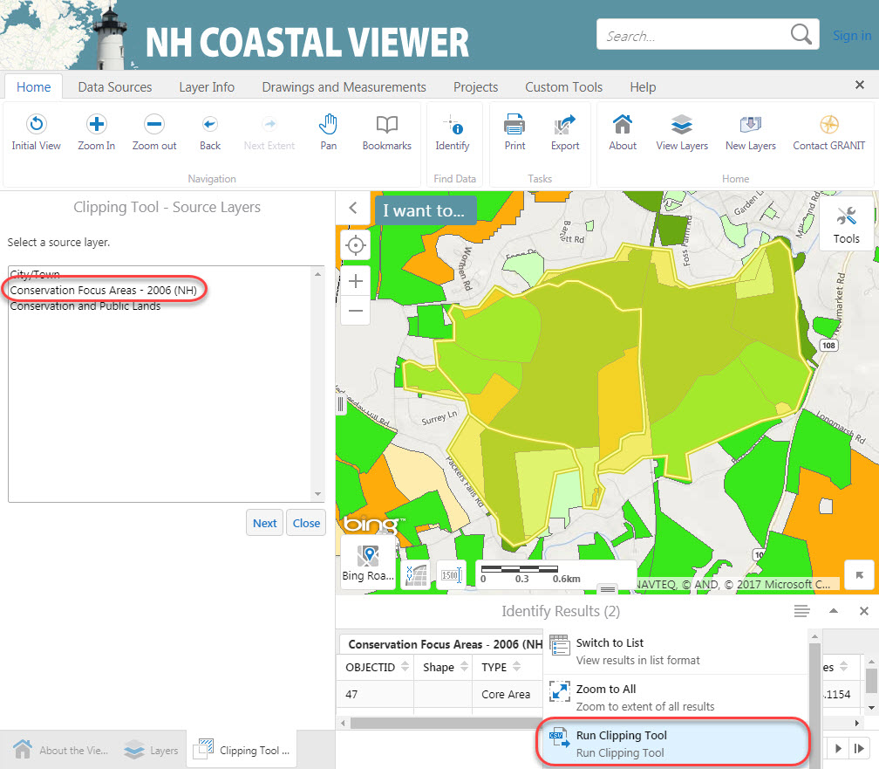
Training Exercise 3 – Tools for Assessing Conservation
5. How much of the LaRoche and Woodman Brooks CFA Core and Supporting Areas is protected at each Level?
Use the Clipping Tool to determine the area of conserved land by Level in the Core and Supporting Areas of this CFA
Run the Clipping Tool
Source Layer is Conservation Focus Areas – 2006 (NH)
Target Layer is Conservation and Public Lands
Group Results by Protection Level
Generate pdf Report
Which Level is most of the conservation land?

Slide 58
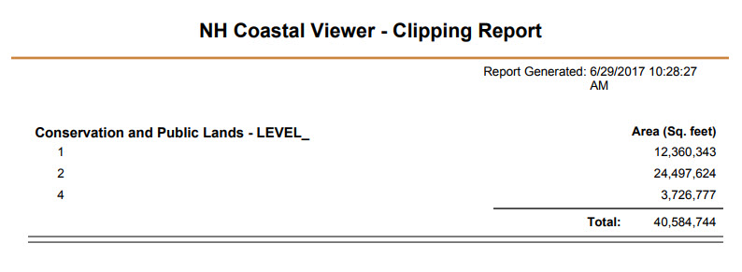
Training Exercise 3 – Tools for Assessing Conservation
5. How much of the LaRoche and Woodman Brooks CFA Core and Supporting Areas is protected at each Level?
Which Protection Level is most of the conservation land in the LaRoche and Woodman Brooks Conservation Focus Area?
Level 1 = Official/Permanent Conservation Land
Level 2 = Unofficial Conservation Land
Level 3 = Unprotected water supply land (not permanent protection, but controlled by public drinking water supplier)
Level 4 = Developed Public Land (ball fields, boat ramps, beaches, etc)
Level 9 = Unknown

Slide 59
Training Exercise 3 – Tools for Assessing Conservation
5. How much of the LaRoche and Woodman Brooks CFA Core and Supporting Areas is protected at each Level?
Conservation Lands Data Standards documents are available on the GRANIT website
Most of the conservation land in the CFA we analyzed is Protection Level 2:
“Unofficial conservation land. Not permanently protected through any legal mechanisms. Owned by a public institution, public agency, or other organization whose mission may not be focused on conservation, but whose clear intent is to keep land for conservation, recreation or educational purposes and in mostly natural land cover.”

Slide 60
Training Exercise 3 – Tools for Assessing Conservation
6. Middle Little River CFA in North Hampton does not currently contain many protected parcels. Identify potential high-value parcels for conservation of wetlands and wildlife habitat in this Core Focus Area.
Zoom to the Town of North Hampton
Find the Middle Little River CFA
(marked with red star)
Turn on National Wetlands Inventory
Turn on Wildlife Action Plan 2015:
Highest Ranked Wildlife Habitat

Slide 61
Training Exercise 3 – Tools for Assessing Conservation
6. Identify potential new parcels for conservation of wetlands and wildlife habitat in the Middle Little River CFA in North Hampton
Adjust Visualizations for all the layers to maximize the amount of information you can show at once. You may choose to change color, transparency, fill style, drawing order, etc
Draw a polygon around an area that would be of interest for conserving wetland areas and highest priority wildlife habitat

Slide 62
Training Exercise 3 – Tools for Assessing Conservation
7. Save your work as a Project
You can save your current map as a Project
You must Sign In to ArcGIS online to save a Project
Click the Save button in the toolbar
Type a Name and Description for your Project
Click Save

Slide 63
Training Exercise 3 – Tools for Assessing Conservation
7. Save your work as a Project
To share your project with others, click Projects
Click the arrow next to the project name, then click Share
Assign Project Privileges for ArcGIS Online users in your network
Or send a Guest Link to View or Edit the project
Your Projects List will show any projects that have been
shared with you (turn off “Show my projects only”)

Slide 64
Training Exercise 3 – Tools for Assessing Conservation
8. Save a printable PDF map
Click Print in the Toolbar
Select desired Layout, Output Format, etc
Type in a Title and any Notes
The pink rectangle is the Print Preview extent
Click Print
Click Open File to open a PDF file that you can save or print

