Slide 1


NH GRANIT Overview
Fay Rubin
Project Director, NH GRANIT
Associate Director, Earth Systems Research Center
Institute for the Study of Earth, Oceans, & Space
University of New Hampshire
May 1, 2019
  http://granit.unh.edu
  http://granitview.unh.edu
  http://nhcoastalviewer.unh.edu
  http://lidar.unh.edu
December 4, 2015

Slide 2

Overview of GRANIT
  Central GIS Data Clearinghouse at UNH Earth Systems Research Center
  Collaboration of Data Providers and Data Users
    State/Federal Agencies
    Regional Planning Commissions
    Municipalities
    Private Sector
    Non-profit Sector
    Academic Community
  Core GRANIT Services
    Create, Archive, and Distribute Data
    Develop Data Standards
    Conduct Spatial Analysis
    Develop/Host Online Resources – Map Services, Map Viewers
    Provide Training and Technical Support
    Participate in GIS Coordination Activities – GIS Advisory Committee, GIS Technical Advisory Committee, Environmental Public Health Tracking, Coordinated LiDAR Acquisition
May 1, 2019
Notes:
First, bit of background on GRANIT.
We started working on the GRANIT system in mid 1980’s, and currently serving as the state’s GIS clearinghouse.
Create data, archive data from other sources, distribute data
Develop standards –metadata standards, land use mapping standards, etc.

Slide 3
GRANIT Resources
  Staffing: 3 full-time staff (75+ years aggregate experience in geospatial technologies), 2 part-time staff
  Specialized software licenses: ESRI software suite, Latitude Geographics/Geocortex, Imagine, eCognition, Cellular Expert
  Servers (Windows): granit18 (2 8 core 2.1 GHz CPUs, 512 Gbs memory, 8 12 TB disks configured as RAID 6), granitweb, broadbandnh
  Input/output devices:
    Large format scanner – ESRC Laboratory for Remote Sensing and Spatial Analysis
    GPS units (mapping grade, recreational grade)
    Drones/hyperspectral scanners (units managed by ESRC faculty)
    Large format plotters (3) – ESRC Laboratory for Remote Sensing and Spatial Analysis
  Data holdings:
    Imagery – 20+ TB
    Vector Data – .5 TB
  IT support – UNH Research Computing Center
NHLSA Annual Meeting
December 4, 2015
May 1, 2019

Slide 4
Current/Recent Projects (partial list)
  Core GRANIT Clearinghouse Activities (OSI, NHDOT, NHDES, Fish & Game, DNCR)
  Cooperating Technical Partner - Floodplain Mapping in Coastal NH (FEMA)
  Broadband Availability in Northern New Hampshire (NBRC)
  PTAPP - Pollution Tracking and Accounting Program (NHDES)
  Landscape Scale Assessment of NERRS Marsh Resilience (NOAA)
  “Dirt to Trees to Wildlife” Tool (Town of Randolph, USDA)
  Data Life Cycle Analysis (NHDES)
  Estimating Economic Vulnerability to Climate Change (Hubbard Foundation)
  Stone Walls Initiative (NH Charitable Foundation, NHDES)
  Imagery Needs Assessment (NHDOIT/NHDOT)
  Agency Map Viewer Pilot Project (NHDOIT/NHDOT)
NHLSA Annual Meeting
December 4, 2015
May 1, 2019
Notes:
We do this work with a variety of funding mechanisms and partnerships. Partial list of current projects. Note highlighted terms.
Current funding - ~20% state; ~80% federal/foundation
Note range of topics we address – including broadband (with clear implications for economic development, public safety, health, education), to impervious surface mapping (with implications for water quality), floodplain mapping, wildlife, pollutant tracking, climate change, stone walls (historic resources)
Our core resource – the GRANIT database that supports the broad range of applications. Will show you a few examples of data sets we have recently developed or acquired.

Slide 5
Overview of GRANIT
  Central GIS Data Clearinghouse at UNH Earth Systems Research Center
  Collaboration of Data Providers and Data Users
    State/Federal Agencies
    Regional Planning Commissions
    Municipalities
    Private Sector
    Non-profit Sector
    Academic Community
  Core GRANIT Services
    Create, Archive, and Distribute Data
    Conduct Spatial Analysis
    Develop/Host Online Resources – Map Services, Map Viewers
    Provide Training and Technical Support
    Participate in GIS Coordination Activities – GIS Advisory Committee, GIS Technical Advisory Committee, Environmental Public Health Tracking, Coordinated LiDAR Acquisition
May 1, 2019
Notes:
First, bit of background on GRANIT.
We started working on the GRANIT system in mid 1980’s, and currently serving as the state’s GIS clearinghouse.
Create data, archive data from other sources, distribute data
Develop standards –metadata standards, land use mapping standards, etc.

Slide 6
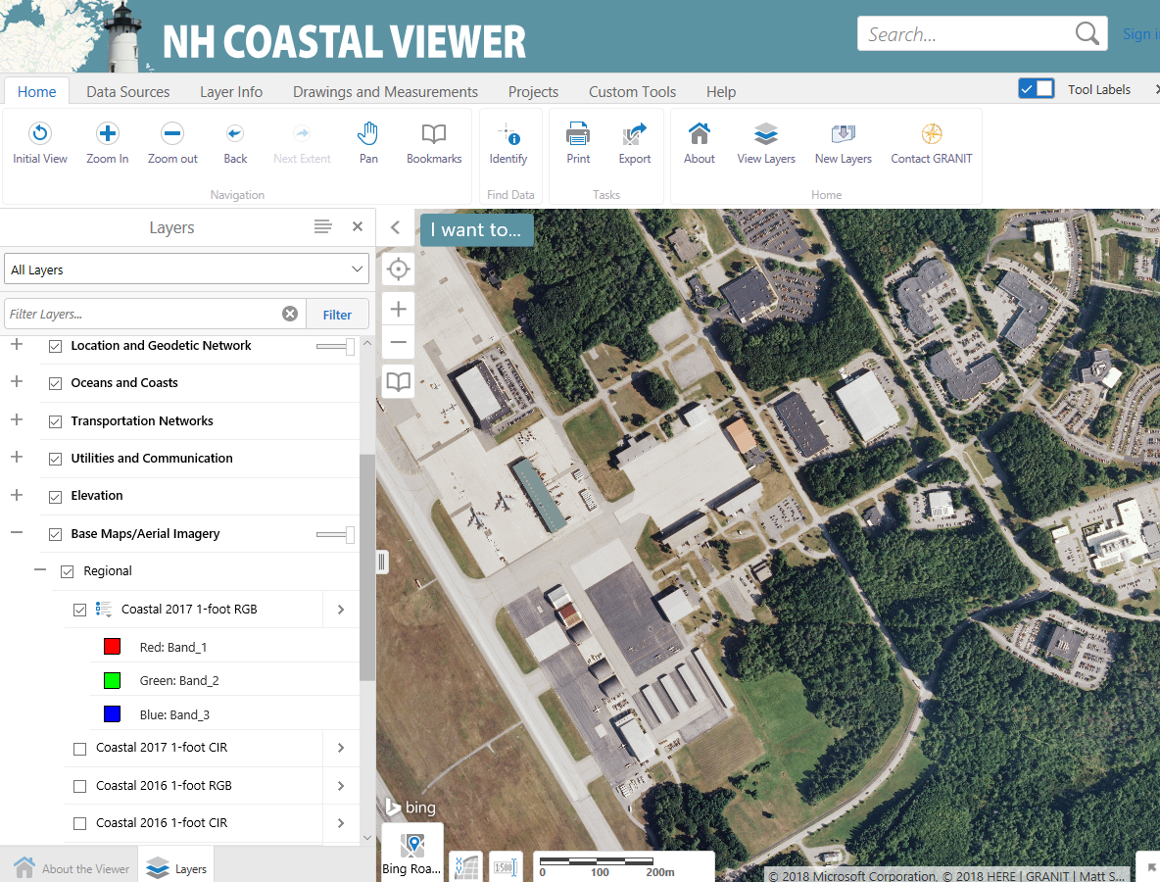
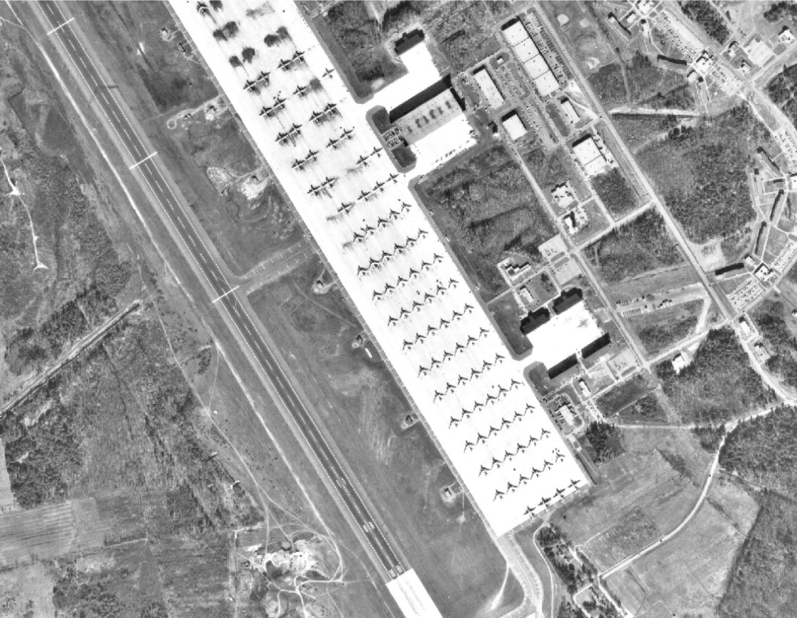
New/Updated Data Sets: Aerial Imagery
Current (2017 1-ft.)
Historic
May 1, 2019

Slide 7
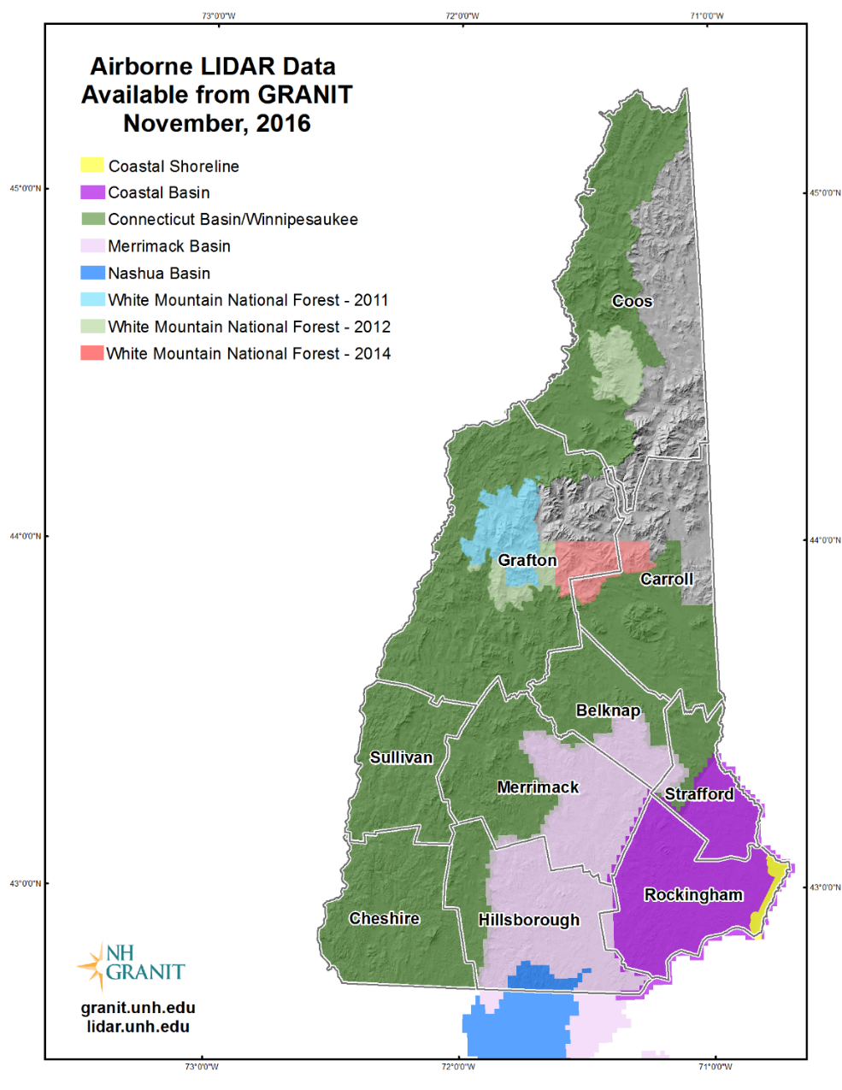
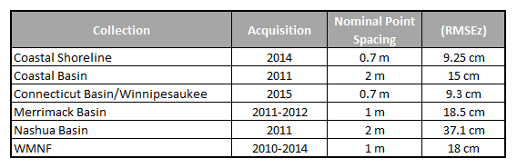
New/Updated Data Sets: Topography/LiDAR
May 1, 2019
Notes:
Gap area – expected this week. GRANIT worked with NHDES to submit a successful grant application to USGS to pay for 50% of cost. Just submitted a new, successful application last fall to recollect in coastal area – increased resolution product.

Slide 8
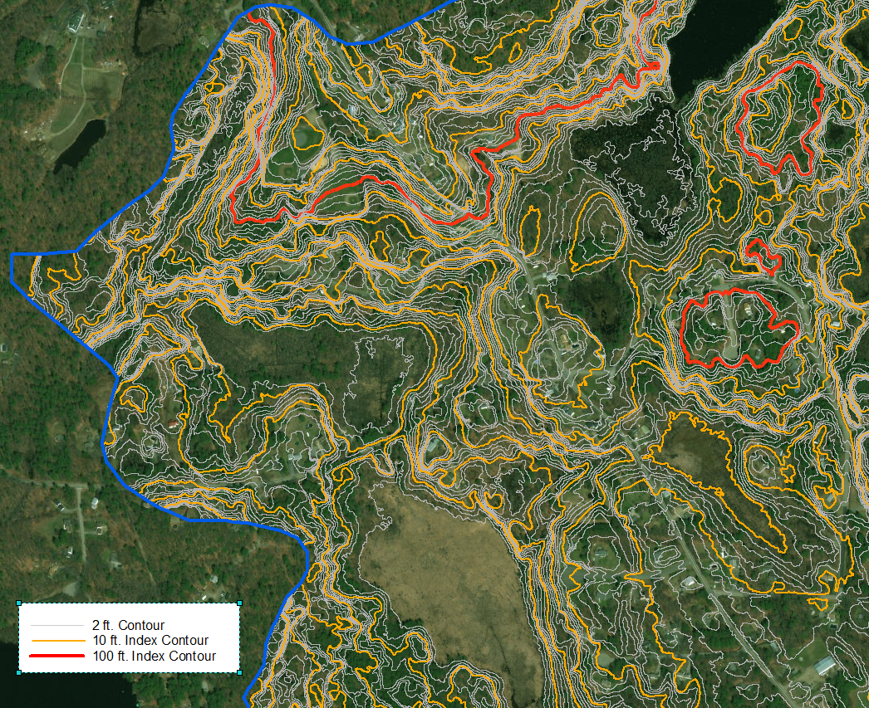
New/Updated Data Sets: 2 Ft. Contours
Contours (2ft.) in Powwow River HUC10 (0107000614)
May 1, 2019
Notes:
Contour data is one of the most frequently requested data sets. We have had generalized data for a number of years, but are now working on much more details data set that will support a broader range of uses.

Slide 9
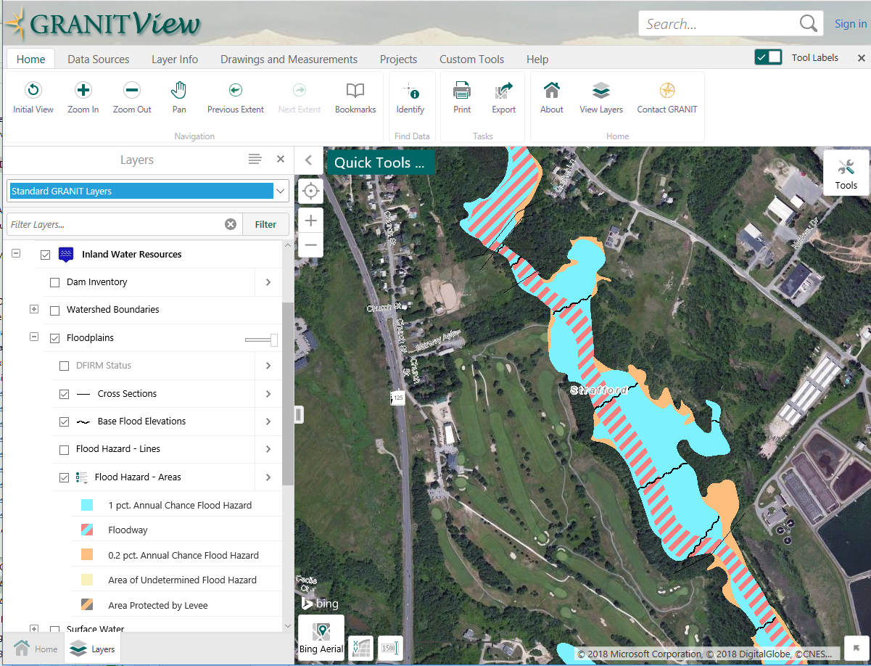
New/Updated Data Sets: Floodplains
May 1, 2019
Notes:
This data set and the following are dependent on the high resolution topographic data that LIDAR delivers. Have done floodplain mapping in every county over the years.

Slide 10
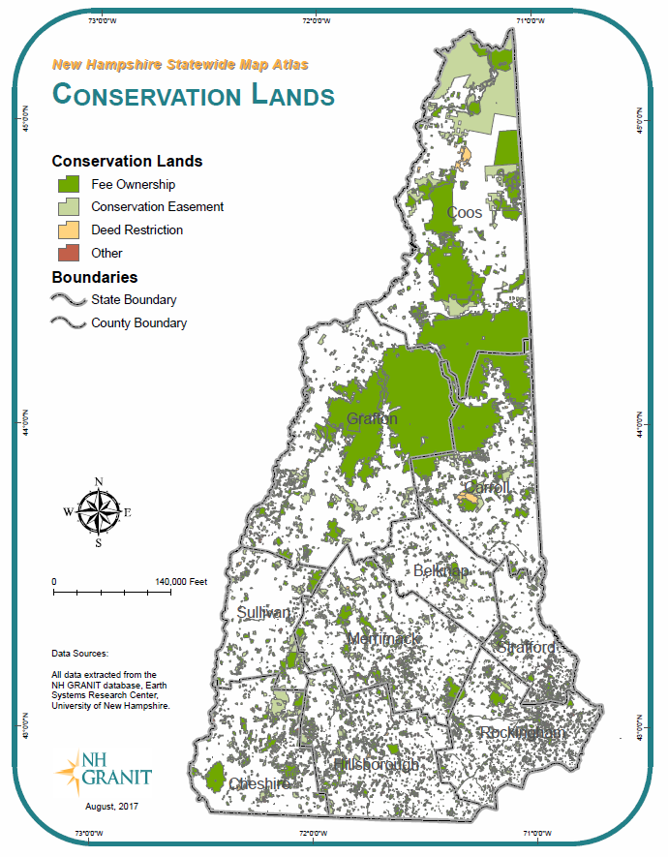
New/Updated Data Sets: Conservation Lands
11,316 tracts
1,919,000 acres
May 1, 2019
Notes:
5,940,000 acres in state, so approximately 32% protected. WMNF alone is 736,000 acres, or 12% of statec

Slide 11
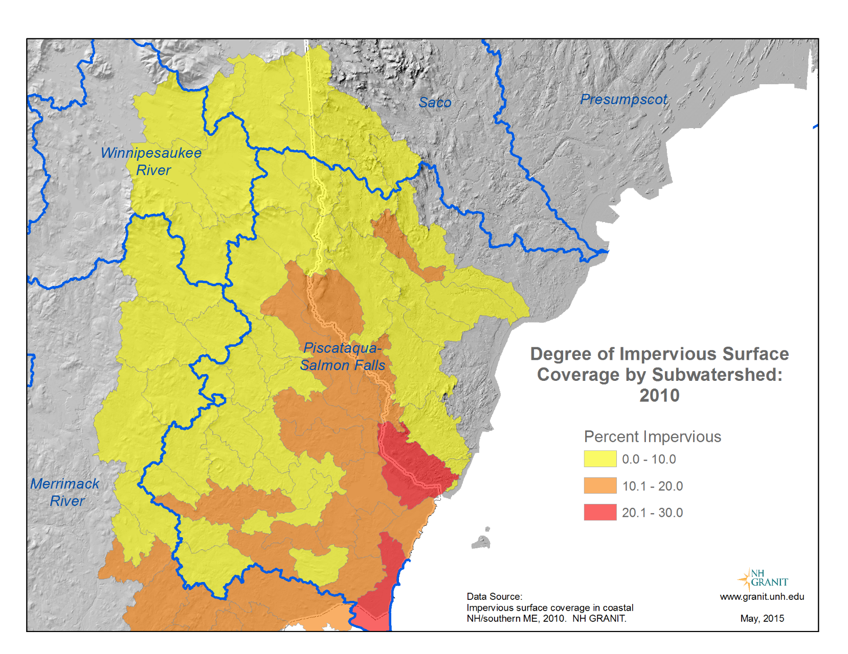
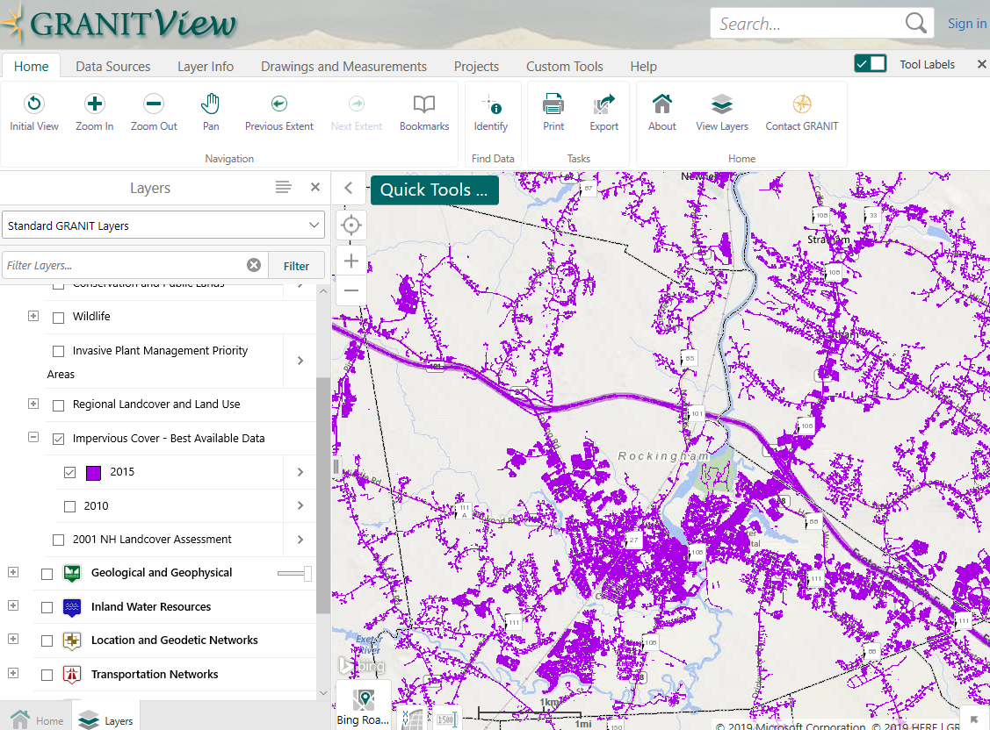
New/Updated Data Sets: Impervious Surfaces
May 1, 2019

Slide 12
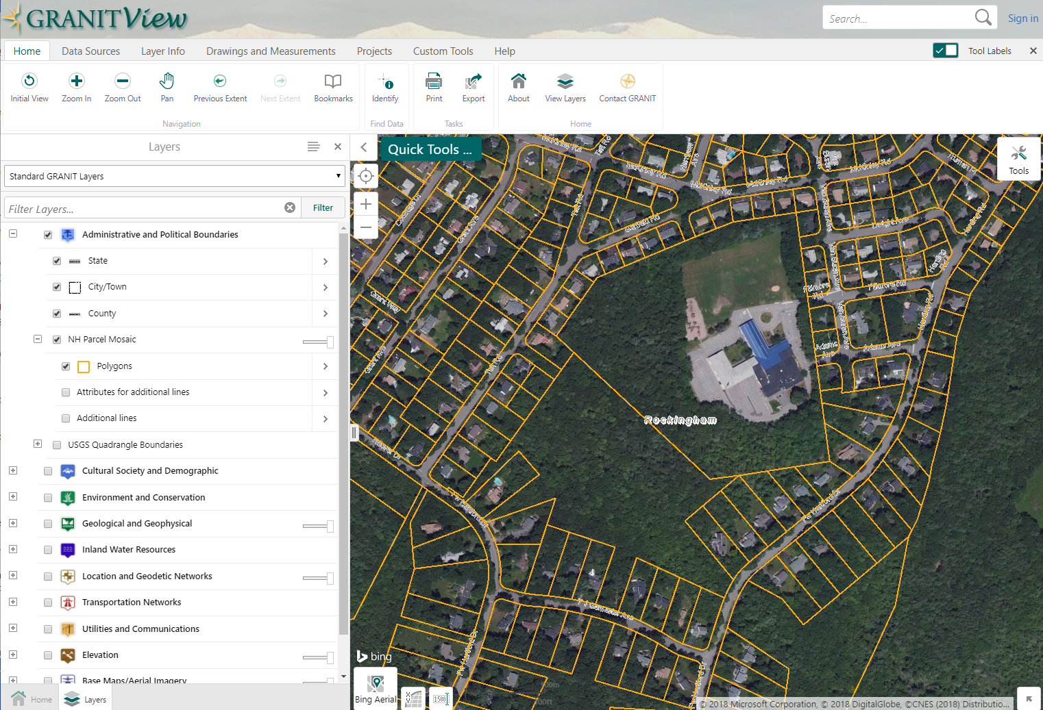
New/Updated Data Sets: NH Parcel Mosaic
NH Parcel Mosaic (2018) in vicinity of Portsmouth High School
NHLSA Annual Meeting
December 4, 2015
May 1, 2019

Slide 13
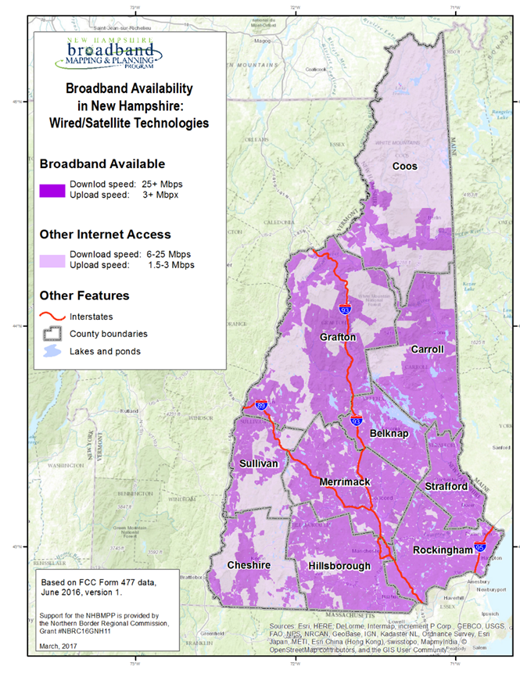
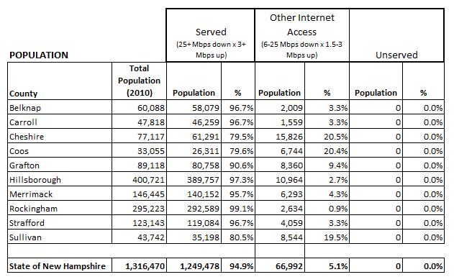
New/Updated Data Sets: Broadband Availability
May 1, 2019

Slide 14
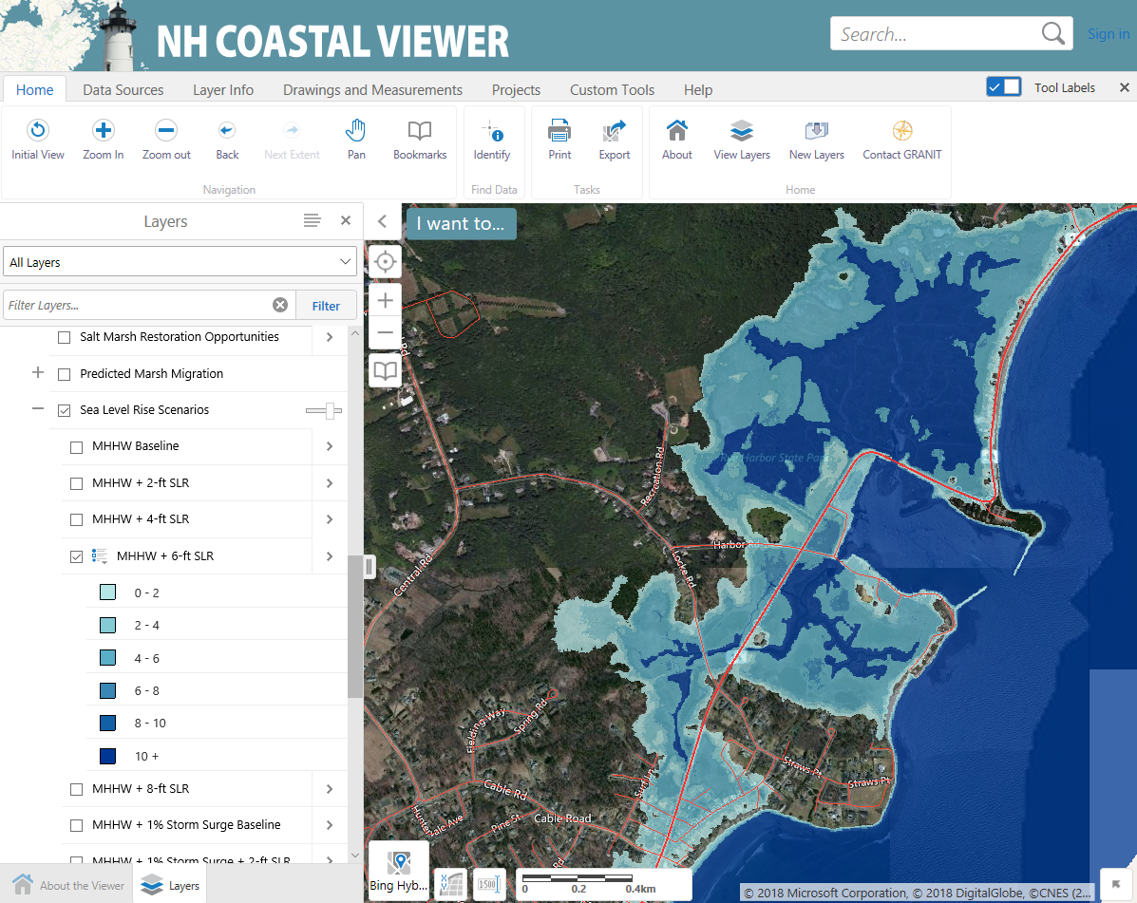
New/Updated Data Sets: Sea Level Rise
May 1, 2019

Slide 15
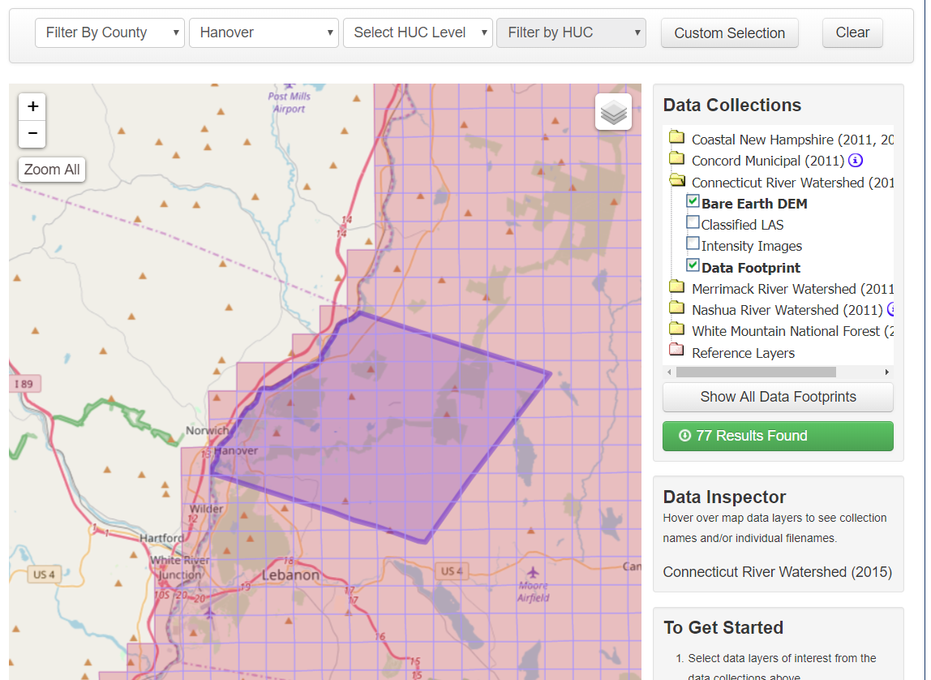
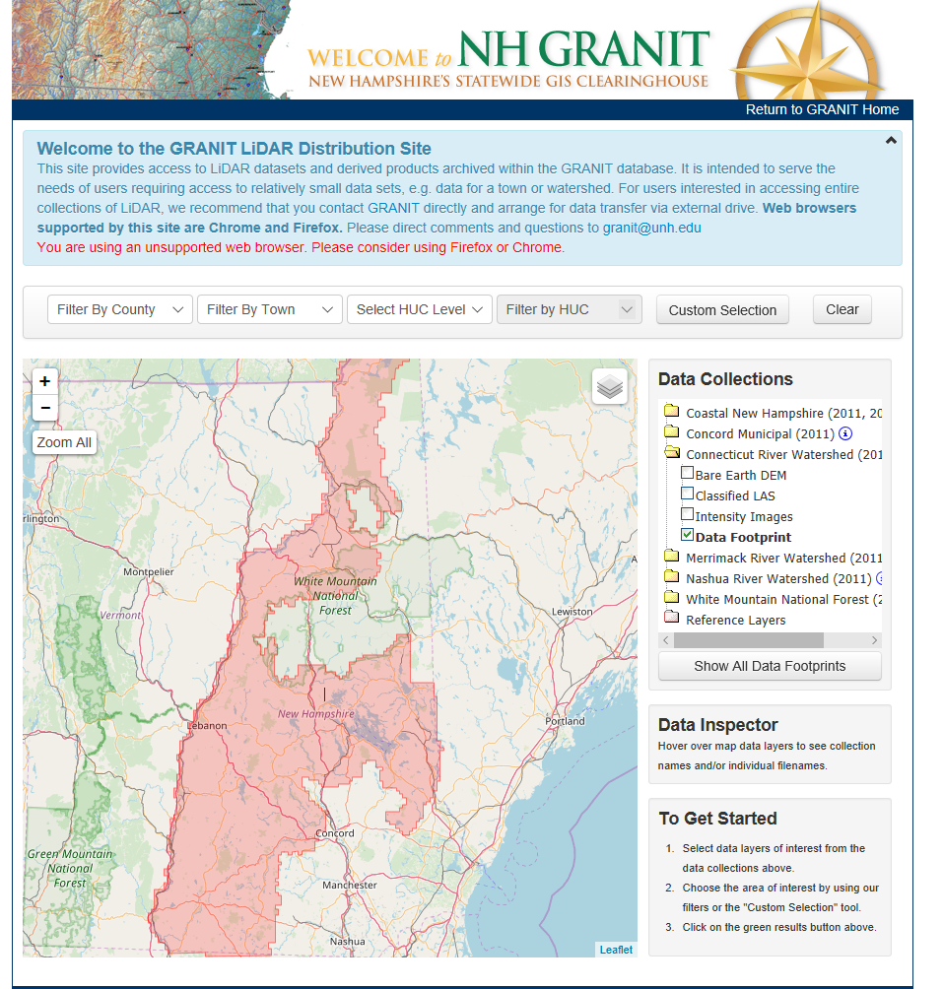
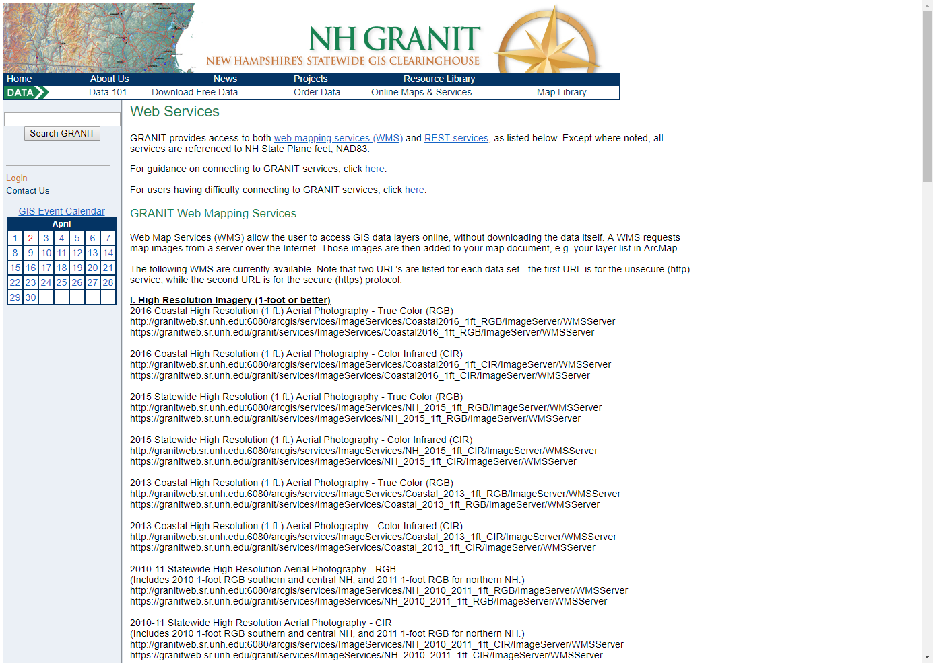
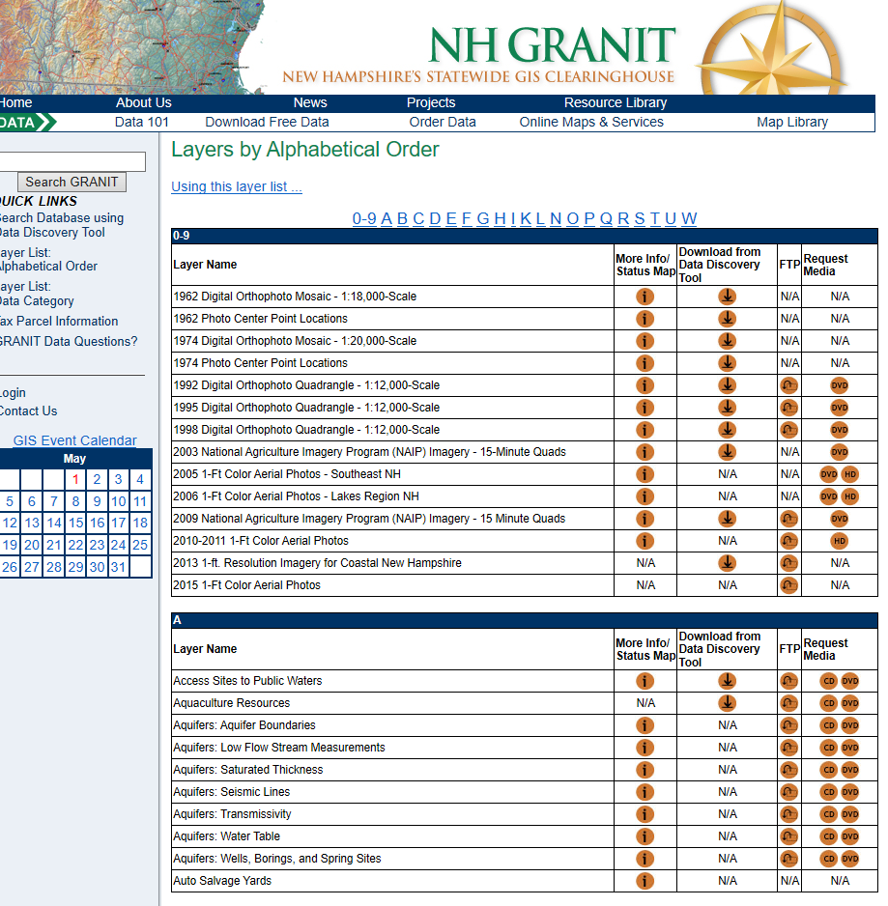
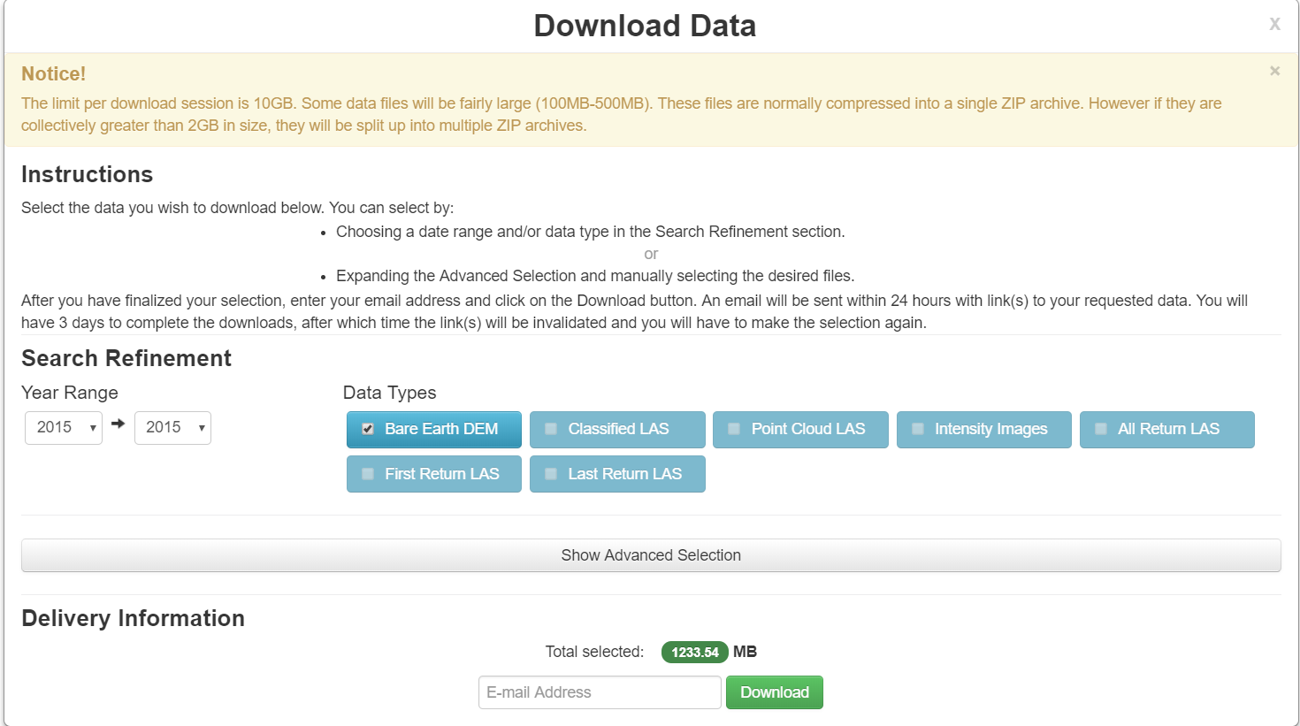
Accessing GRANIT Data
http://lidar.unh.edu
https://granit.unh.edu
Standard and secure https connections
NHLSA Annual Meeting
December 4, 2015
May 1, 2019
Notes:
Portal – shows footprint of data availability; density of features, previews attributes; access to metadata; can create webmap directly from data service, can download

Slide 16
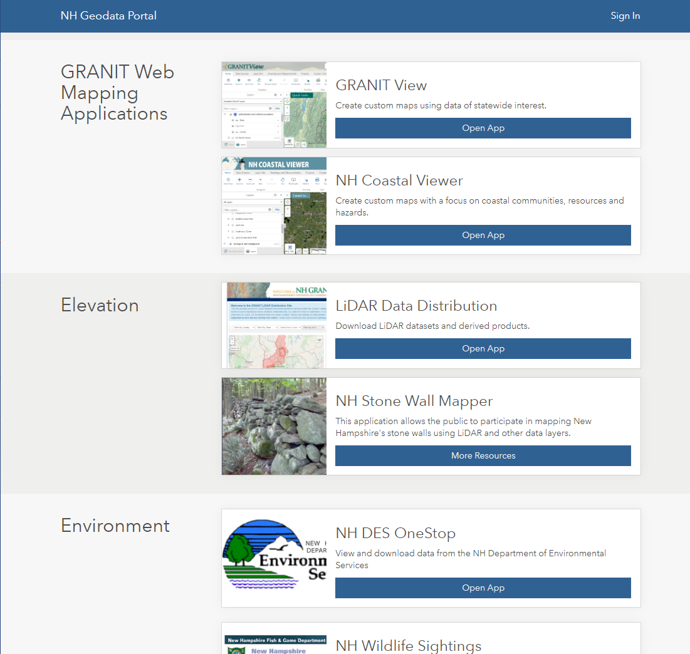
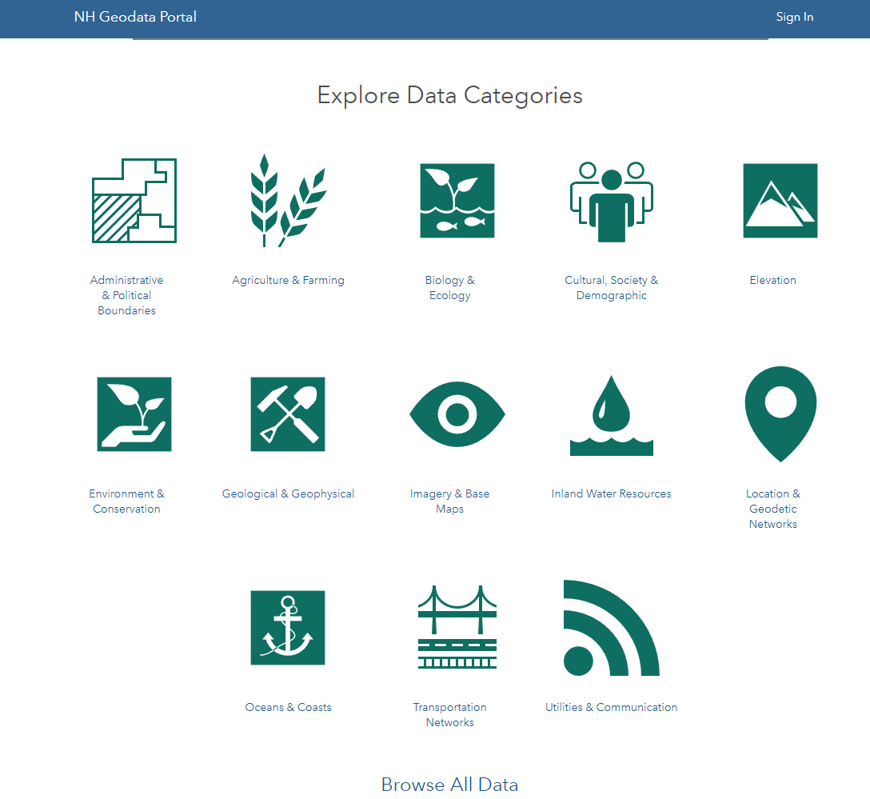
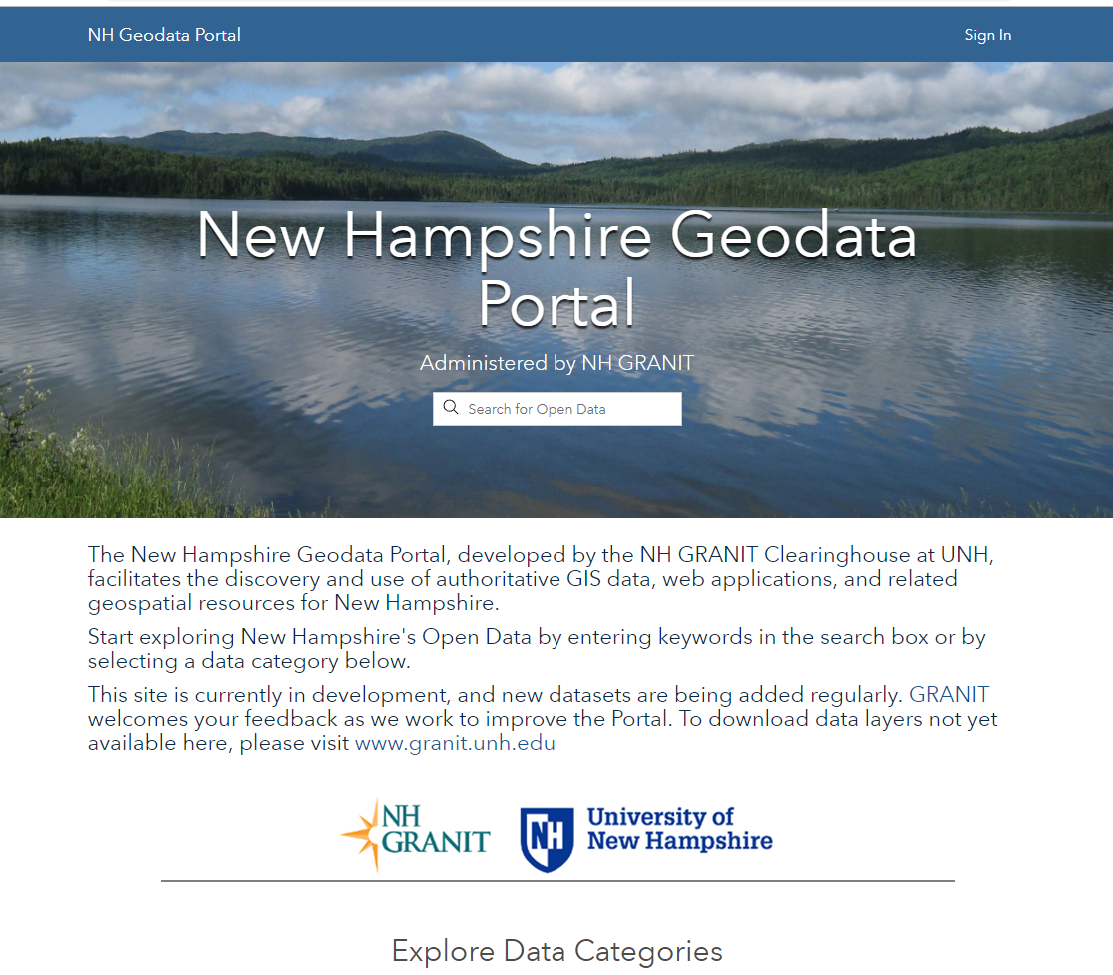
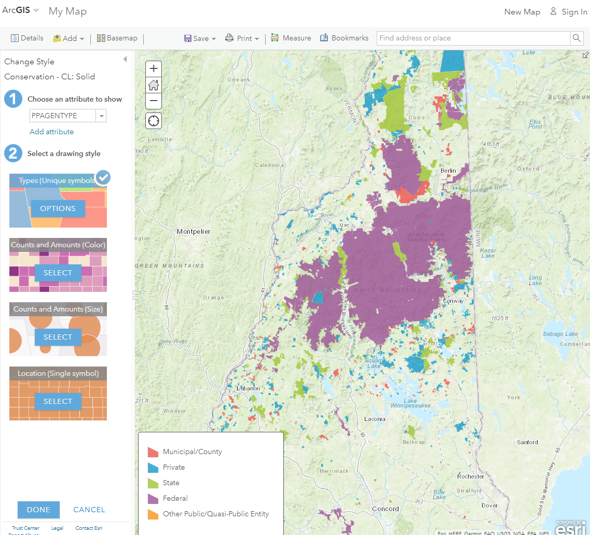
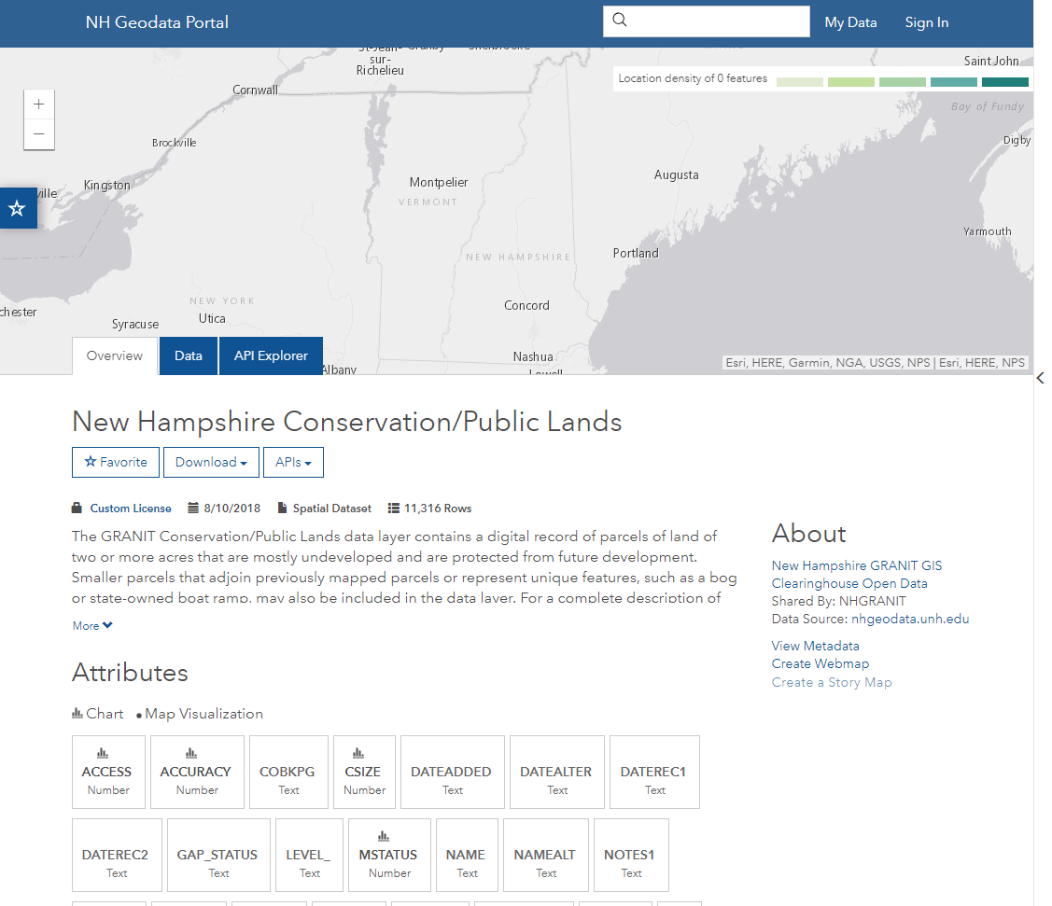
Accessing GRANIT Data
Link
NHLSA Annual Meeting
December 4, 2015
May 1, 2019
Notes:
Portal – shows footprint of data availability; density of features, previews attributes; access to metadata; can create webmap directly from data service, can download

Slide 17
Overview of GRANIT
  Central GIS Data Clearinghouse at UNH Earth Systems Research Center
  Collaboration of Data Providers and Data Users
    State/Federal Agencies
    Regional Planning Commissions
    Municipalities
    Private Sector
    Non-profit Sector
    Academic Community
  Core GRANIT Services
    Create, Archive, and Distribute Data
    Conduct Spatial Analysis
    Develop/Host Online Resources – Map Services, Map Viewers
    Provide Training and Technical Support
    Participate in GIS Coordination Activities – GIS Advisory Committee, GIS Technical Advisory Committee, Environmental Public Health Tracking, Coordinated LiDAR Acquisition
May 1, 2019
Notes:
First, bit of background on GRANIT.
We started working on the GRANIT system in mid 1980’s, and currently serving as the state’s GIS clearinghouse.
Create data, archive data from other sources, distribute data
Develop standards –metadata standards, land use mapping standards, etc.

Slide 18
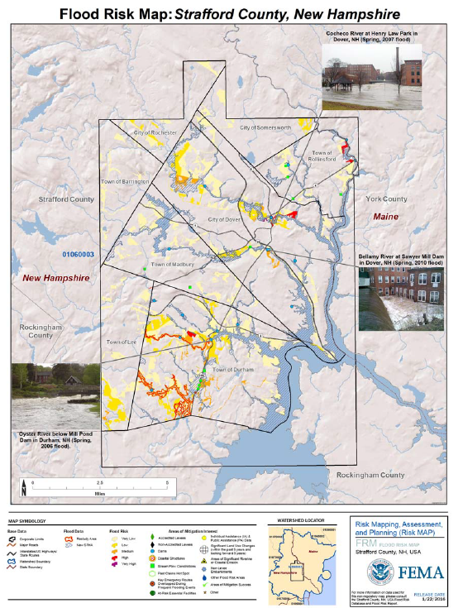
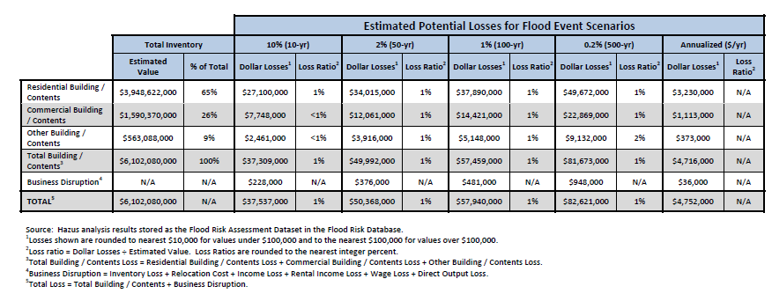
Data Analysis: FEMA Risk MAP Products
HAZUS Analysis – City of Dover
May 1, 2019
Notes:
Nonregulatory products to help communities understand flood risk Here, extracts from Flood Risk Report for coastal communities in Strafford County – Dover, Durham, Madbury, Rollinsford

Slide 19
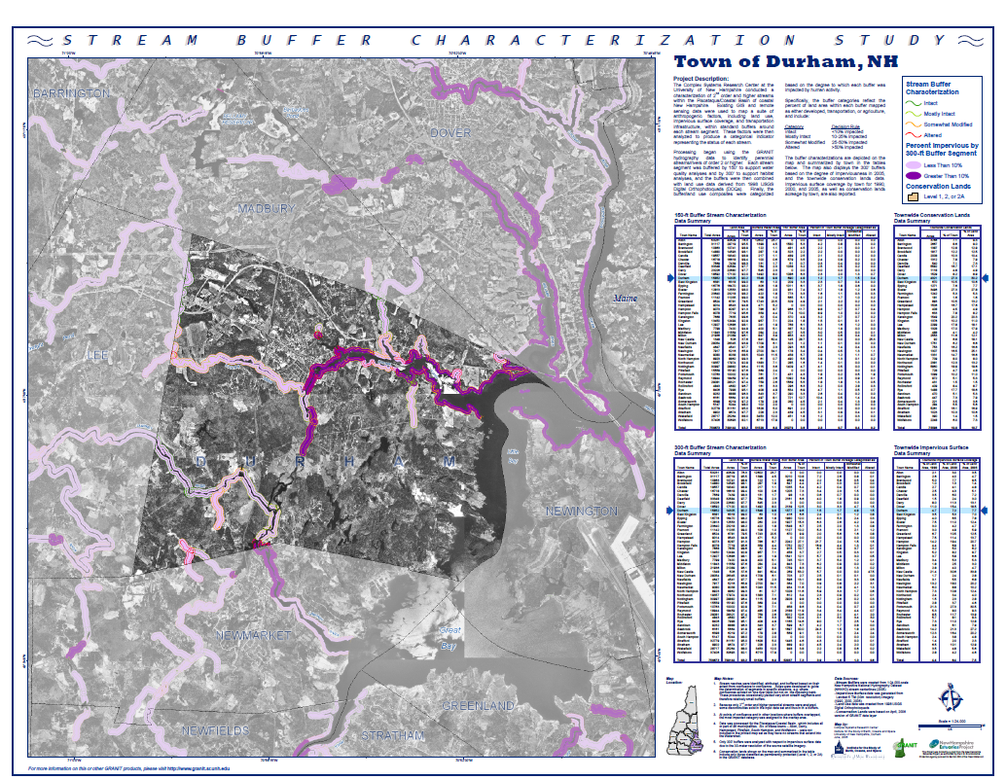
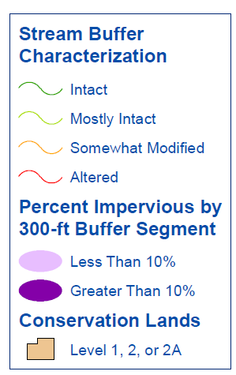
Data Analysis: Stream Buffer Characterization
May 1, 2019
Notes:
Map suite of factors – land use, impervious surface, transportation, within standard buffers around stream segments. Then generate an indicator of each stream to reflect degree to which each has been impacted by human activity.
Intact: < 10% impacted
Mostly Intact: 10-25% impacted
Somewhat Modified: 25-50% impacted
Altered: >50% impacted

Slide 20
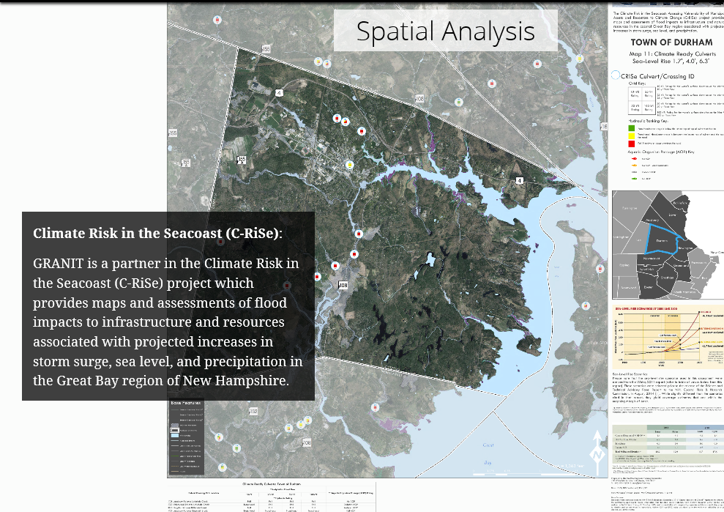
Data Analysis: Climate Change Impacts
May 1, 2019

Slide 21
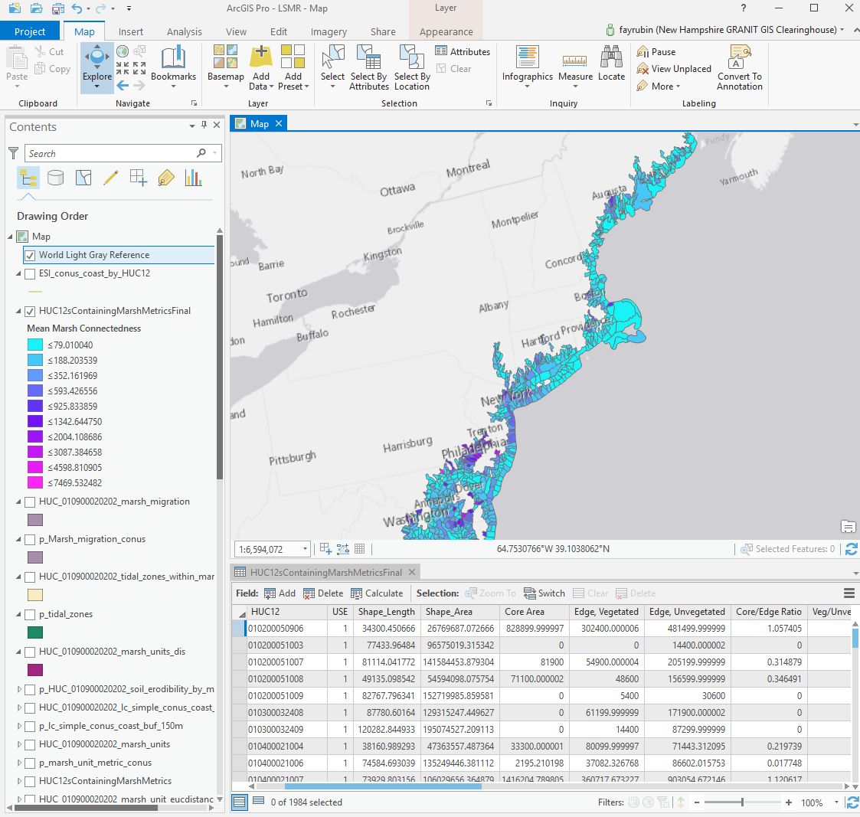
Data Analysis: Marsh Resilience
May 1, 2019
Notes:
Marsh resilience – coastal HUC12’s in continental US (so demonstrates regional projects). Marsh connectedness – lower values signify marshes within the HUC are more connected. Goal o f project – assign “score” to each HUC to indicate resilience to climate change. For significance: Q:\Projects\LSMR\Documents\TNC_Resilient...pdf. Partners – NH F&G, NOAA OCM, Great Bay Reserve, Padilla Bay National Estuarrne Research Reserve in Washington

Slide 22
Overview of GRANIT
  Central GIS Data Clearinghouse at UNH Earth Systems Research Center
  Collaboration of Data Providers and Data Users
    State/Federal Agencies
    Regional Planning Commissions
    Municipalities
    Private Sector
    Non-profit Sector
    Academic Community
  Core GRANIT Services
    Create, Archive, and Distribute Data
    Conduct Spatial Analysis
    Develop/Host Online Resources – Map Services, Map Viewers
    Provide Training and Technical Support
    Participate in GIS Coordination Activities – GIS Advisory Committee, GIS Technical Advisory Committee, Environmental Public Health Tracking, Coordinated LiDAR Acquisition
May 1, 2019
Notes:
First, bit of background on GRANIT.
We started working on the GRANIT system in mid 1980’s, and currently serving as the state’s GIS clearinghouse.
Create data, archive data from other sources, distribute data
Develop standards –metadata standards, land use mapping standards, etc.

Slide 23
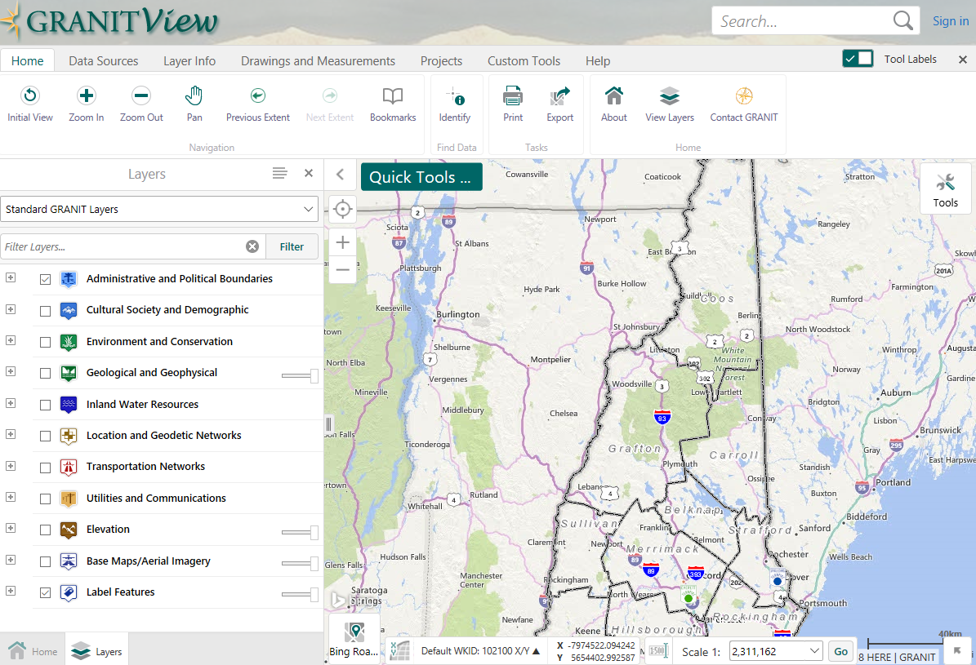
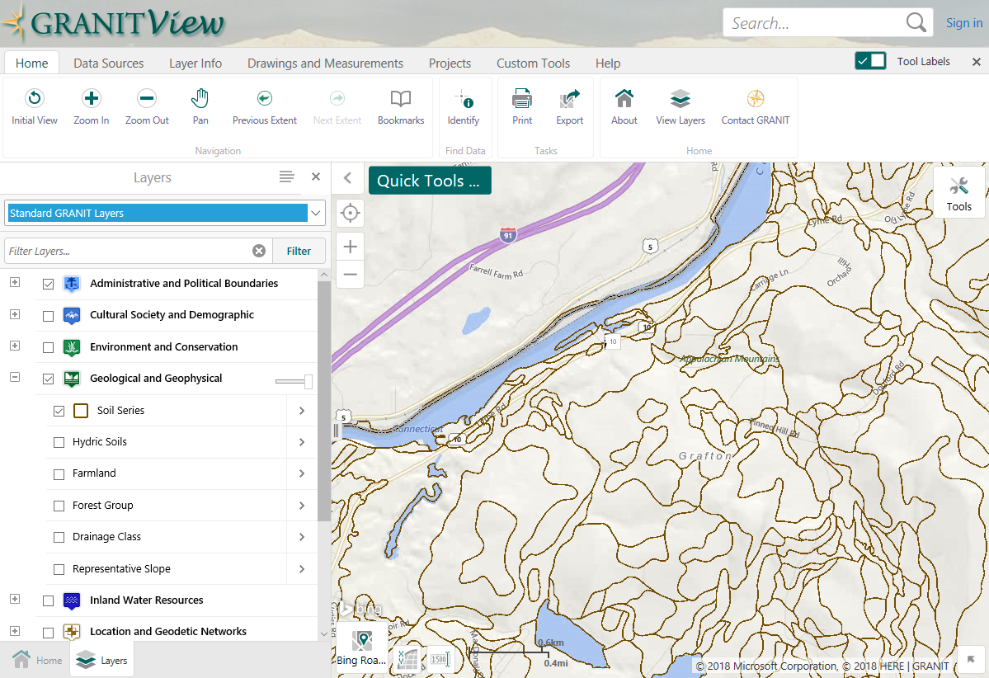
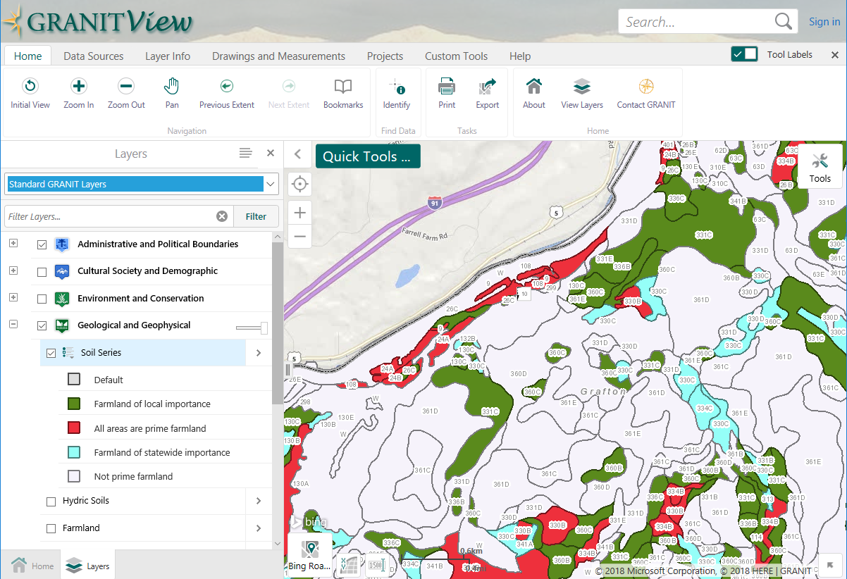
GRANITView
https://granitview.unh.edu
NHLSA Annual Meeting
December 4, 2015
May 1, 2019
Notes:
GRANITView – Not really new, but keep expanding it and adding capability. Start out with default display of soils, use custom symbolization and labeling tools to produce second image

Slide 24
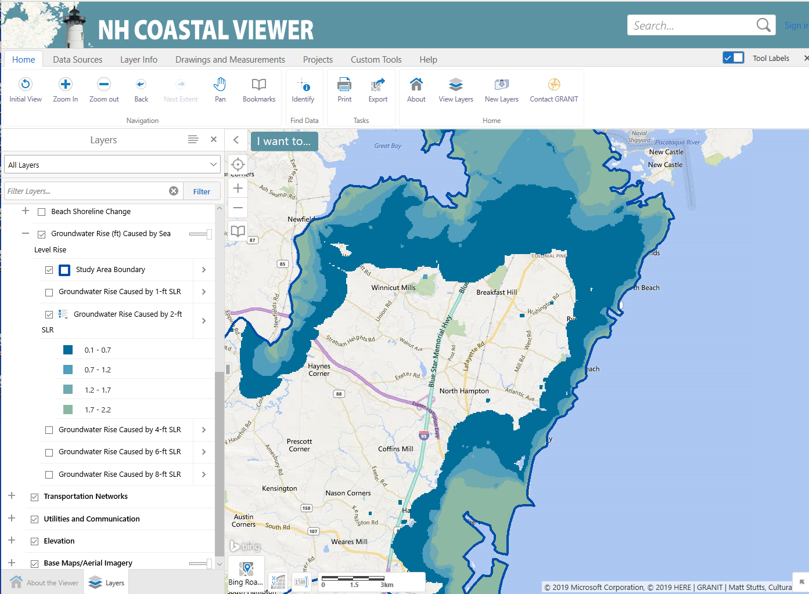
NH Coastal Viewer
https://www.nhcoastalviewer.org
NHLSA Annual Meeting
December 4, 2015
May 1, 2019

Slide 25
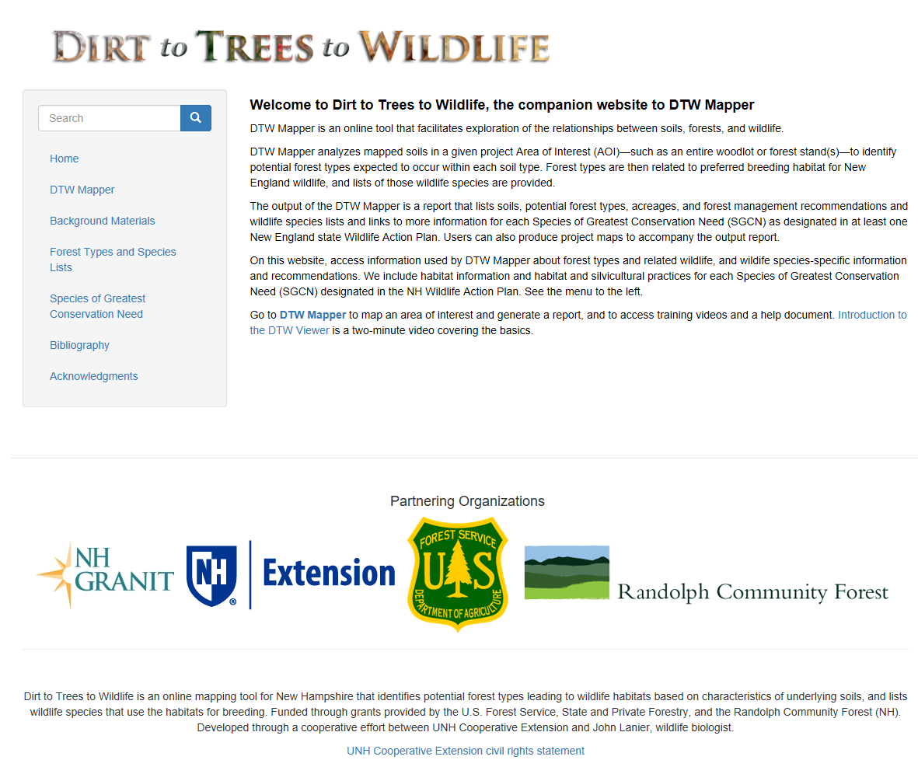
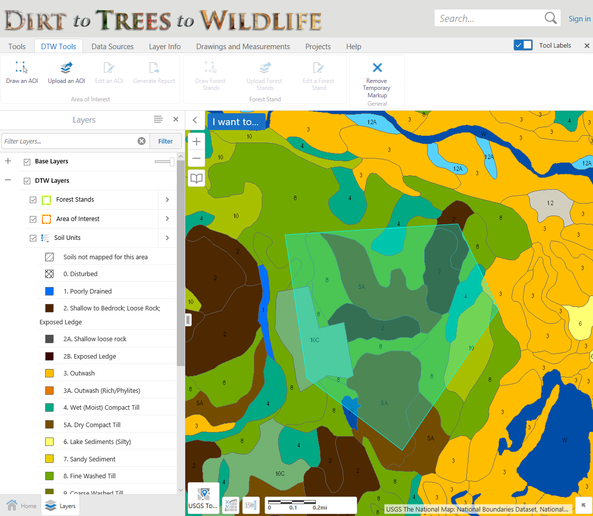
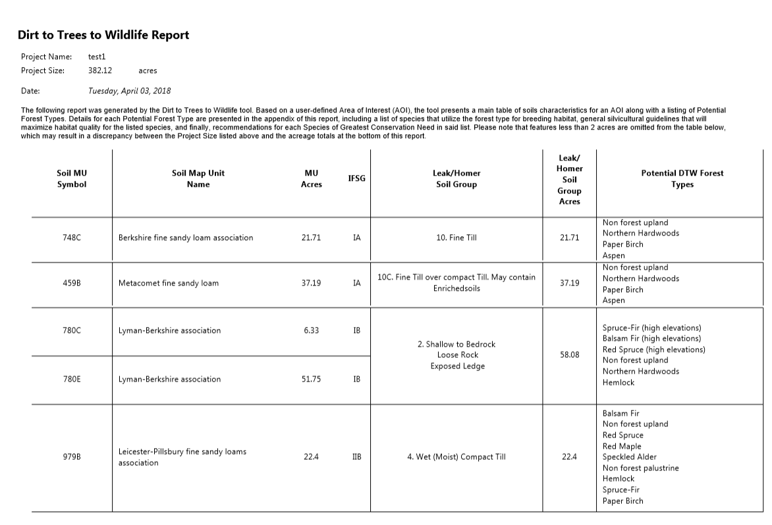
Dirt to Trees to Wildlife
https://dirttreeswildlife.org
NHLSA Annual Meeting
December 4, 2015
May 1, 2019
Notes:
Created with partners from UNHCE, and with funding from USFS and Town of Randolph.
Online tool that links a) soils within an area of interest to the forest cover types those soils can support; b) then to the preferred breeding habitats associated with those forest types; and c) then to individual species of wildlife supported by those wildlife habitats.
Soils mapped based on Homer Leak classification. Per Joe Homer – In NH, there are approximately 190 soil series mapped. Soils were aggregated into 20 or so of Bill Leak’s Forest Habitat groups based on common physical properties (primarily parent material, dominant soil texture, drainage class, and depth to bedrock).
Can use to create report.

Slide 26
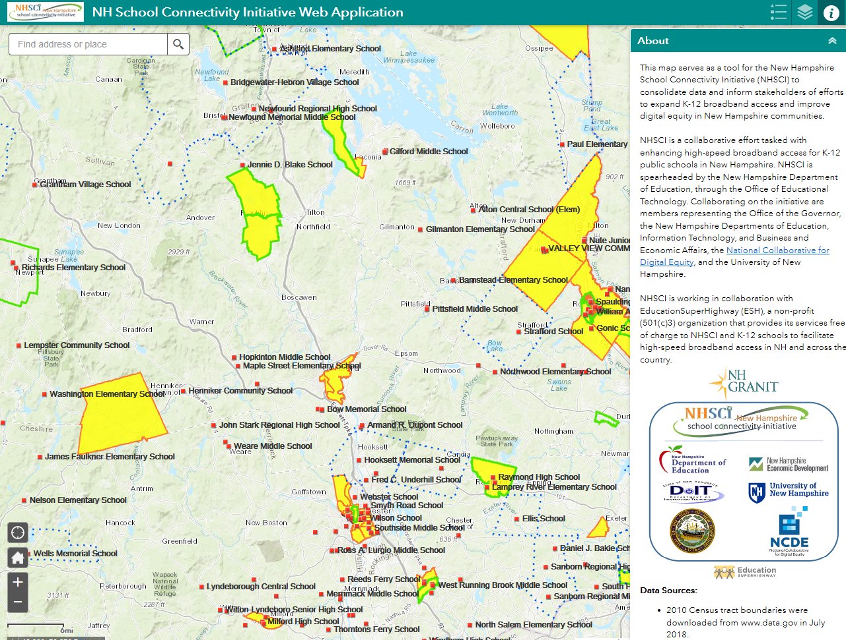
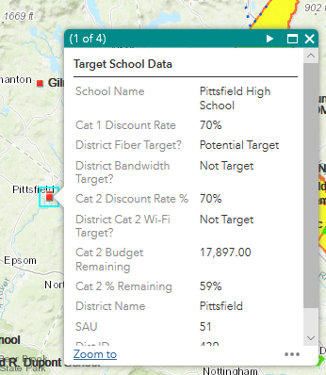
NH School Connectivity Initiative (NHSCI)
Link
NHLSA Annual Meeting
December 4, 2015
May 1, 2019
Notes:
Created with partners from UNHCE, and with funding from USFS and Town of Randolph.
Online tool that links a) soils within an area of interest to the forest cover types those soils can support; b) then to the preferred breeding habitats associated with those forest types; and c) then to individual species of wildlife supported by those wildlife habitats.
Soils mapped based on Homer Leak classification. Per Joe Homer – In NH, there are approximately 190 soil series mapped. Soils were aggregated into 20 or so of Bill Leak’s Forest Habitat groups based on common physical properties (primarily parent material, dominant soil texture, drainage class, and depth to bedrock).
Can use to create report.

Slide 27
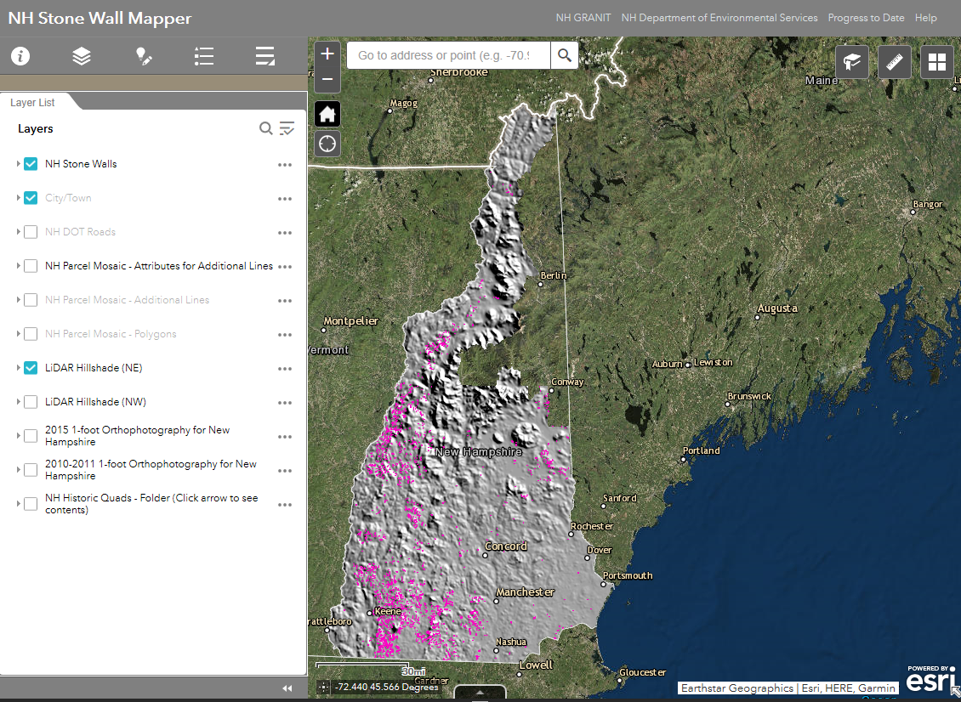
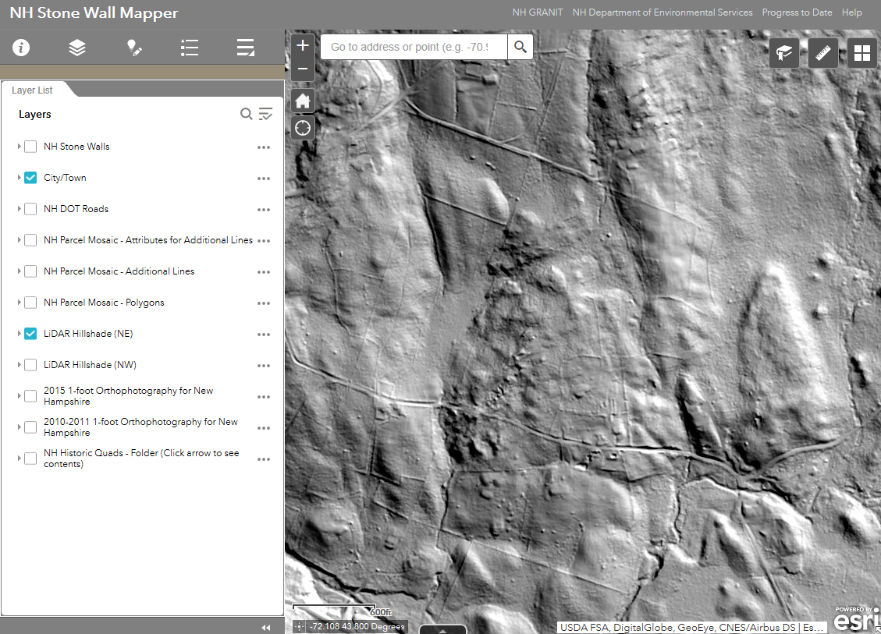
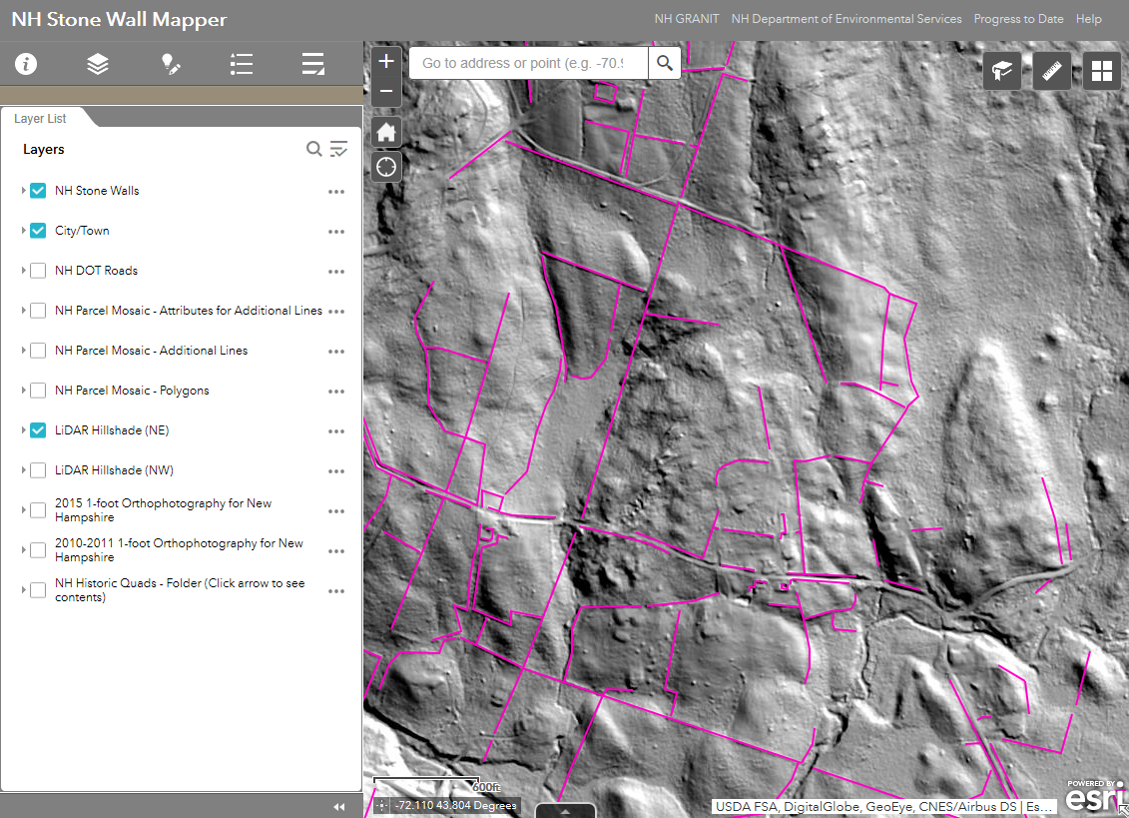
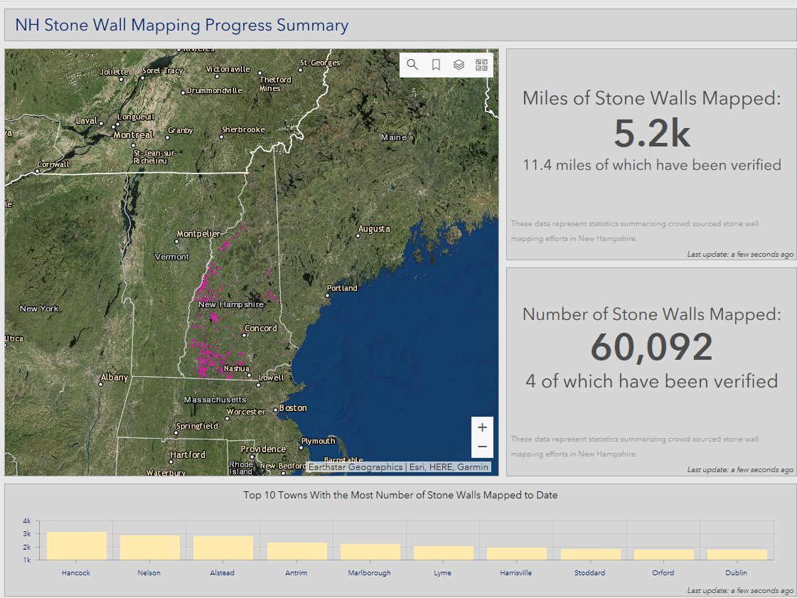
NH Stone Wall Mapper
Link
NHLSA Annual Meeting
December 4, 2015
May 1, 2019
Notes:
Created with partners from NHDES.

Slide 28
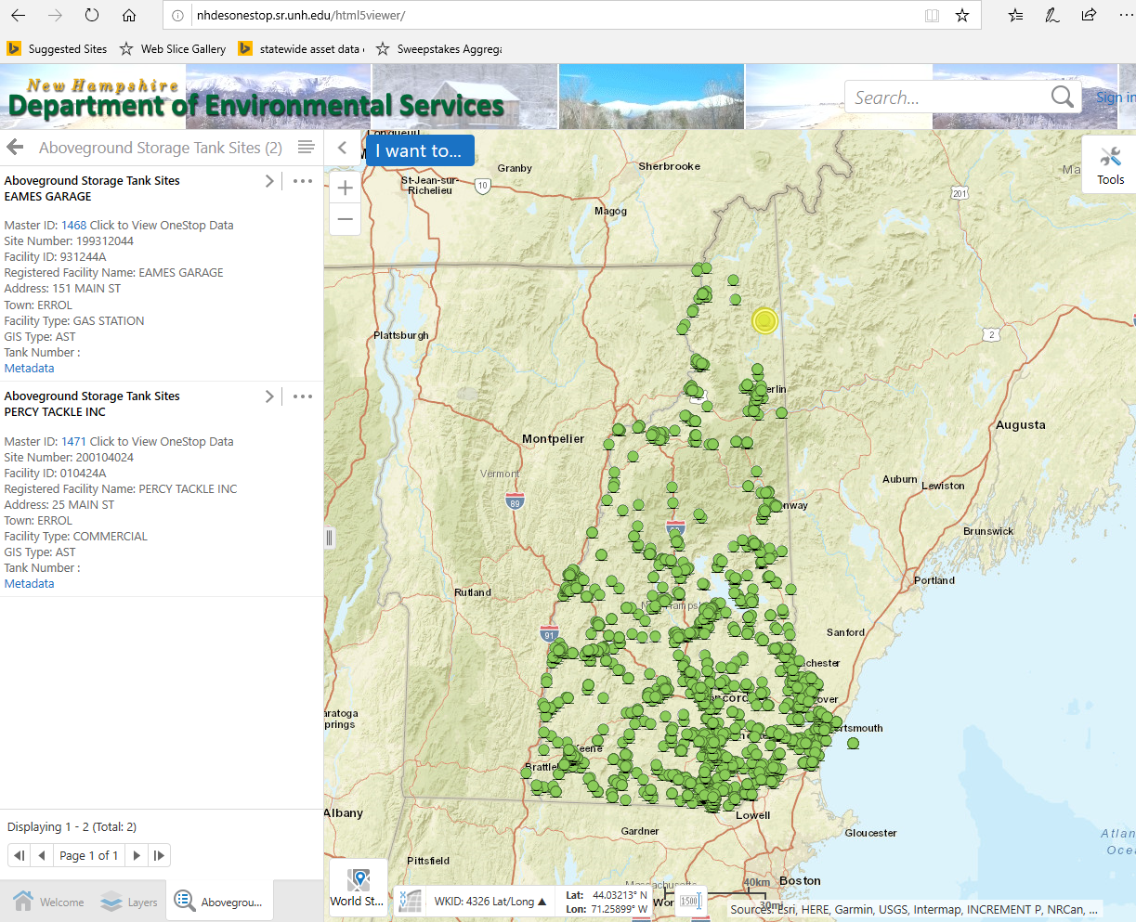
NHDES OneStop Mapper (hosted viewer)
OneStop Mapper Link
NHLSA Annual Meeting
December 4, 2015
May 1, 2019

Slide 29
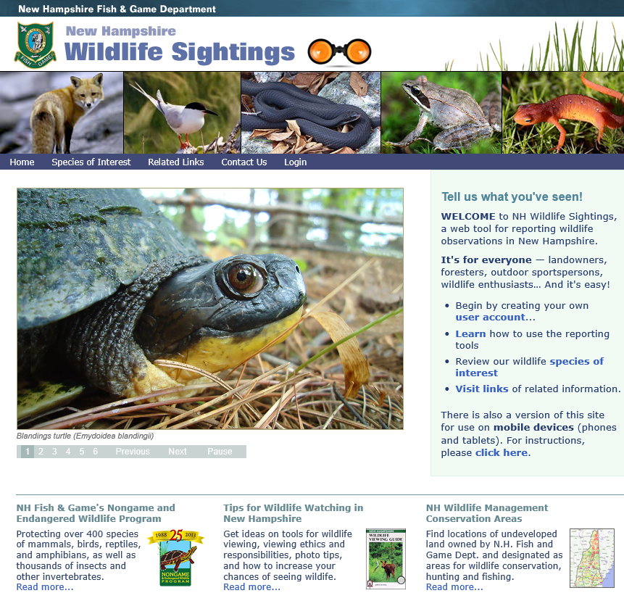
NH Wildlife Sitings (hosted viewer)
https://nhwildlifesightings.unh.edu
NHLSA Annual Meeting
December 4, 2015
May 1, 2019

Slide 30
NH Wildlife Sitings (hosted viewer)
https://nhwildlifesightings.unh.edu
NHLSA Annual Meeting
December 4, 2015
May 1, 2019

Slide 31
Overview of GRANIT
  Central GIS Data Clearinghouse at UNH Earth Systems Research Center
  Collaboration of Data Providers and Data Users
    State/Federal Agencies
    Regional Planning Commissions
    Municipalities
    Private Sector
    Non-profit Sector
    Academic Community
  Core GRANIT Services
    Create, Archive, and Distribute Data
    Conduct Spatial Analysis
    Develop/Host Online Resources – Map Services, Map Viewers
    Provide Training and Technical Support
    Participate in GIS Coordination Activities – GIS Advisory Committee, GIS Technical Advisory Committee, Environmental Public Health Tracking, Coordinated LiDAR Acquisition
May 1, 2019
Notes:
First, bit of background on GRANIT.
We started working on the GRANIT system in mid 1980’s, and currently serving as the state’s GIS clearinghouse.
Create data, archive data from other sources, distribute data
Develop standards –metadata standards, land use mapping standards, etc.

Slide 32
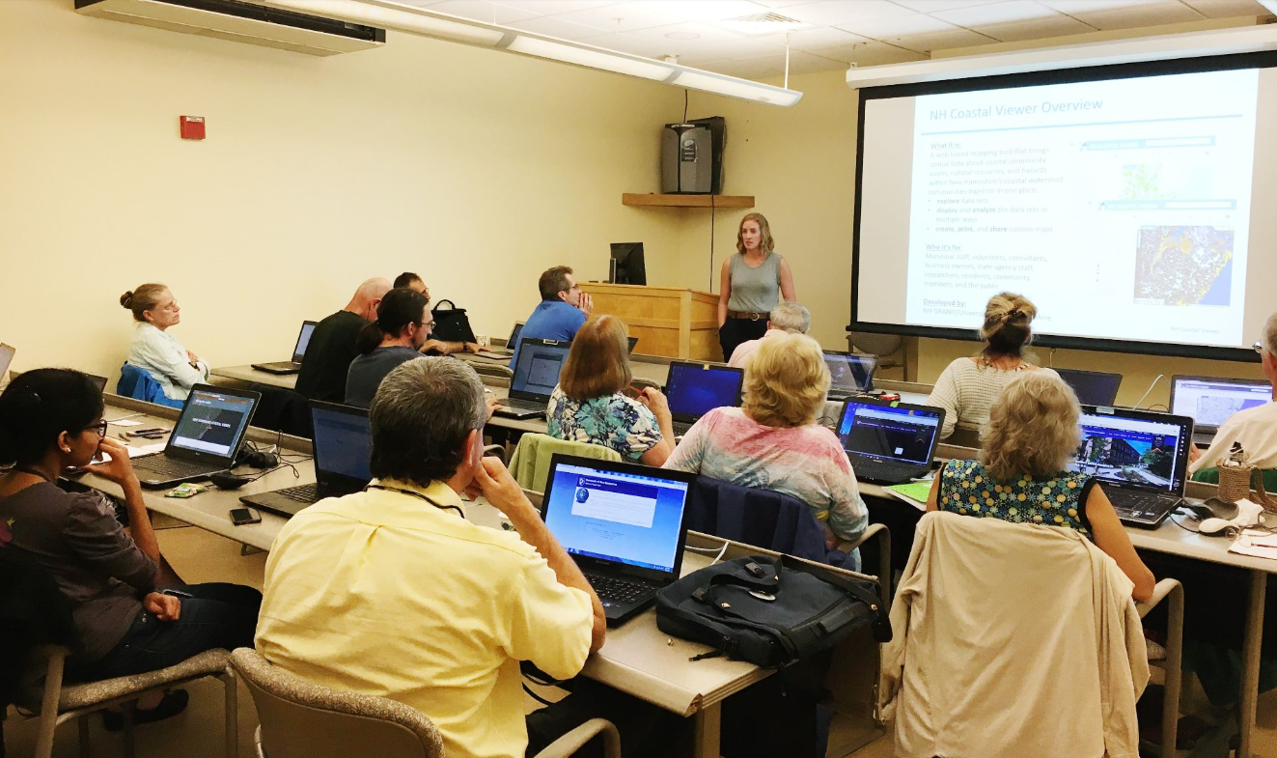
Training and Technical Support
May 1, 2019
Notes:
In person training – here with partner from NH Coastal Program

Slide 33
Service Usage
Usage of published GRANIT map and image services
January 1-March 30, 2019
Total Service Usage | Average Service Usage/Day | Average Service Usage/ Workday
19,976,491 | 224,455 | 327,483
May 1, 2019
Notes:
In person training – here with partner from NH Coastal Program

Slide 34
Overview of GRANIT
  Central GIS Data Clearinghouse at UNH Earth Systems Research Center
  Collaboration of Data Providers and Data Users
    State/Federal Agencies
    Regional Planning Commissions
    Municipalities
    Private Sector
    Non-profit Sector
    Academic Community
  Core GRANIT Services
    Create, Archive, and Distribute Data
    Conduct Spatial Analysis
    Develop/Host Online Resources – Map Services, Map Viewers
    Provide Training and Technical Support
    Participate in GIS Coordination Activities – GIS Advisory Committee, GIS Technical Advisory Committee, Environmental Public Health Tracking, Coordinated LiDAR Acquisition
May 1, 2019
Notes:
First, bit of background on GRANIT.
We started working on the GRANIT system in mid 1980’s, and currently serving as the state’s GIS clearinghouse.
Create data, archive data from other sources, distribute data
Develop standards –metadata standards, land use mapping standards, etc.

Slide 35

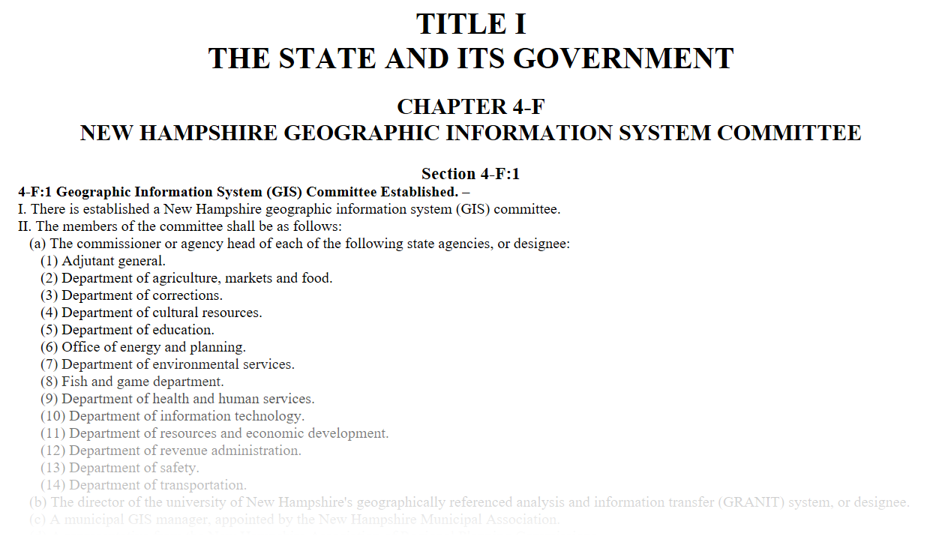
GIS Coordination: GIS Advisory Committee
The committee shall review the use, development, and coordination of geospatial data and resources …
NHLSA Annual Meeting
December 4, 2015
May 1, 2019
Notes:
Don’t want to represent this as a GRANIT activity specifically, but think it’s important that everyone know about this relatively new committee.
HB 377 passed last legislative session. Resulted in RSA 4-F:1 – establishing a GIS Advisory Committee. Some of you may know that we have had a GIS Advisory Committee meeting since the 1980’s. That committee, which was more technical in nature, has been renamed the GIS Technical Advisory Committee. And this new group, which is charged with strategic planning and coordination for GIS in NH, has been formed and has met twice. Statute requires that the Committee, whose members include state agency commissioners, an RPC rep, a municipal rep, the GRANIT Director, report to the legislature each November.
Progress to date – agreement on a set of guiding principles. These principles relate to establishing data standards, data coordination and sharing, sharing applications, and engaging with more stakeholders.

Slide 36
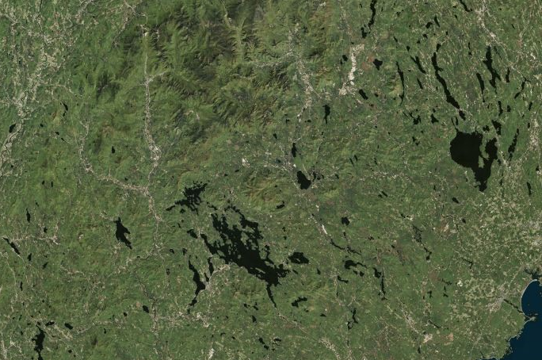
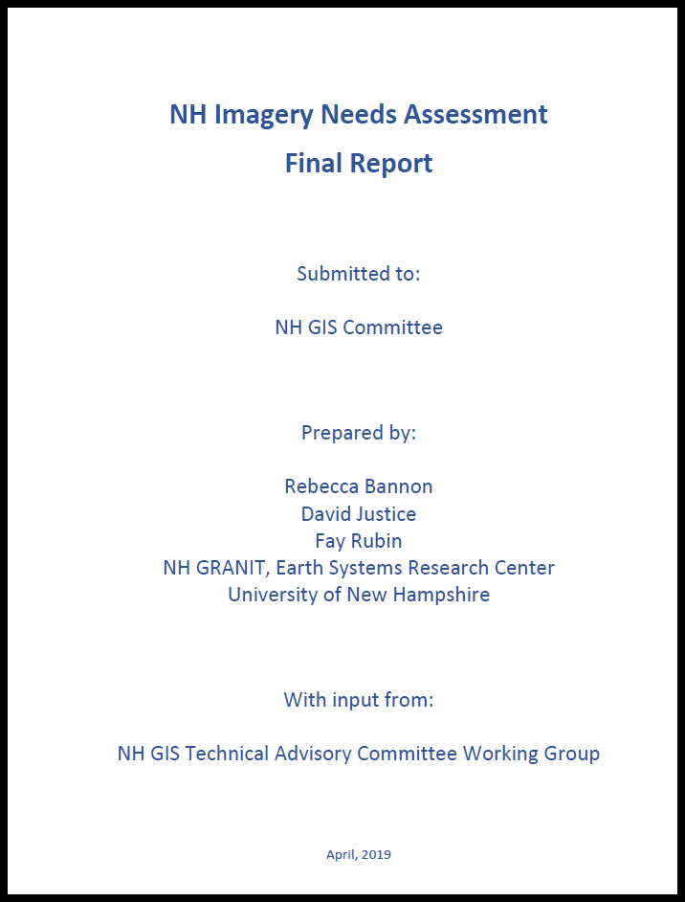
GIS Coordination: Imagery Needs Assessment
  Goal: Develop plan for regular acquisition of statewide base map imagery
  Project Components:
    Conduct 2-3 user input sessions
      How do you presently use high resolution imagery?
      What resolution do you need to support these and future applications?
      What acquisition cycle do you need?
      Leaf on? Leaf off?
      ...
    Host/distribute on-line questionnaire
    Generate imagery specifications
    Research imagery vendor options
    Develop funding allocation model
    Finalize plan
May 1, 2019

Slide 37
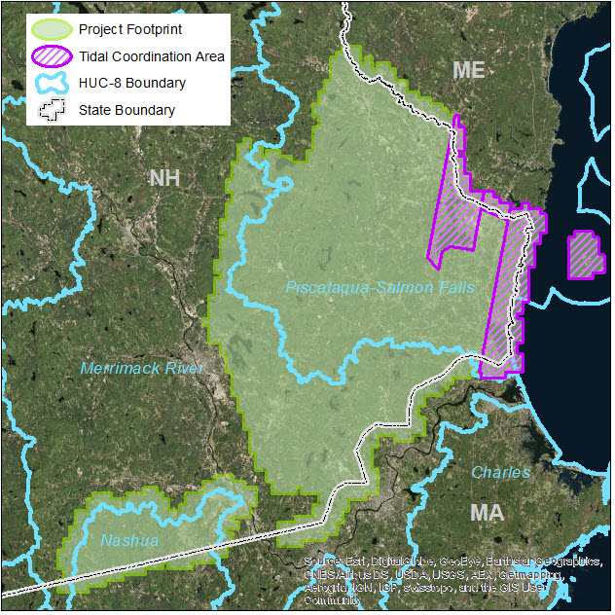
GIS Coordination: LIDAR Acquisition
May 1, 2019
Notes:
Recent successful proposal to acquire updated data for 1278 sq. miles. Leveraging $160,000 in federal funds to cover $460,000 in project costs.

Slide 38

Thank you …
Contact Info:
Fay Rubin
Earth Systems Research Center
University of New Hampshire
fay.rubin@unh.edu
NHLSA Annual Meeting
December 4, 2015
April 4, 2018

Slide 39
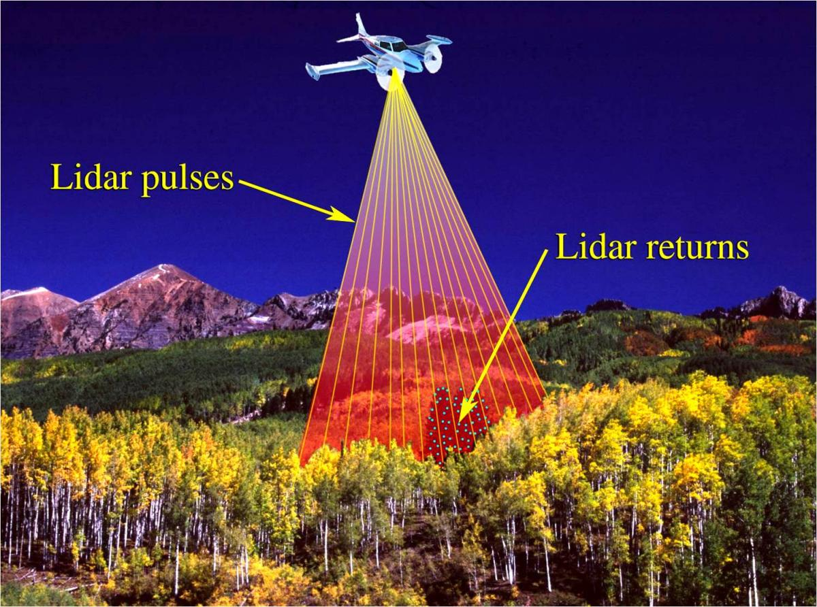
LIDAR Defined
(LIght Detection And Ranging)
Source: US Geological Survey
Notes:
First of all, what does LIDAR stand for? Most people in industry today agree that it stands for Light Detection and Ranging. However, there is documentation that suggests that it was originally a combination of the words “light” and “radar”, and the acronym actually came later. Either way, it is a remote sensing technology that is used to examine the surface of the earth. It is now the technology of choice for collecting elevation data over large areas. Originated in the 1960’s – initially used primarily in meteorology.
Works by emitting light pulses from a laser, those pulses are reflected off a target object (e.g. the earth, a building, trees), and the <click> time it takes for the reflected light to be received is then recorded. This information can be used to compute ranges or distances to objects, and therefore elevation values. In addition to capturing the time of transmission, the sensor also captures the light intensity of the reflected pulse – which provides additional information on the terrain. I will return to this in a moment and provide a bit more explanation.

Slide 40

LIDAR
System
Components
INS
Source: USGS
Notes:
So what does a LIDAR system look like? Typically, a basic system includes a laser scanner that includes components to 1) generate and transmit rapid laser pulses (by reflecting them off an internal mirror), and to 2) receive and record the time it took for the signal to be returned using high precision clocks.
<click>From this elapsed time, we know the speed of light so can calculate the range or distance from the scanner to the target.
Today’s scanners – capable of up to 400,000 pulses per second.
To establish the ground coordinates of the target, also need components of a direct georeferencing system, which includes the GPS and an Inertial Navigation System (INS). The GPS is something you are all familiar with, and collects the location of the scanner. The INS monitors the pitch, roll, and altitude of the aircraft and therefore the orientation of the scanner. Both are required to get the accuracies we see with LIDAR data.

Slide 41
GRANIT History/Overview
Data Development/Hosting: - see GRANITPOverview_February6_2017.pptx
  Conservation Lands
  Floodplains
  Impervious surfaces – show Burack slide
  SLR
  Contours
  LC/LU
  Surficial Geology
  Imagery – orthos/LIDAR
  Hosting:
    DRA -Parcels
    DOT - Transportation Layers
    F&G - Wildlife Action Plan
    DES – NWIplus, Dams, etc.
Data Stream buffer characterization - N:\d-buffer\d-maps or see story map
  PTAPP and Hot Spot Analysis – Powwow River
  SLR Vulnerability Analysis – see Story Map analysis; Crise, including culvert assessments for Tom B
  DTW (make point that it “crosses” into online mapping tools)
  Broadband – show table of results
  Natural Services Network - D:\NaturalServicesNetwork
  Lamprey River Work – D:\FloodplainClimateChange

Slide 42
Data Access:
  Portal
  LIDAR site
  Online Mapping/Viewing Tools
    Stone Wall Mapper
    GRANITView
    Coastal Viewer – show groundwater rise data
    CRA Mapping Tool
    Hosting:
      Wildlife Sitings
      OneStop
      Wetlands
      DOT Roads Viewer (DRAFT)
Technical Support & training
  Grab stats from last GRANIT status report
  Training – see StoryMap
GIS Coordination
  Helped author the recent successful 3DEP Lidar acquisition
  Orthoimagery needs assessment
  DES Data Life Cycle
  Committees – DHHS, PREP, GAC, GTAC
OR SEE Update on NH GRANIT Clearinghouse

Slide 43


Accessing GRANIT Data
Link
http://lidar.unh.edu
https://granit.unh.edu
Standard and secure https connections
NHLSA Annual Meeting
December 4, 2015
May 1, 2019
Notes:
Portal – shows footprint of data availability; density of features, previews attributes; access to metadata; can create webmap directly from data service, can download

