Slide 1
GRANIT Update
Fay Rubin
Earth Systems Research Center
University of New Hampshire
April 4, 2018
http://granit.unh.edu
http://granitview.unh.edu
http://nhcoastalviewer.unh.edu
http://lidar.unh.edu
December 4, 2015

Slide 2
Overview of GRANIT
Central GIS Data Clearinghouse at UNH Earth Systems Research Center
Core GRANIT Services
Create, Archive, and Distribute Data
Develop Data Standards
Conduct Spatial Analysis
Develop and Host Online Resources – Map Services, Map Viewers
Provide Training and Technical Support
Collaboration of Data Providers and Data Users
April 4, 2018
Notes:
First, bit of background on GRANIT.
We started working on the GRANIT system in mid 1980’s, and currently serving as the state’s GIS clearinghouse.
Create data, archive data from other sources, distribute data
Develop standards –metadata standards, land use mapping standards, etc.

Slide 3
Current GRANIT Projects (partial list)
Core GRANIT Clearinghouse Activities (OSI, NHDOT, NHDES, Fish & Game, DNCR)
GRANIT Data Hosting/GRANIT Web Site
GRANITView, NH Wetlands Mapper, NH Wildlife Sitings Site
Data Development (Conservation Lands)
Cooperating Technical Partner (FEMA)
Floodplain Map Updates – Rockingham/Strafford Counties
Broadband Availability in Northern New Hampshire (NBRC)
PTAPP - Pollution Tracking and Accounting Program (NHDES)
NH Coastal Viewer Development (NOAA, NHDES)
“Dirt to Trees to Wildlife” Tool (Town of Randolph, USDA)
Data Life Cycle Analysis (NHDES)
Stone Walls Initiative (NH Charitable Foundation, NHDES)
Imagery Needs Assessment (pending – NHDOIT/NHDOT)
Agency Map Viewer Pilot Project (pending – NHDOIT/NHDOT)
NHLSA Annual Meeting
December 4, 2015
April 4, 2018
Notes:
We do this work with a variety of funding mechanisms and partnerships. Partial list of current projects
Project areas range from floodplain mapping to habitat management to pollutant tracking.
Other projects:
Landscape Scale Assessment of NERRS Marsh Resilience (NOAA)

Slide 4
What’s New
New/Updated Data Sets
Parcel Mosaic
LIDAR Derivatives (contours)
Conservation/Public Lands
New Ways to Access GRANIT Data
GRANIT Data Portal (in development)
LIDAR Data Access Site
Enhanced Map Services
New/Updated Applications
GRANITView
“Dirt to Trees to Wildlife”
New GIS Coordination
GIS Advisory Committee
Imagery Needs Assessment
NHLSA Annual Meeting
December 4, 2015
April 4, 2018
Notes:
I have organized my “new technologies” into the 4 main categories presented here. And I’ve selected just a couple of examples in each area to highlight. Will say only a brief word or two about each.

Slide 5
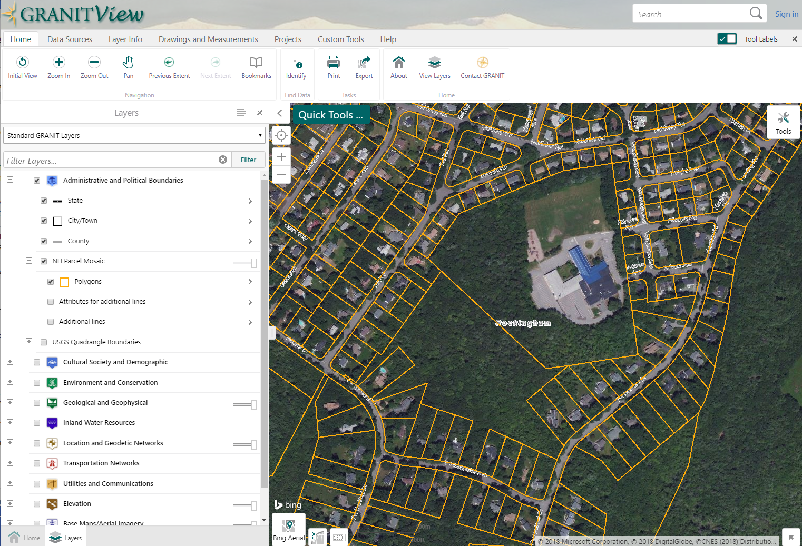
New/Updated Data Sets: NH Parcel Mosaic
NH Parcel Mosaic (2017) in vicinity of Portsmouth High School
NHLSA Annual Meeting
December 4, 2015
April 4, 2018

Slide 6
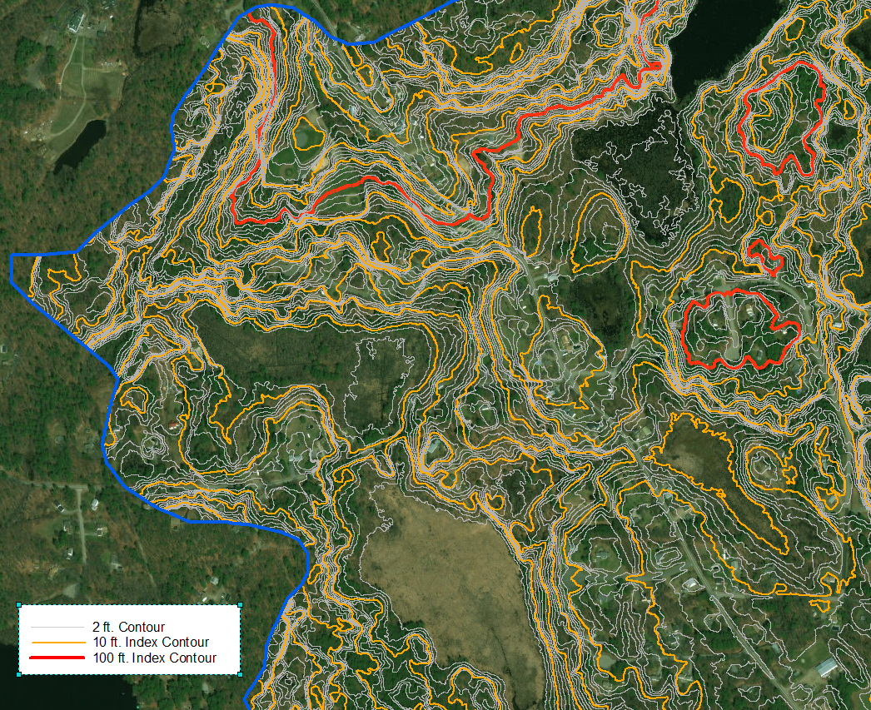
New/Updated Data Sets: 2 Ft. Contours
Contours (2ft.) in Powwow River HUC10 (0107000614)
NHLSA Annual Meeting
December 4, 2015
April 4, 2018
Notes:
Contours - Powwow River HUC10 – part of Merrimack River HUC8. Generating raw contours and smoothed version. Will be doing entire state, once we have the LIDAR data gap filled in.

Slide 7
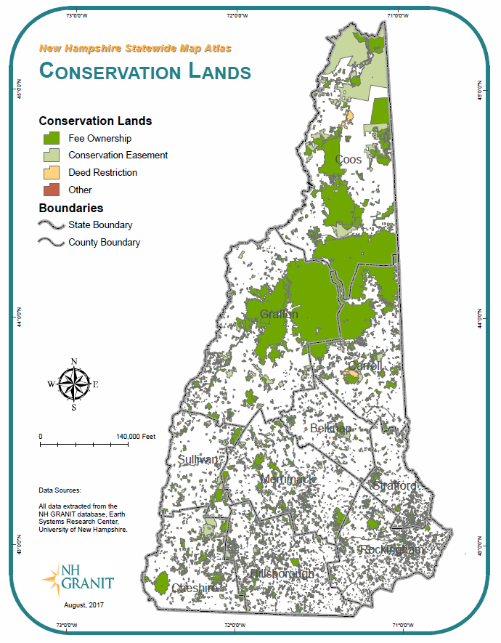
New/Updated Data Sets: Conservation Lands
10,781 tracts
1,0878,000 acres
NHLSA Annual Meeting
December 4, 2015
April 4, 2018

Slide 8
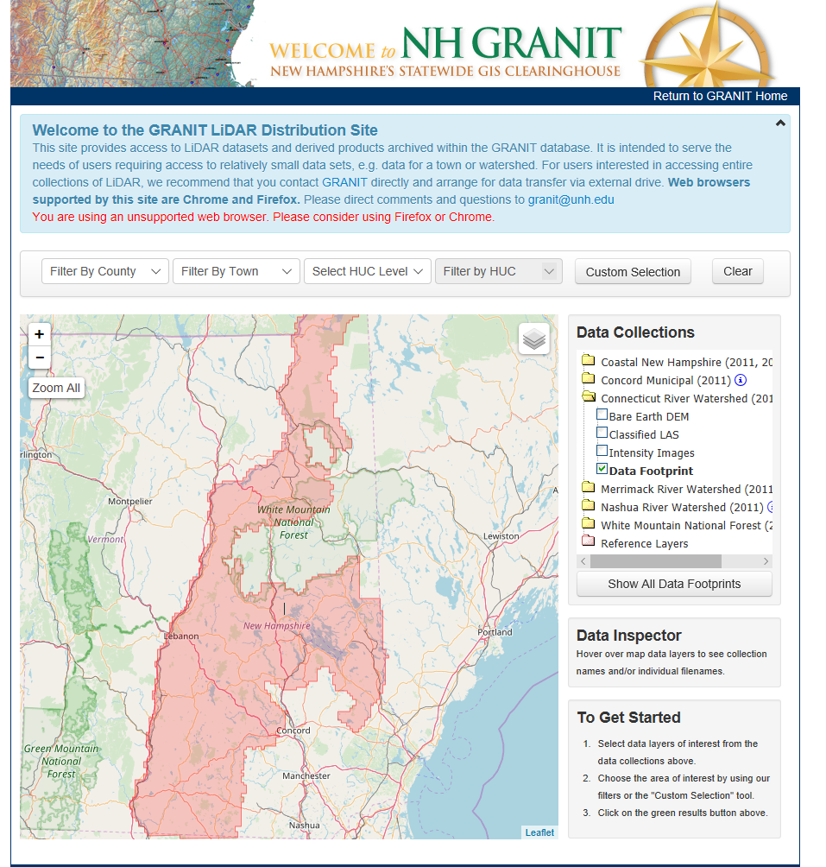
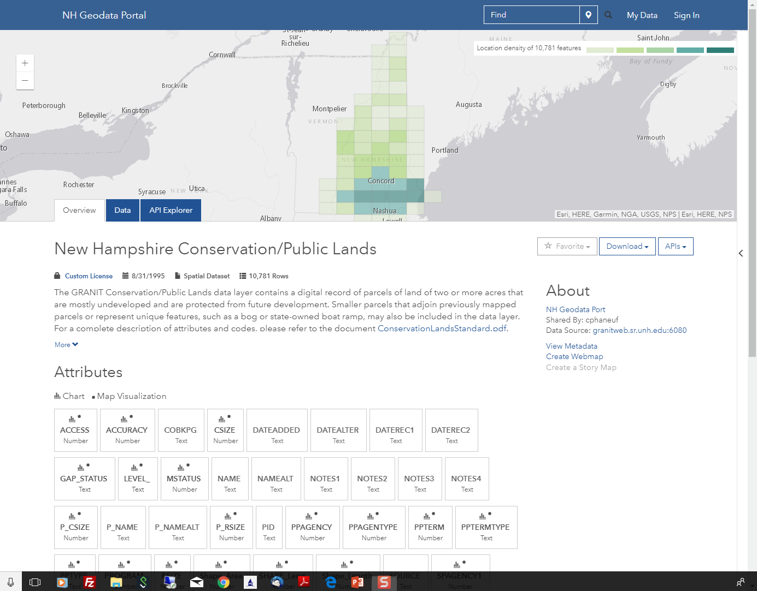
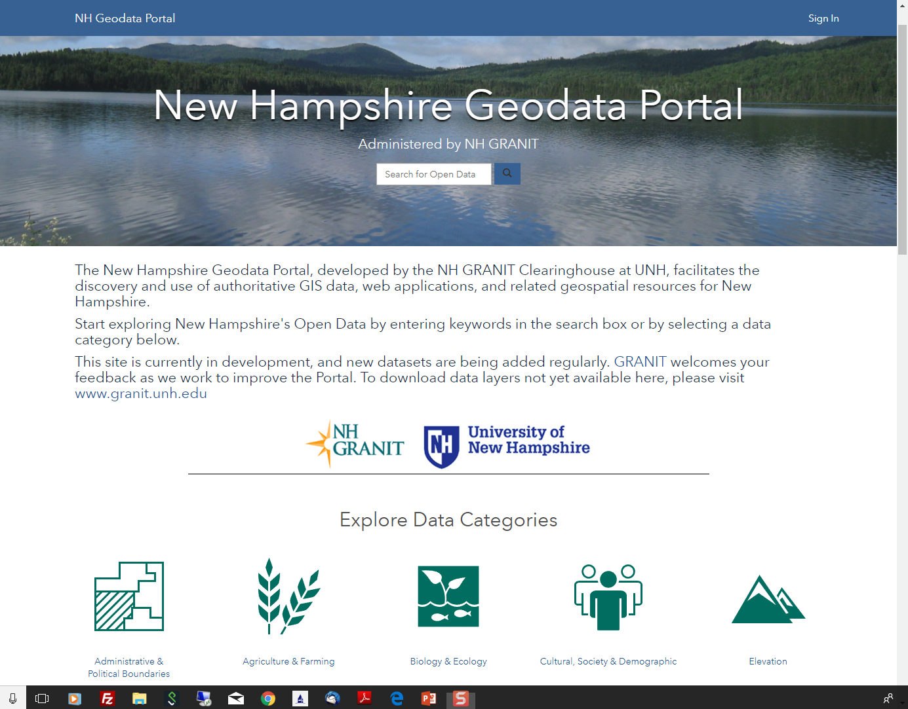
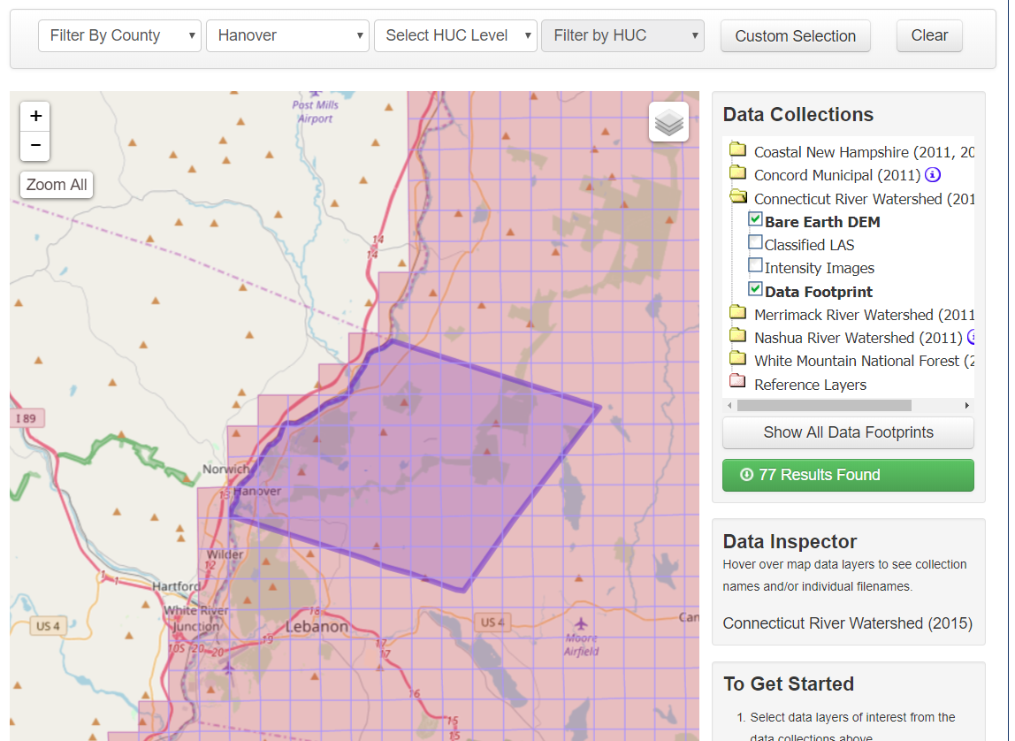
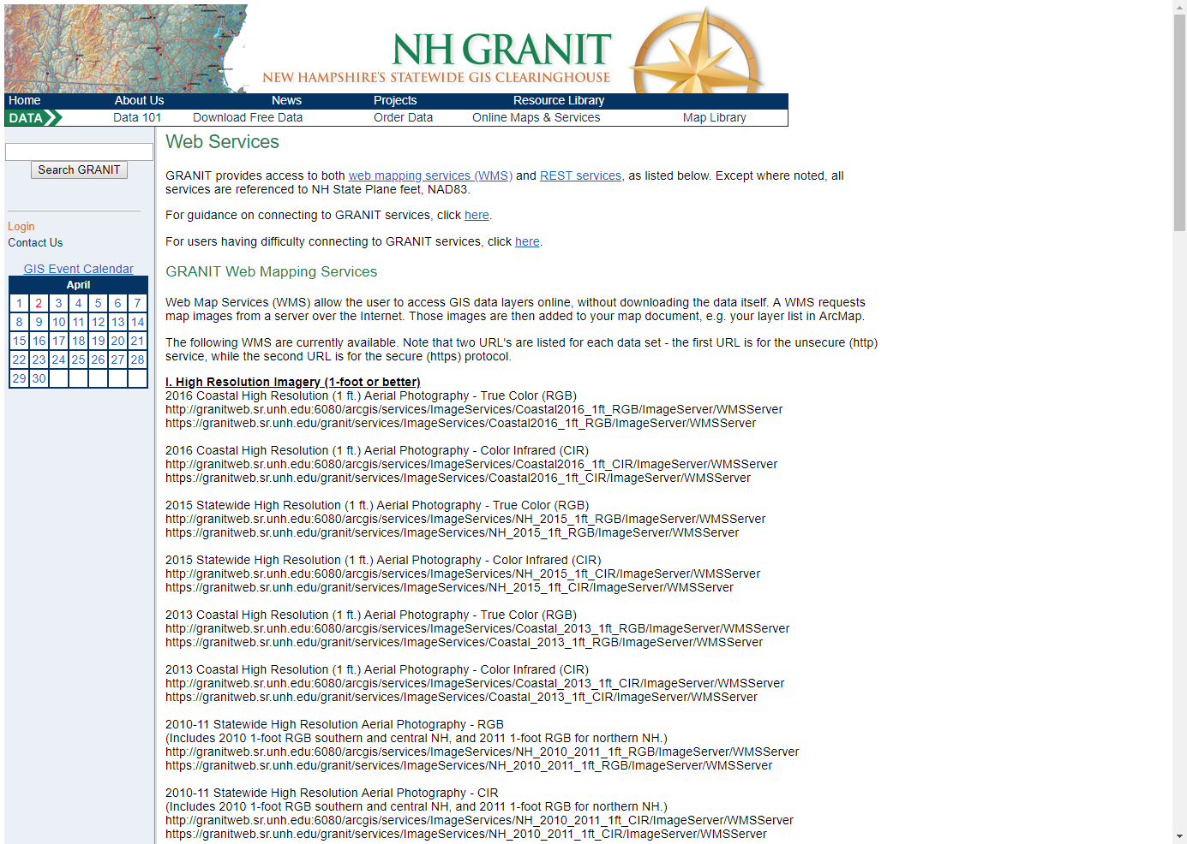
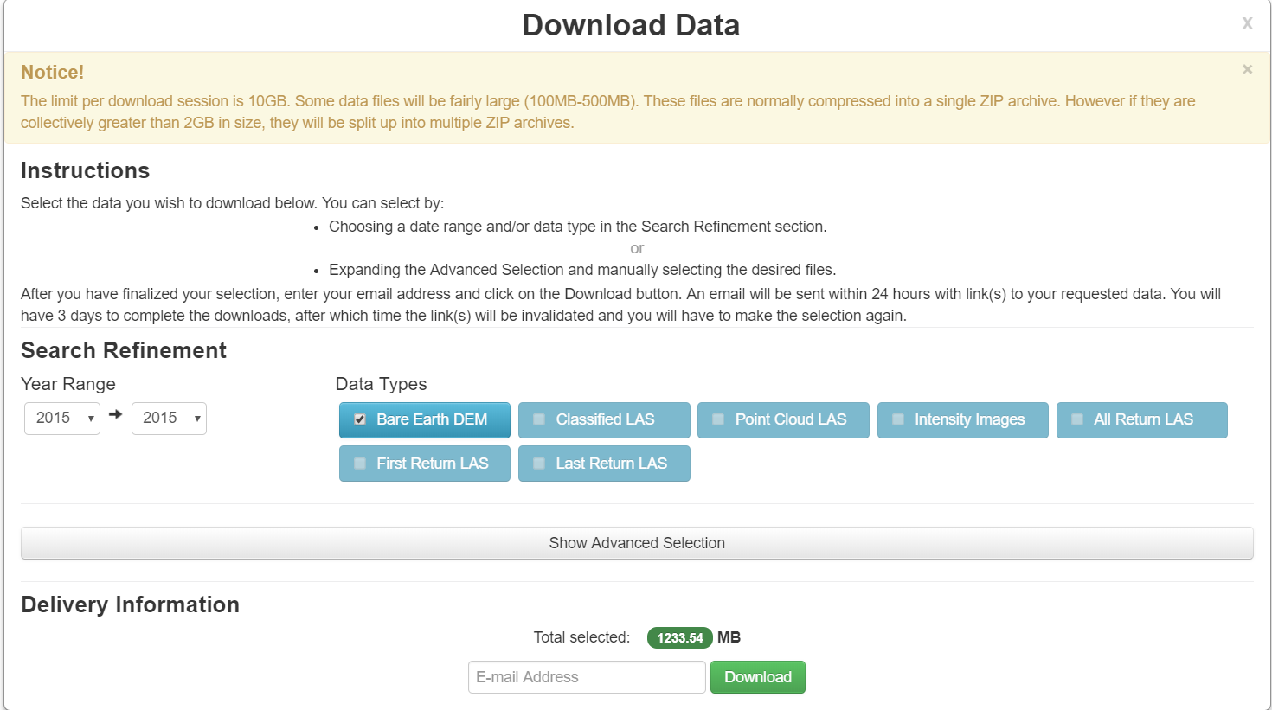
New Ways to Access GRANIT Data
http://lidar.unh.edu
http://granit.unh.edu
14 services for high resolution imagery -
standard and secure https connections
NHLSA Annual Meeting
December 4, 2015
April 4, 2018
Notes:
Portal – shows footprint of data availability; density of features, previews attributes; access to metadata; can create webmap directly from data service, can download

Slide 9
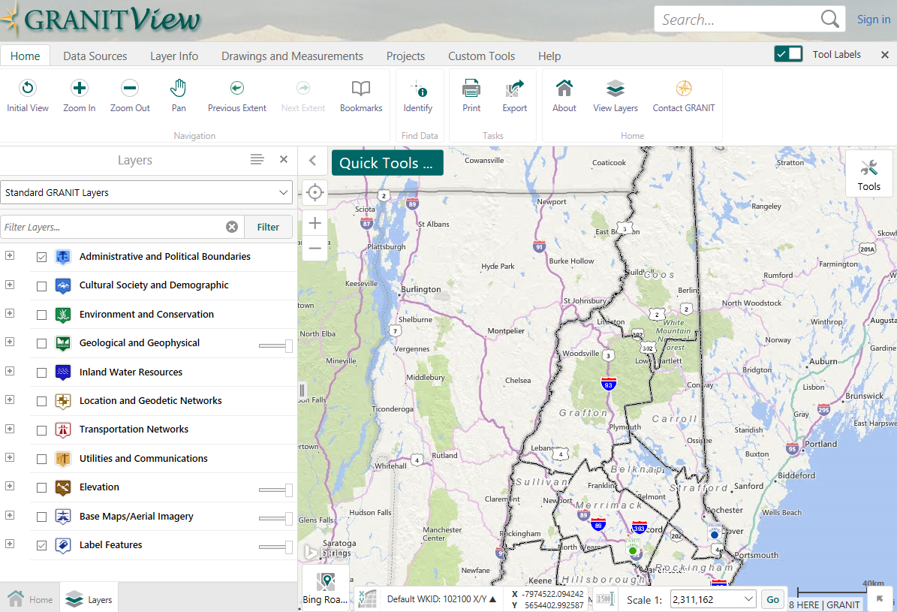
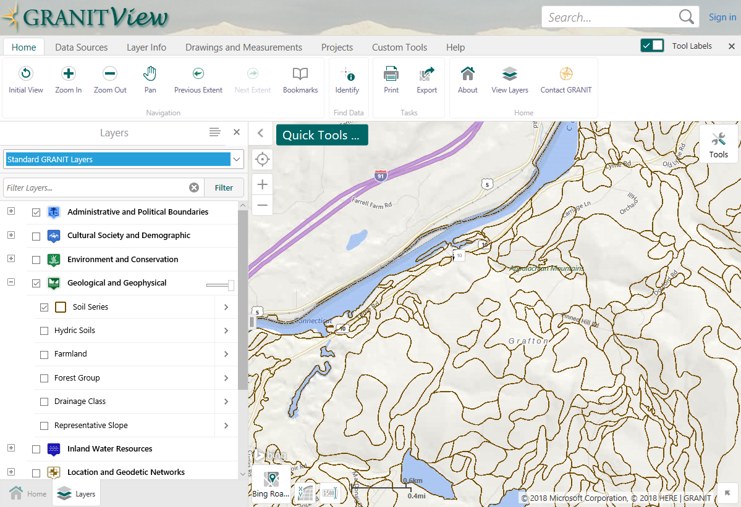
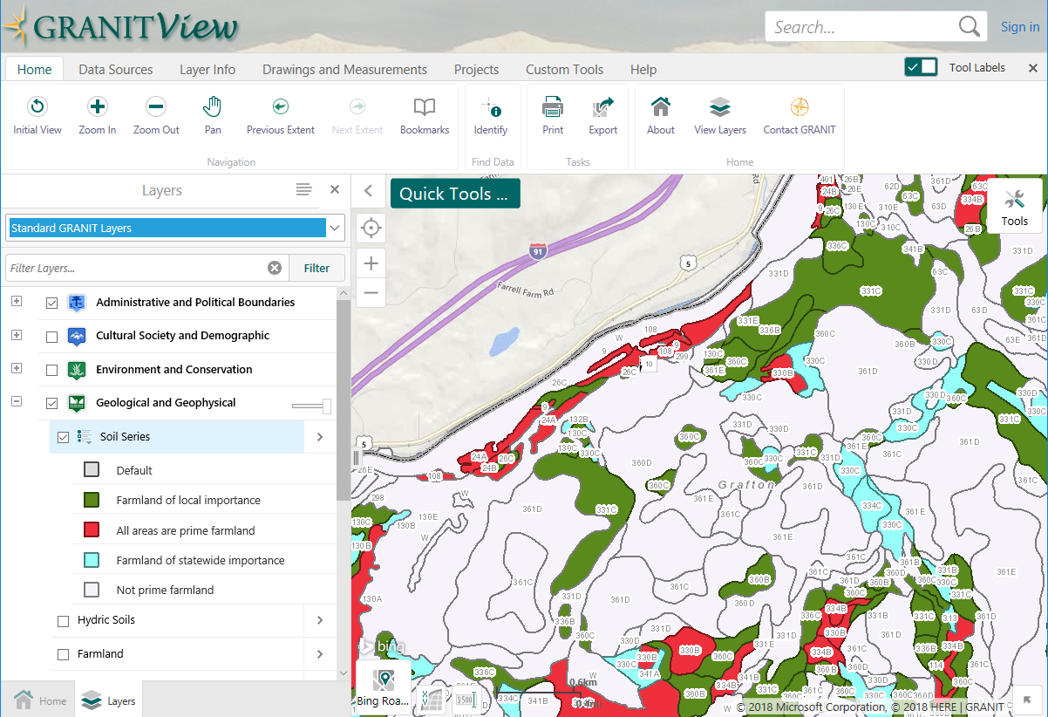
New Applications: GRANITView
http://granitview.unh.edu
NHLSA Annual Meeting
December 4, 2015
April 4, 2018
Notes:
GRANITView – Not really new, but keep expanding it and adding capability. Start out with default display of soils, use custom symbolization and labeling tools to produce second image

Slide 10
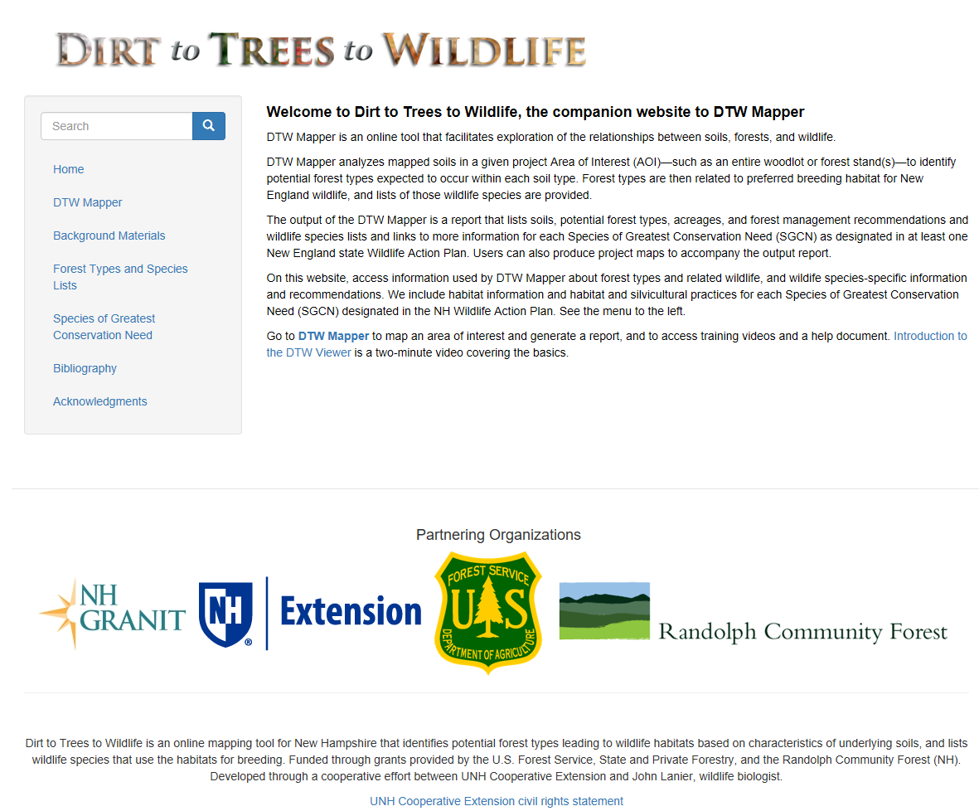
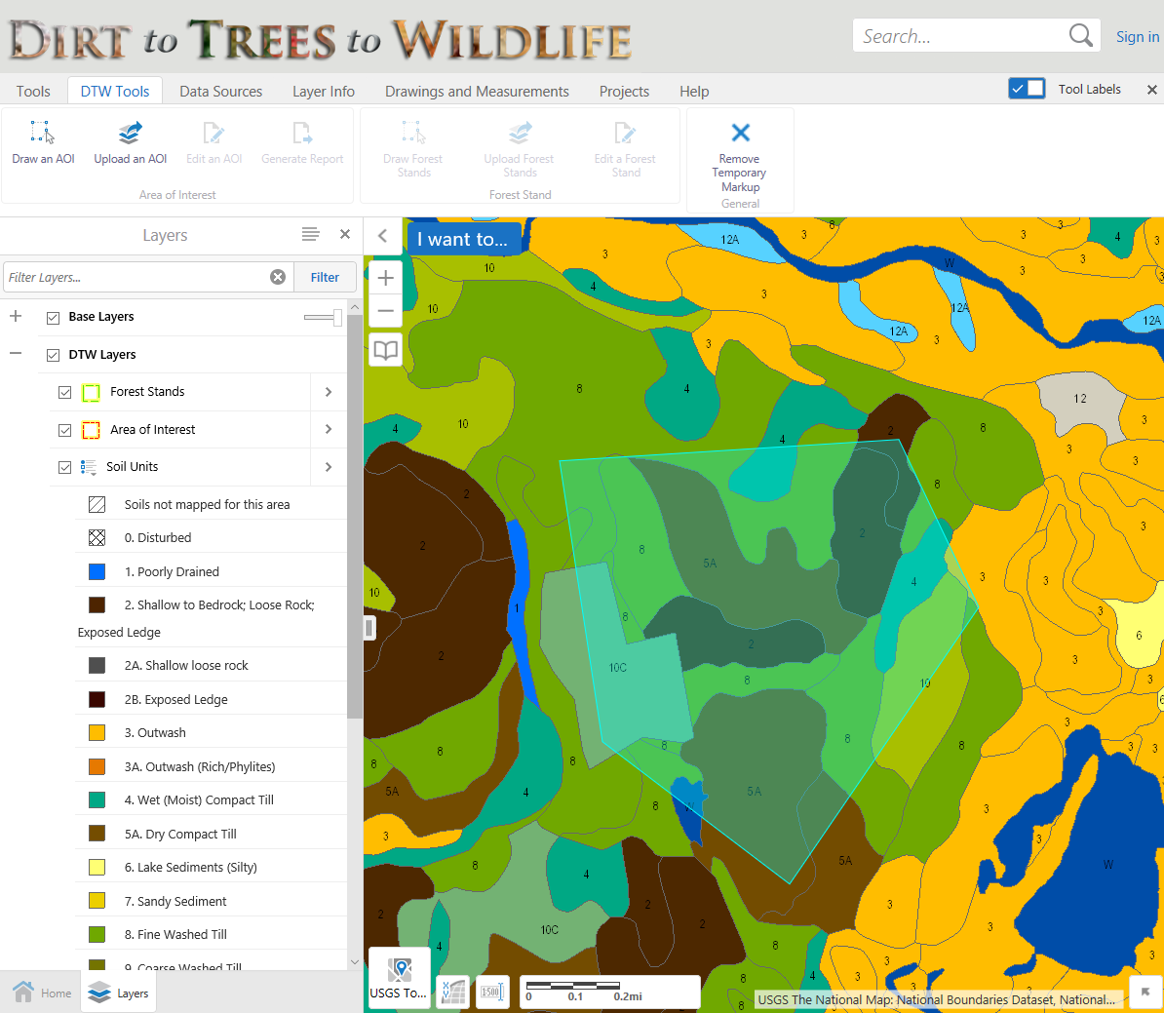
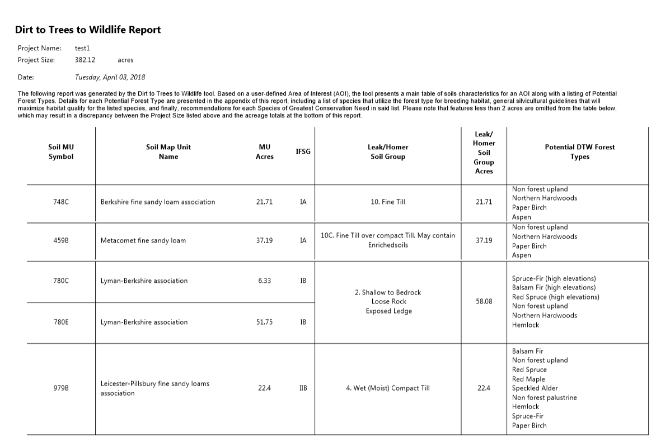
New Applications: Dirt to Trees to Wildlife
https://dirttreeswildlife.org
NHLSA Annual Meeting
December 4, 2015
April 4, 2018
Notes:
Created with partners from UNHCE, and with funding from USFS and Town of Randolph.
Online tool that links a) soils within an area of interest to the forest cover types those soils can support; b) then to the preferred breeding habitats associated with those forest types; and c) then to individual species of wildlife supported by those wildlife habitats.
Soils mapped based on Homer Leak classification. Per Joe Homer – In NH, there are approximately 190 soil series mapped. Soils were aggregated into 20 or so of Bill Leak’s Forest Habitat groups based on common physical properties (primarily parent material, dominant soil texture, drainage class, and depth to bedrock).
Can use to create report.

Slide 11
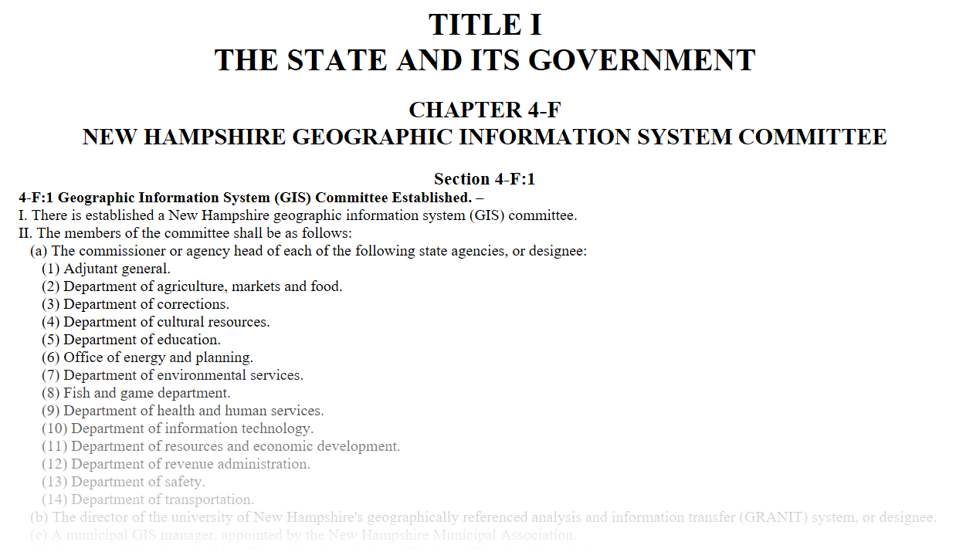
GIS Coordination in NH: GIS Advisory Committee
The committee shall review the use, development, and coordination of geospatial data and resources …
NHLSA Annual Meeting
December 4, 2015
April 4, 2018
Notes:
Don’t want to represent this as a GRANIT activity specifically, but think it’s important that everyone know about this relatively new committee.
HB 377 passed last legislative session. Resulted in RSA 4-F:1 – establishing a GIS Advisory Committee. Some of you may know that we have had a GIS Advisory Committee meeting since the 1980’s. That committee, which was more technical in nature, has been renamed the GIS Technical Advisory Committee. And this new group, which is charged with strategic planning and coordination for GIS in NH, has been formed and has met twice. Statute requires that the Committee, whose members include state agency commissioners, an RPC rep, a municipal rep, the GRANIT Director, report to the legislature each November.
Progress to date – agreement on a set of guiding principles. These principles relate to establishing data standards, data coordination and sharing, sharing applications, and engaging with more stakeholders.

Slide 12
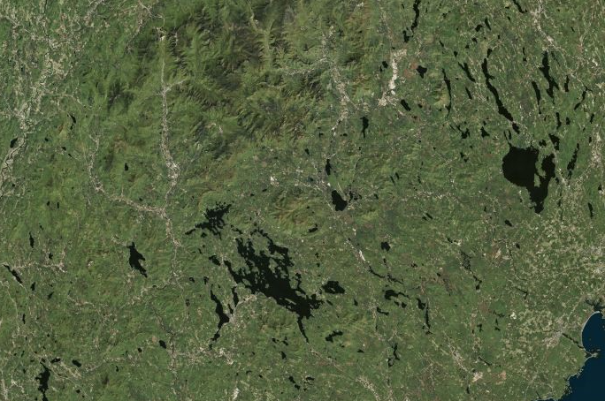
GIS Coordination in NH: Imagery Needs Assessment
Goal: Develop plan for regular acquisition of statewide base map imagery
Project Components:
Conduct 2-3 user input sessions
How do you presently use high resolution imagery?
What resolution do you need to support these and future applications?
What acquisition cycle do you need?
Leaf on? Leaf off?
...
Host/distribute on-line questionnaire
Generate imagery specifications
Research imagery vendor options
Develop funding allocation model
Finalize plan
April 4, 2018

Slide 13
Thank you …
Contact Info:
Fay Rubin
Earth Systems Research Center
University of New Hampshire
fay.rubin@unh.edu
NHLSA Annual Meeting
December 4, 2015
April 4, 2018

