Slide 1
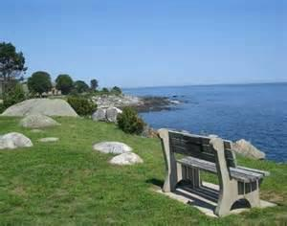
Municipal Board Empowerment Series Workshop #4 NH Coastal Viewer 101 for Land Conservation September 6, 2017 University of New Hampshire Pettee Hall
March 2, 2015
Notes:
Barbara

Slide 2
Introductions
Presenters:
New Hampshire Coastal Program
Kirsten Howard, Coastal Resilience Specialist
GRANIT, University of New Hampshire
Fay Rubin, Project Director
David Justice, Senior GIS Analyst
Partners:
NH Association of Conservation Commissions
Barbara Richter, Executive Director
Piscataqua Region Estuaries Partnership
Abigail Lyon, Technical Assistance Program Manager
The Nature Conservancy
Peter Steckler, GIS & Conservation Project Manager
Great Bay National Estuarine Research Reserve
Steve Miller, Coastal Training Program Coordinator
NH Coastal Viewer
Notes:
Kirsten

Slide 3
Welcome
Objectives:
Learn how to access the NH Coastal Viewer
Become familiar with the NH Coastal Viewer features and datasets
Be able to produce basic maps focused on community conservation priorities
Agenda:
6:00 pm Light Refreshments/Networking
6:30 pm Welcome and Introduction – Kirsten
6:45 pm NH Coastal Viewer Basics - Fay
7:00 pm Hands-on Training on Computers
7:55 pm Wrap-up
8:00 pm Adjourn
NH Coastal Viewer
Notes:
Kirsten

Slide 4
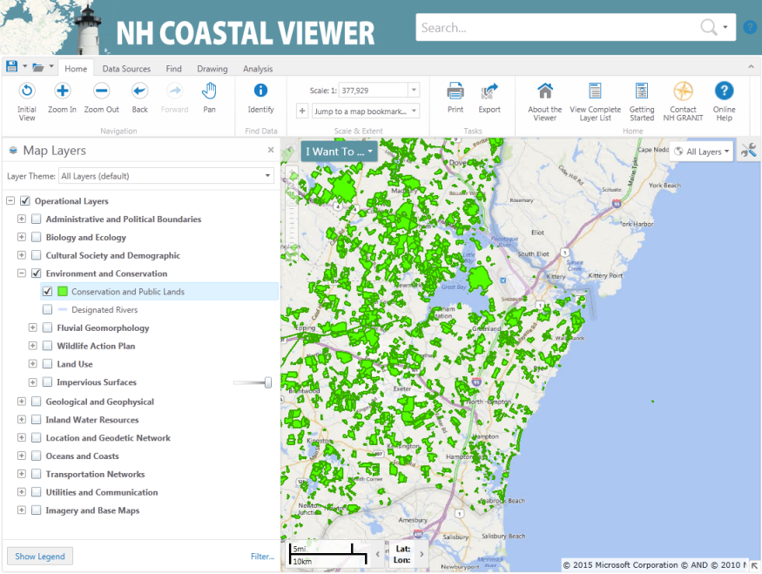
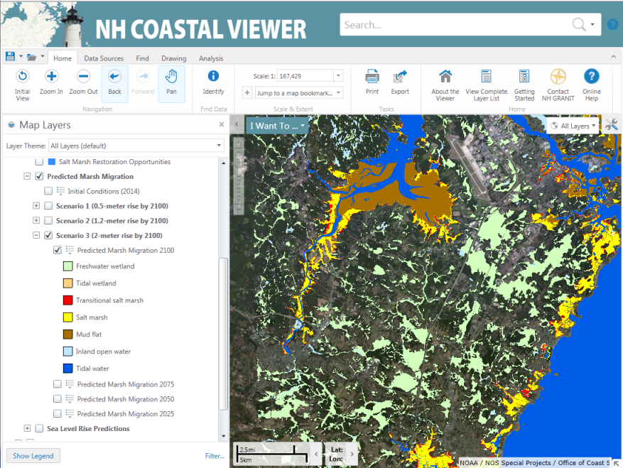
NH Coastal Viewer Overview
What it is:
A web-based mapping tool that brings spatial data about coastal community assets, natural resources, and hazards within New Hampshire’s coastal watershed communities together in one place.
explore data sets
display and analyze the data sets in multiple ways
create, print, and share custom maps
Who it’s for:
Municipal and state agency staff, volunteers, consultants, business owners, state agency staff, researchers, residents, community members, and the public
Developed by:
NH GRANIT/University of New Hampshire
NH Coastal Viewer
Notes:
Kirsten
Only requirement – computer with web browser, preferably Chrome

Slide 5
Using the NH Coastal Viewer to
Prioritize Land Conservation
Land Conservation Priorities for the Protection of Coastal Water Resources
A supplement to the Land Conservation Plan for New Hampshire’s Coastal Watersheds
Published 2016 by The Nature Conservancy
Flood Storage and Risk Mitigation
Public Water Supply
Pollutant Attenuation
https://extension.unh.edu/resources/files/Resource006517_Rep9334.pdf
NH Coastal Viewer
Notes:
How many on Cons Comm? Work in land conservation?
Lots of datasets on the Coastal Viewer that could conceivably help you answer some question about protecting land.
Our best advice is that you play around with the Viewer, get to know the datasets, and come up with some combination that makes sense for you.
Conservation Lands dataset, etc.
That said, The Nature Conservancy processed some data in 2016 that we’re really excited about. Pete is here to answer any technical questions you have about the data development. Fay and I are going to show you some ways to use it.

Slide 6
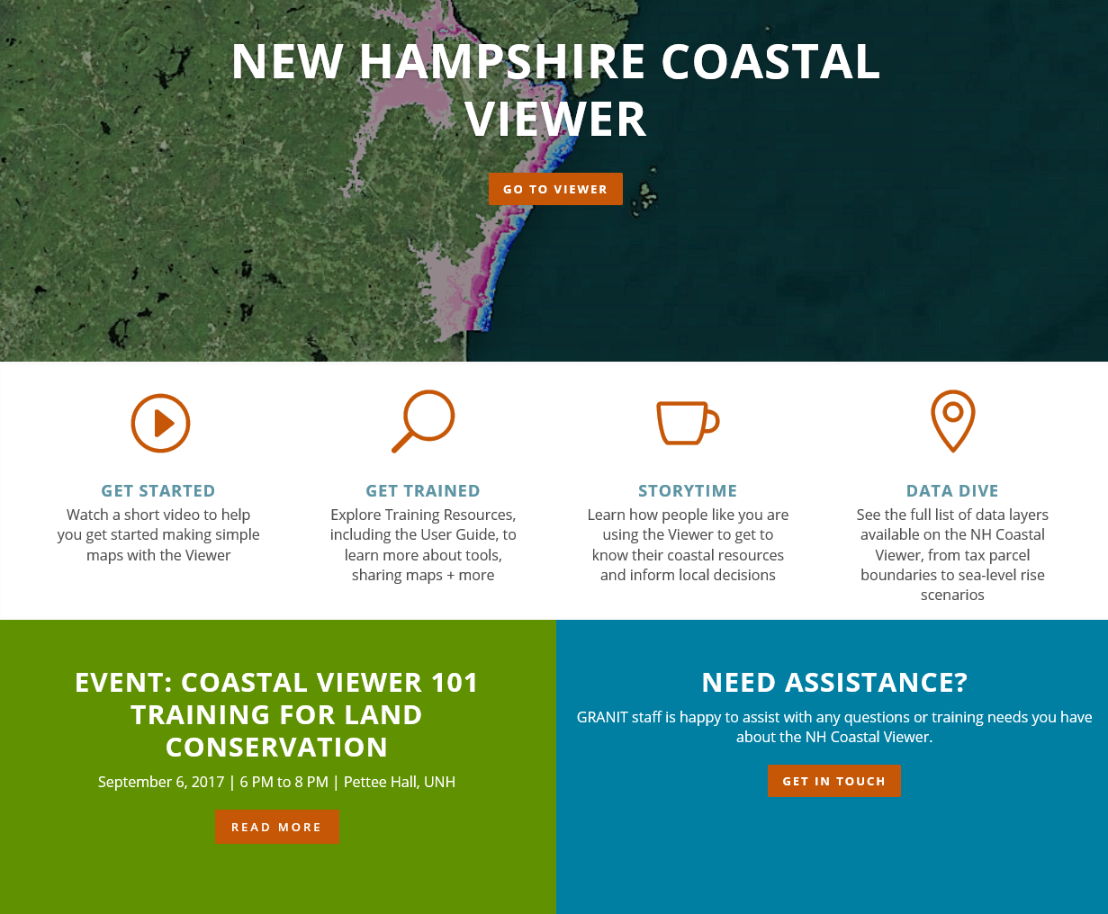
Landing Page – www.nhcoastalviewer.org
NH Coastal Viewer
Notes:
Kirsten

Slide 7
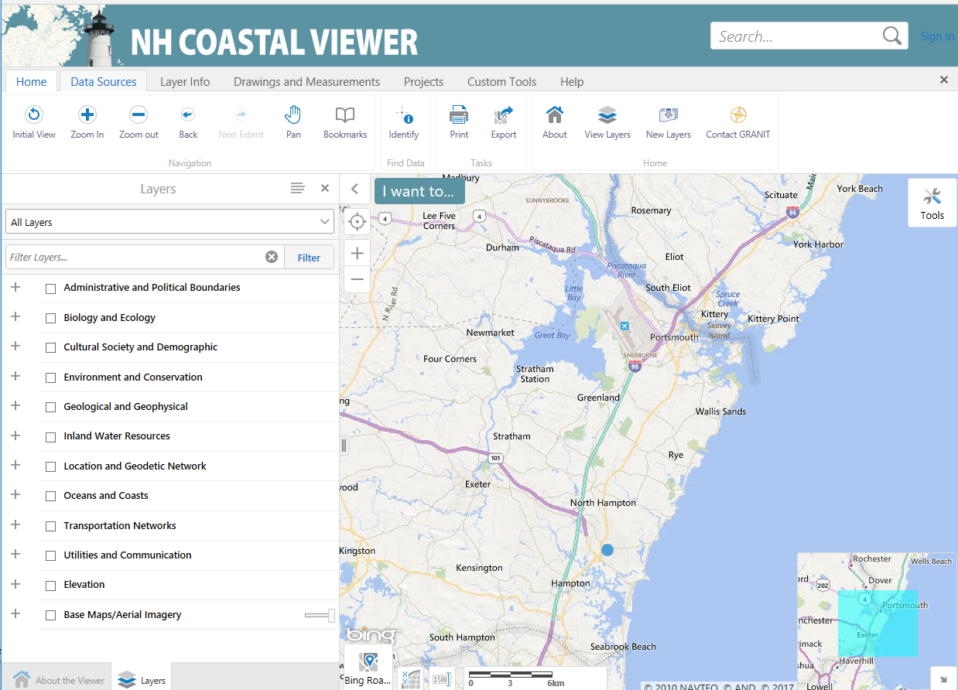
User Interface
Toolbar
Toolbar Tabs
Main Map Area
Table of Contents
Base Map; Cursor Location;
Nominal Scale
Overview Map
Map Scale Bar
NH Coastal Viewer
Notes:
Fay

Slide 8
Dataset Listing (partial)
Town and political boundaries
Community anchor institutions (police, fire stations, schools, hospitals, etc.)
Roads
National Wetlands Inventory
Conservation lands
Land use (2015, 2010 and historical)
Impervious surfaces
Sea-level rise scenarios
Freshwater culvert analysis
Fluvial erosion hazard zones
Predicted salt marsh migration under sea-level rise
Outfalls
Dams
Eelgrass (current and historical)
Shellfish beds and open/closed harvest areas
Oyster aquaculture
Access sites to public water
Census Block population (2010)
Orthophotography (aerial imagery)
LiDAR derivatives
NH Coastal Viewer

Slide 9
Basic Concepts/Tools
Map layers organized in the table of contents in expandable folders
Display map layers by checking the adjacent box
Tools to interact with the data organized in tabs at the top
Additional tools in Quick Tools dropdown
Multiple base map options
Themes used to focus on issues or on user groups
NH Coastal Viewer

Slide 10
EXERCISES
Explore the NH Coastal Viewer
Drinking Water and Land Conservation
Tools for Assessing Land Conservation in NH
NH Coastal Viewer

Slide 11
Wrap-up
Contact Information: Kirsten Howard
Coastal Resilience Specialist
New Hampshire Coastal Program
kirsten.howard@des.nh.gov
603-559-0020
Fay Rubin
GRANIT Project Director
Earth Systems Research Center, UNH
fay.rubin@unh.edu
603-862-4240
NH Coastal Viewer

Slide 12
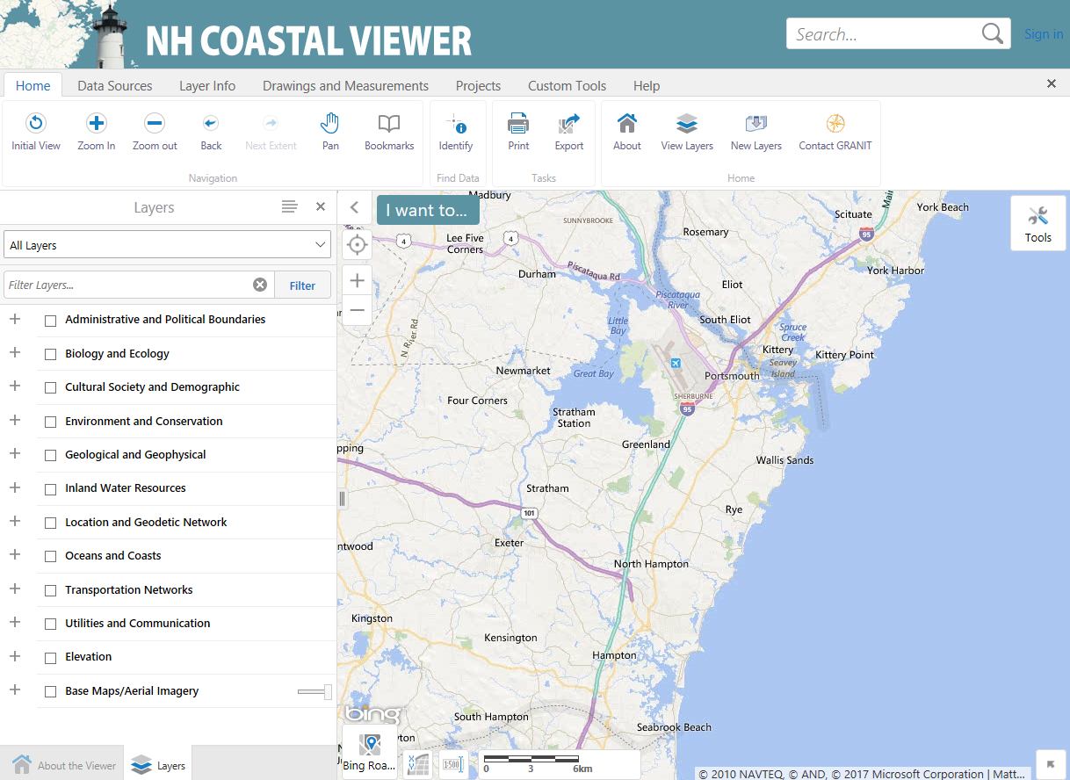

Slide 13
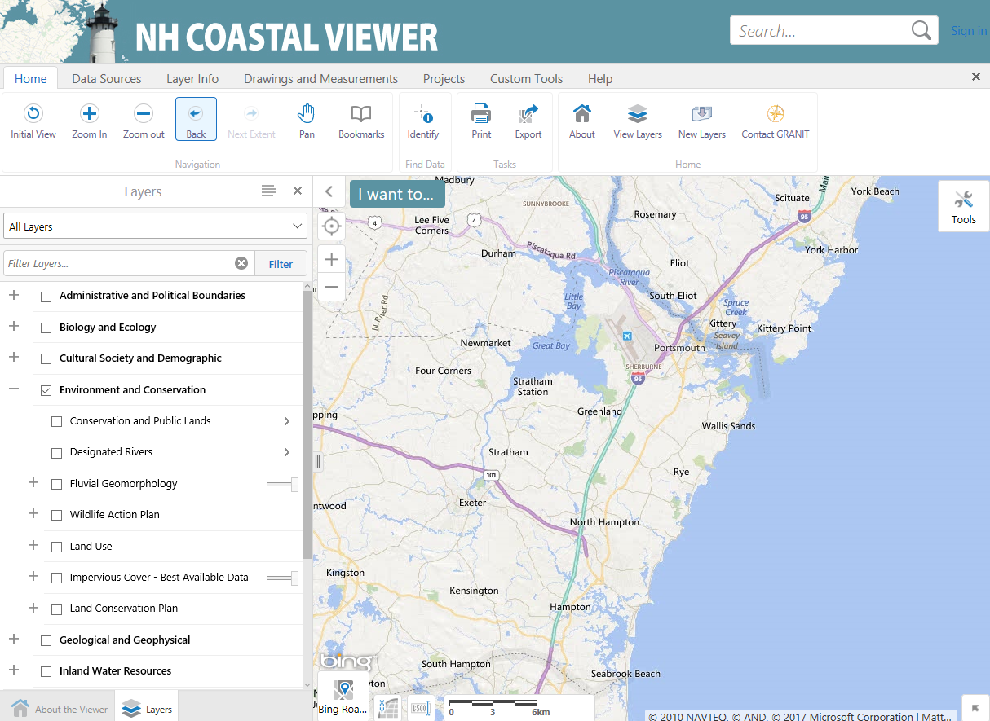

Slide 14
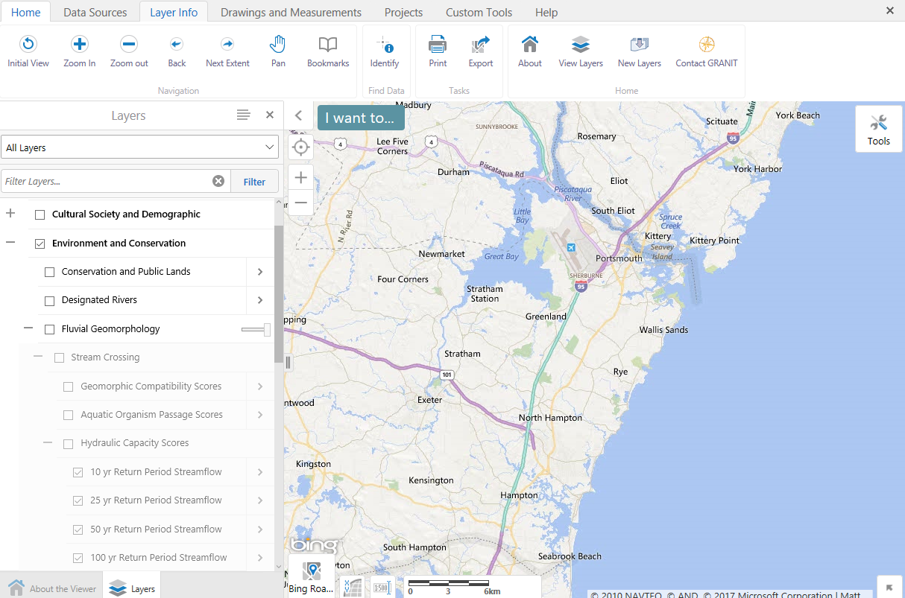

Slide 15
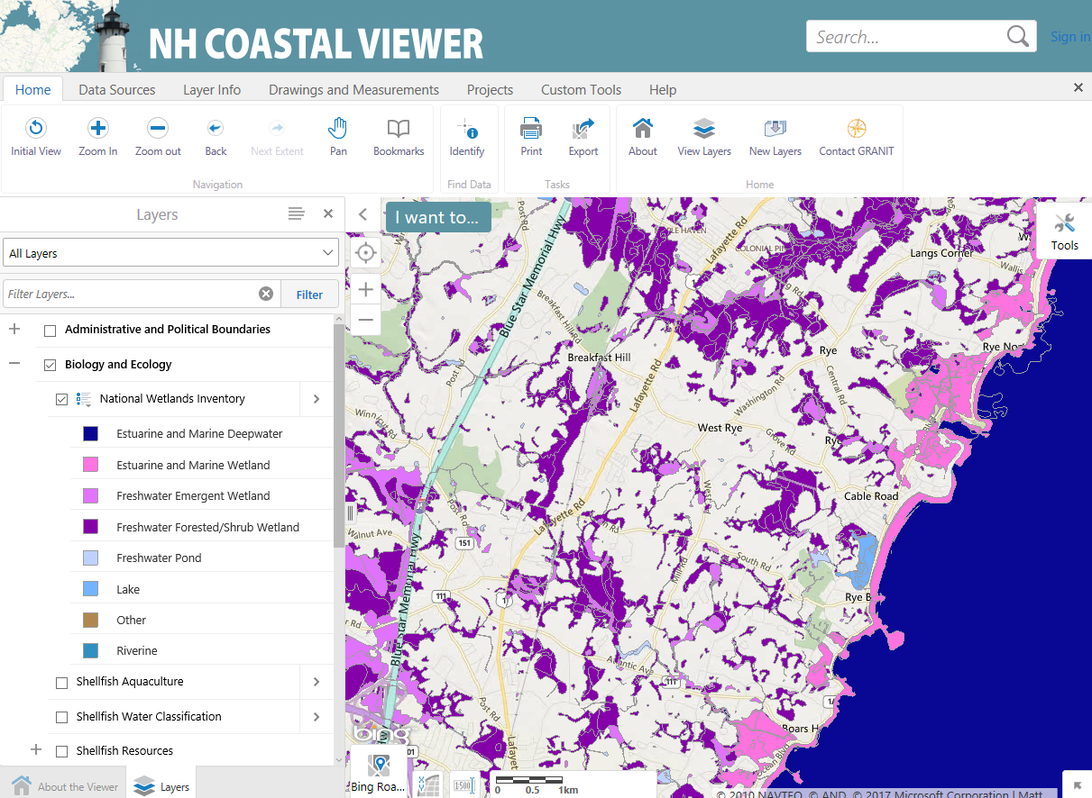

Slide 16
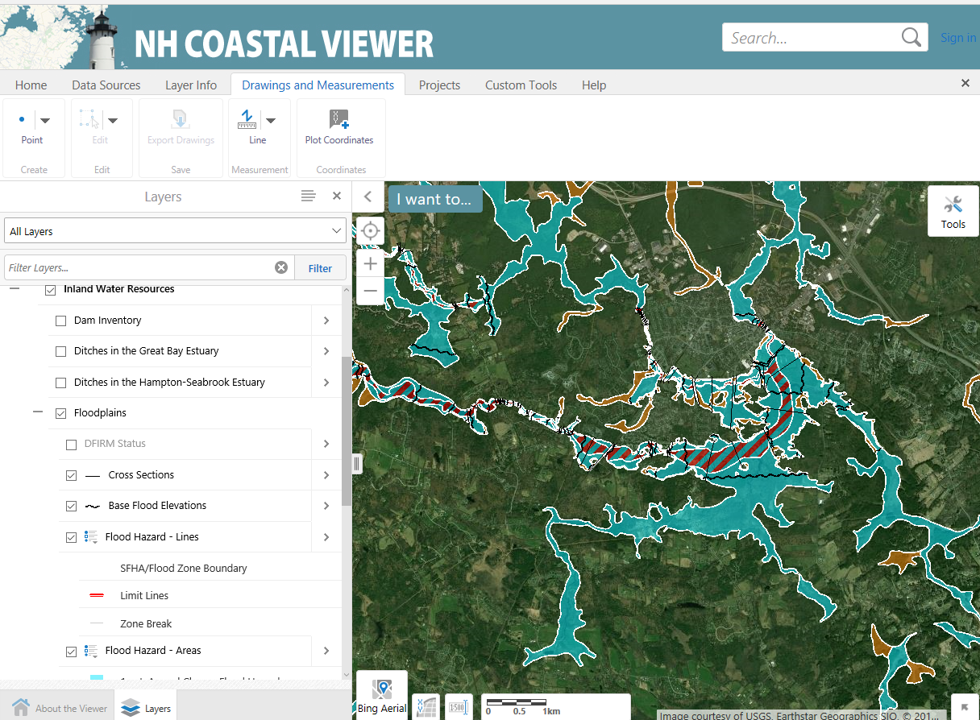

Slide 17
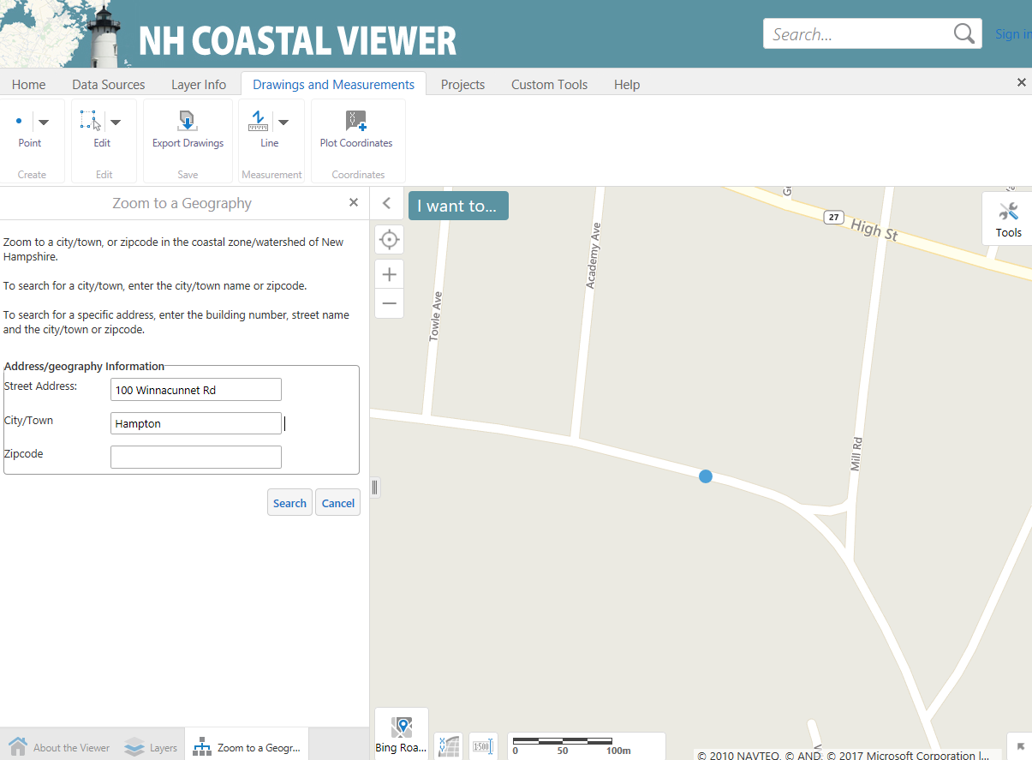
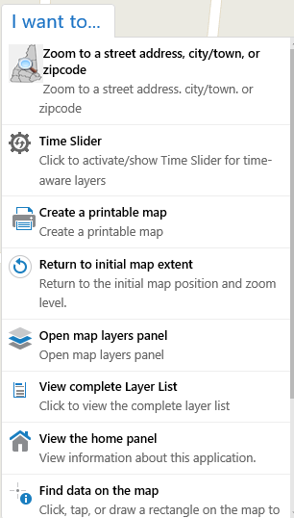

Slide 18
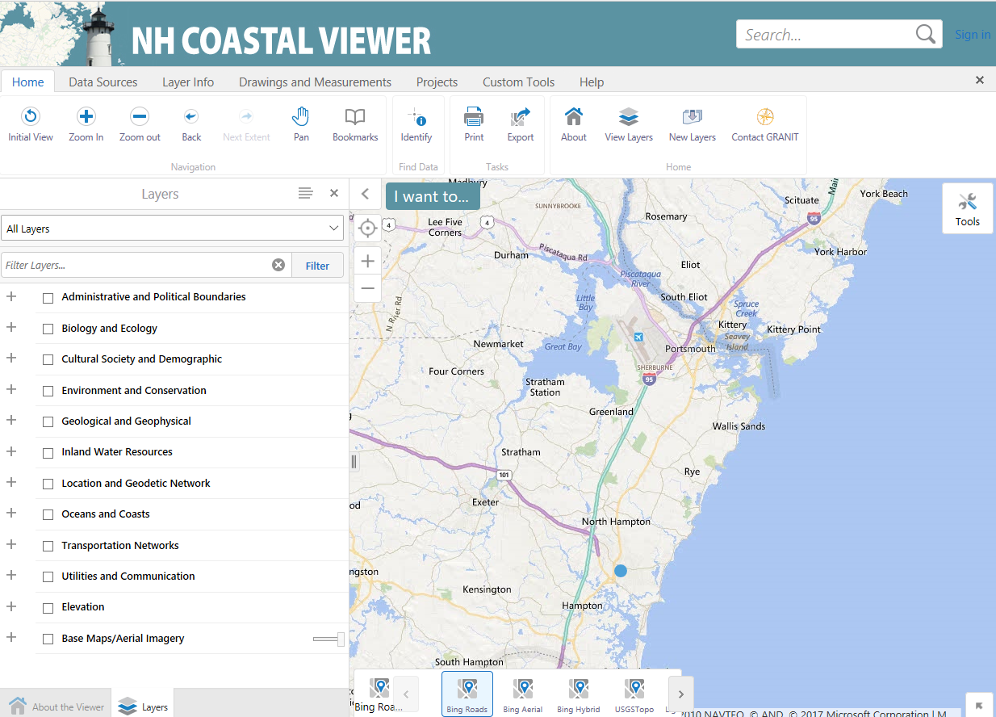

Slide 19
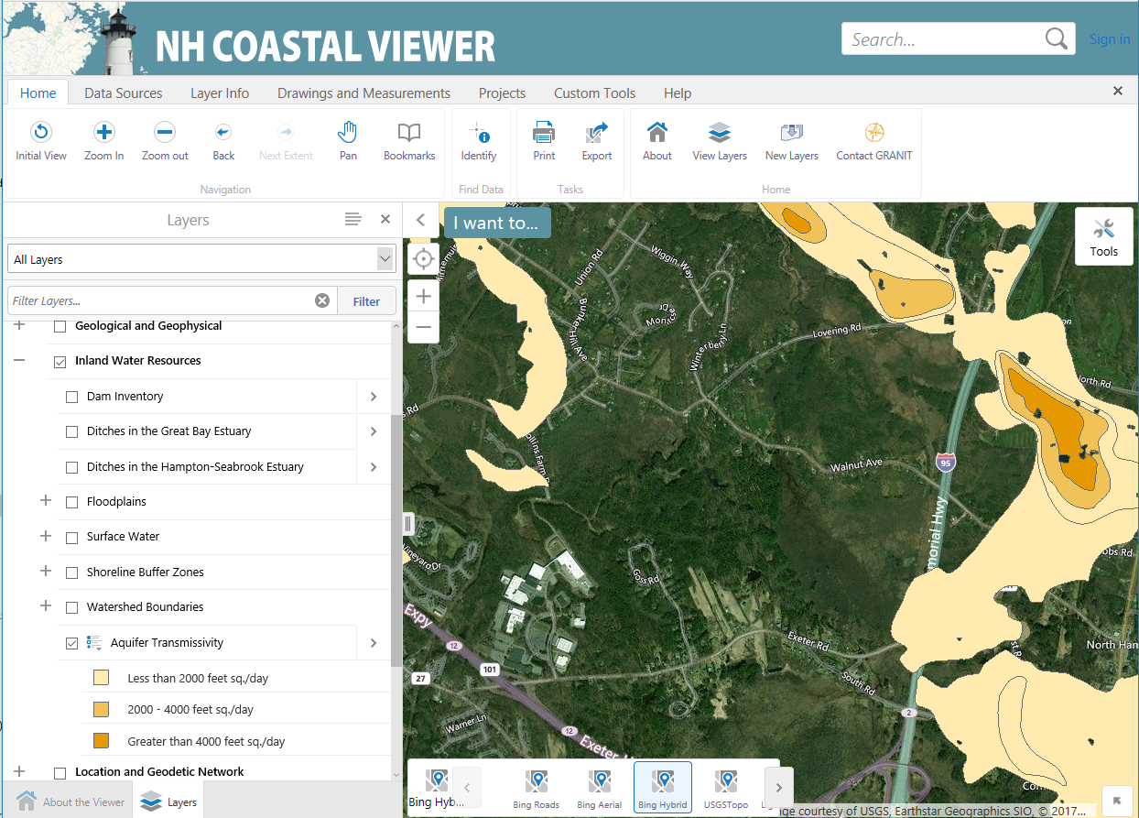

Slide 20
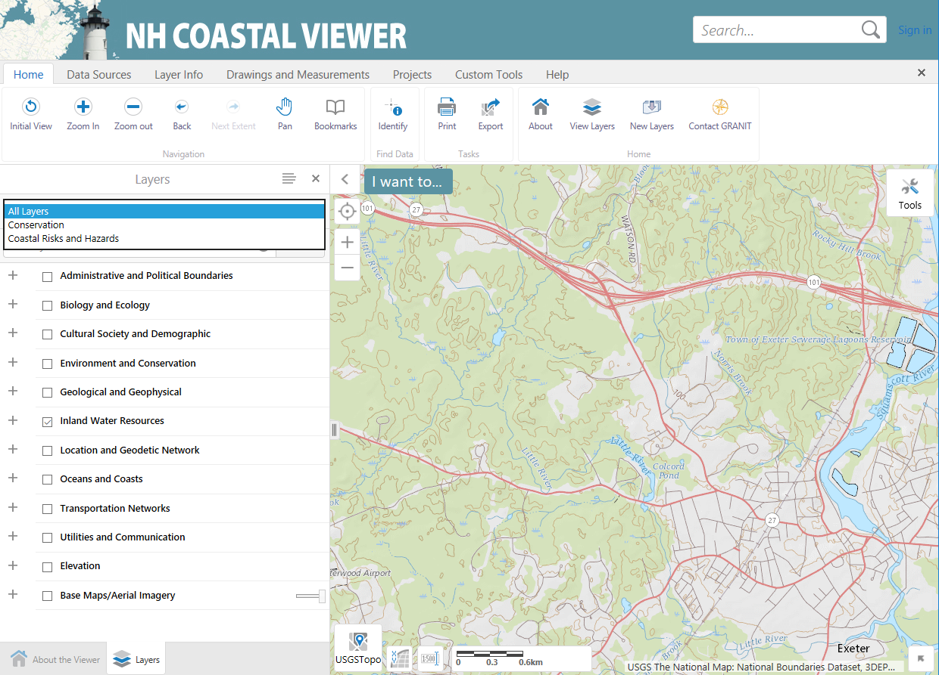

Slide 21
