Slide 1
PENNSYLVANIA HIGHLANDS REGIONAL STUDY WATER RESOURCES ASSESSMENT Curtis L. Schreffler, Acting Associate Director Edward H. Koerkle, Hydrologist Tammy M. Zimmerman, Hydrologist U.S. Geological Survey, New Cumberland, Pennsylvania

Slide 2
Water Resources Assessment
Groundwater
Aquifer Types
Water-use
Water Quality
Surface Water
Drainage
Water-use
Reservoirs
Water Quality
Water Budget
Regional Mass Balance
Watershed model

Slide 3
Ground Water – Aquifer Types
Carbonate (Limestones and Dolomites)
Clastic (Sandstones, Silstones and Shales)
Crystalline (Quartzites, Gneiss, and Diabase)

Slide 4
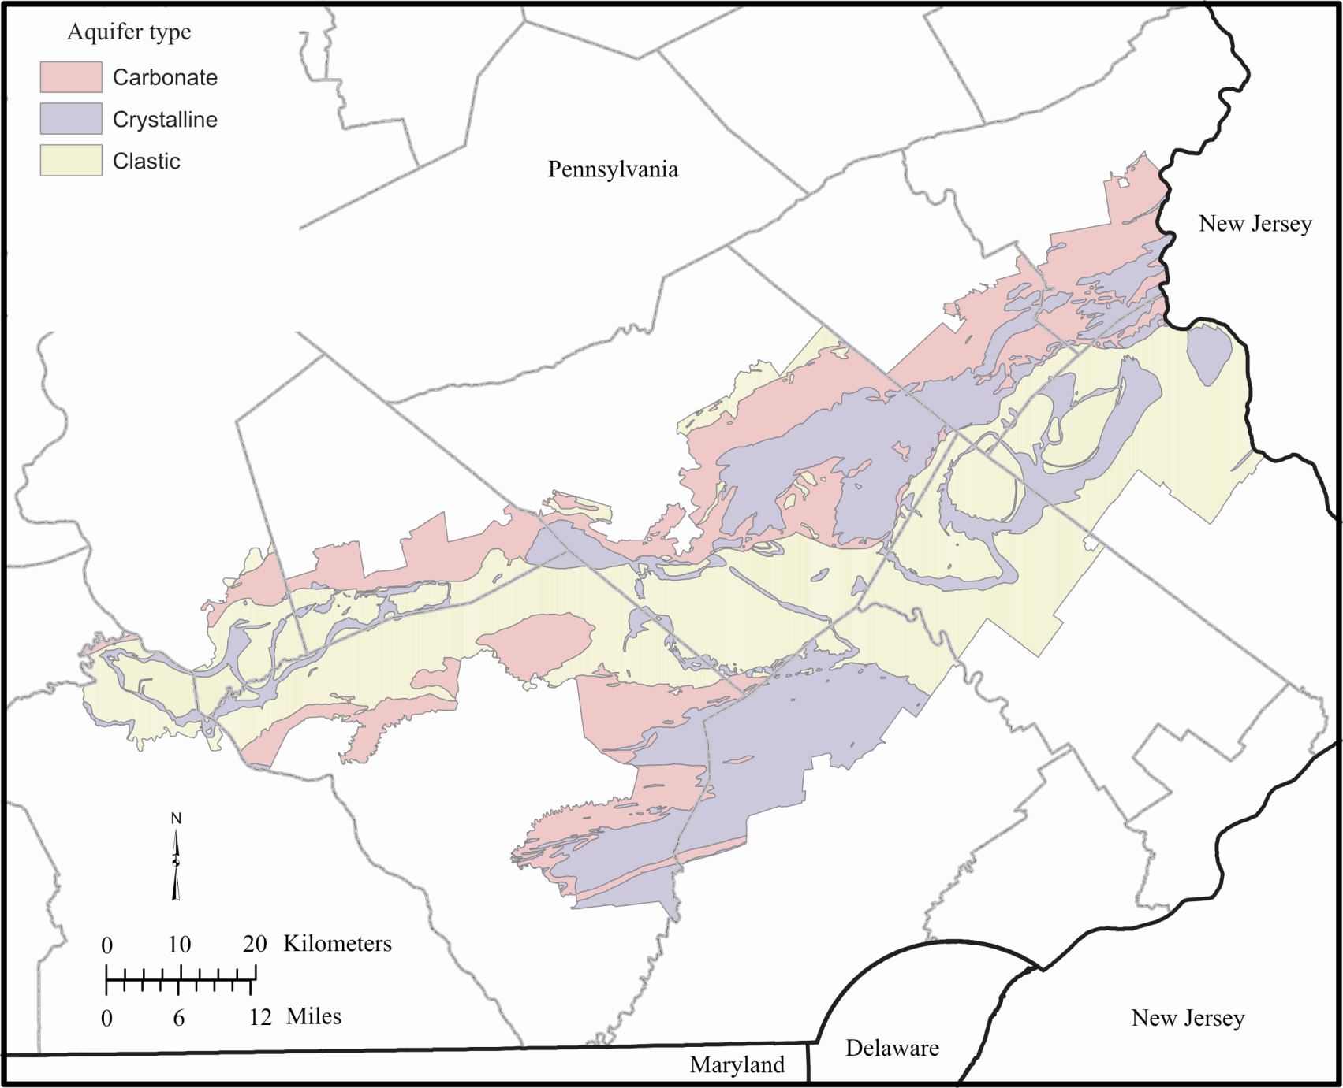
Aquifer types

Slide 5
Ground Water – Water Use
Non-domestic Ground-water Use
Total Withdraws in 2000 were 81 Mgal/d
51 Mgal/d from Carbonate Aquifers
30 Mgal/d from Crystalline and Clastic Aquifers
Estimated Domestic Ground-water Withdrawals
Estimated Total Withdraws in 2000 were 26 Mgal/d

Slide 6
Non-Domestic Groundwater use

Slide 7
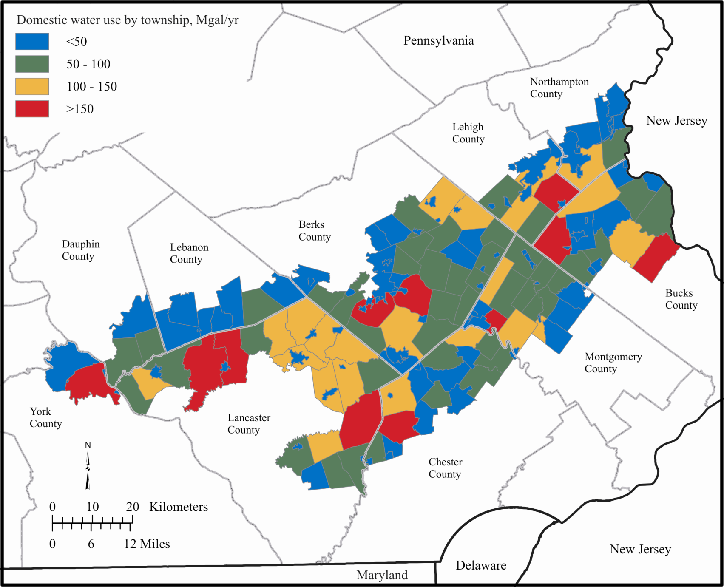
DOMESTIC WATER USE BY TOWNSHIP
Estimated Domestic Groundwater use

Slide 8
Ground Water – Quality
Nitrate
Present in nearly all samples
Concentrations below Drinking Water Standard
Pesticides
47 Analyzed – None above Drinking Water Standard
45% of samples had detectable Desethyl Atrazine which was the most common pesticide found
Upward Trends in Sodium and Chloride
Downward Trends in Nitrate and Sulfate

Slide 9
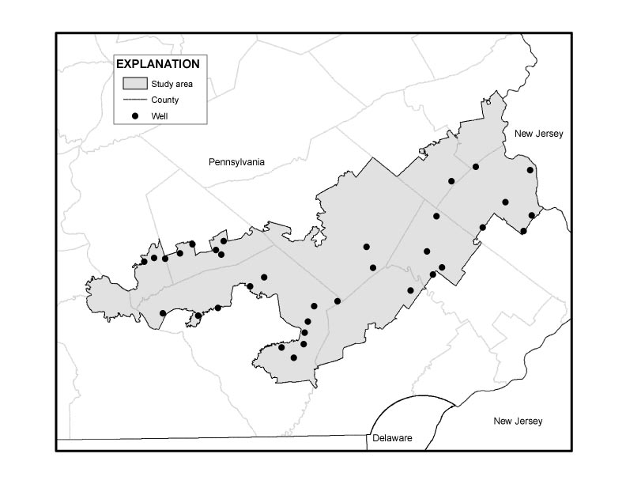
USGS
NAWQA
Well
Locations

Slide 10
Surface Water – Drainage
Delaware River Drainage – 65% Highlands Region
Susquehanna River Drainage – 35% Highlands Region

Slide 11
Surface Water – Water Use
Total Surface-water Withdrawals were 112 Mgal/d in 2000
Public-supply 48%
Thermoelectric 48%
Use by Category
Public Supply – 54.2 Mgal/d
ThermoElectric Generation – 53.4 Mgal/d
Industrial – 3.6 Mgal/d
Commercial – 0.8 Mgal/d
Mining – 0.1 Mgal/d

Slide 12
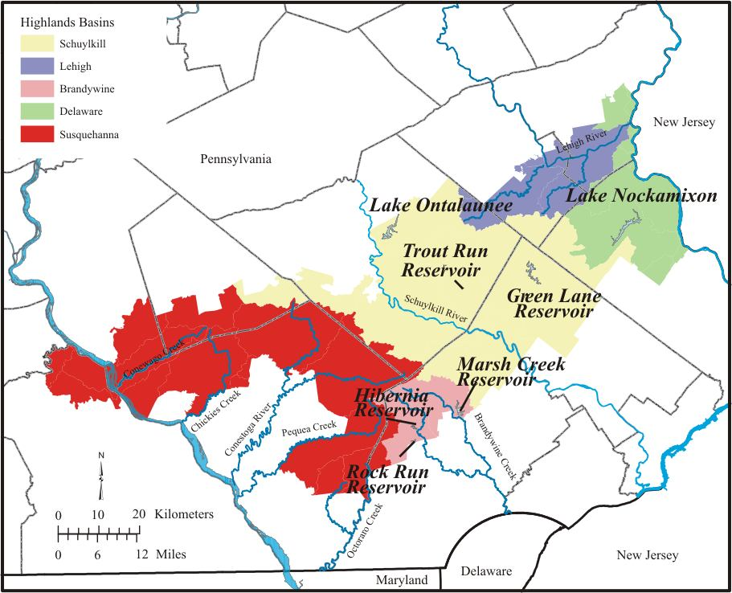
Total Storage in 7 Major Impoundments is 24 Billion Gallons

Slide 13
Surface Water – Quality
Overall stream water quality improving over the last decade
Sampling of macroinvertebrate communities in Highlands’ streams indicate comparatively healthy aquatic invertebrate populations. Sites in the Pennsylvania Highlands were among those assessed as nonimpacted with stable physical and chemical data during a17-year study period

Slide 14
Water Budget – Regional Mass Balance

Slide 15
Watershed Model
Build-out Scenarios increase runoff by 40% and decrease baseflow by 10% percent.
This implies, given similar climatic conditions, less water in streams during dry periods and higher peak flows during wet periods.
Based on the Low Constraint Build-out Scenario consumptive use of groundwater is estimated to remove an additional 11.9 million gallons per day from aquifers underlying the watersheds.

Slide 16
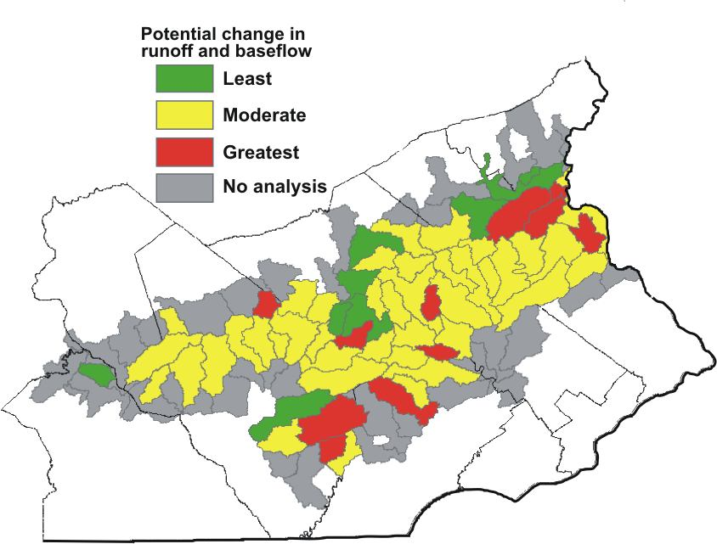

Slide 17
