Slide 1
NH Geographic Information System
(GIS) Committee
Established under HB377

Slide 2
HB 377 NH GIS Committee
Authorized under RSA 4-F
The committee shall:
Review – the use, development, and coordination of geospatial data & resources by state agencies and municipal governments.
Consider – the need for central coordination, storage, and distribution of such data & resources, and suggest appropriate responses
Advise – on GIS needs at public & semi-public agencies; identify avenues where legislation may further efficiencies through enhanced cooperation.
Notes:
HAM ?
GLENN?

Slide 3
GIS Technical Advisory Committee
Gap Analysis
Outputs:
Identify gaps in practice and organization between:
Guiding principles (future state) and
Where the state is now (current state).
Outcomes:
Inform the GIS Committee on policy recommendations to the legislature that:
Define future horizon 3-5 years.
Identify level of effort and resources.
Develop plan/matrix (based on working group of 4-5 people)
Define actions that promote the benefits of supporting GIS collaboration.
Notes:
HAM ?
GLENN?

Slide 4
Gap Analysis Working Group
Catherine Callahan, NH DOIT/NH Fish and Game Department
Glenn Davison, NH Department of Transportation
Ken Gallager, NH Office of Energy and Planning
Sean Goodwin, NH Department of Safety
Hamilton McLean, NH Department of Environmental Services
Fay Rubin, University of New Hampshire
Tim Scott, NH Department of Safety
Sara Siskavich, Nashua Regional Planning Commission
Notes:
HAM ?
GLENN?

Slide 5
STRATEGY #1
Develop and maintain NH statewide base map and derivative data products
Objectives –
Develop a statewide data acquisition plan for updates to base map
Recommend a formalized protocol for data collection and aggregation
Implement a common way to locate geospatial features of interest
Notes:
HAM ?
GLENN?
Strategy …that meet the operational needs of stakeholder agencies.
Develop a statewide data acquisition plan for updates of aerial imagery, LiDAR, and derivatives on a regular schedule tied to the biennial budget.
Recommend a formalized protocol for data collection and aggregation similar to successful statewide projects such as Statewide Asset Data Exchange Service (SADES) & T² Parcel Mosaic, that may be used by other agencies to maintain local-scale authoritative data.
Implement a common way to locate geospatial features of interest to a location on the earth e.g. US National Grid as a master index for enterprise level data sharing

Slide 6
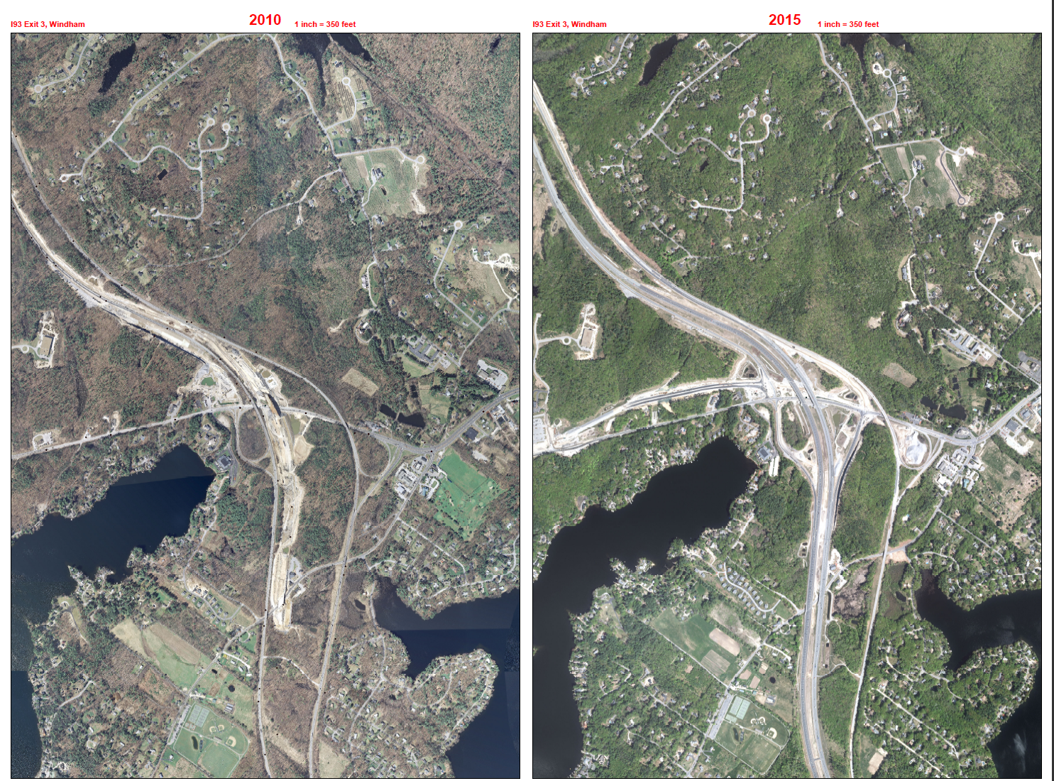

Slide 7
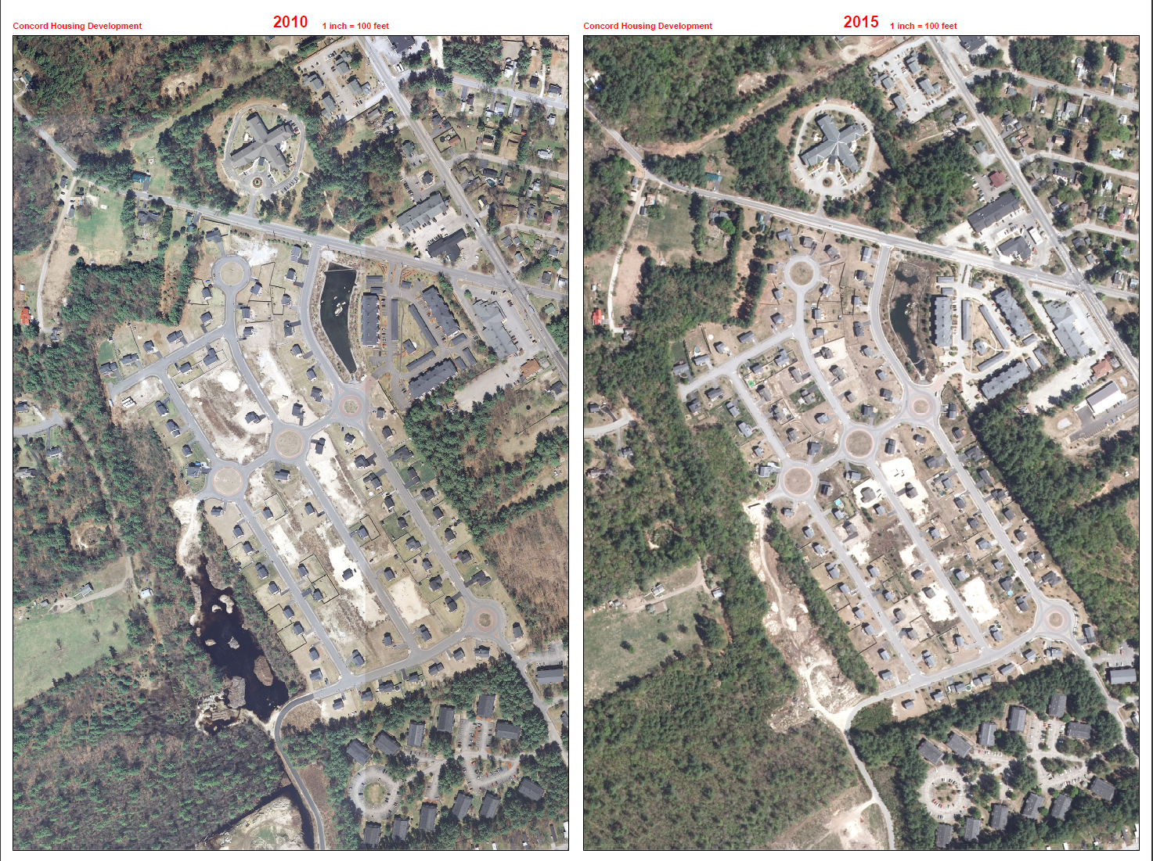

Slide 8
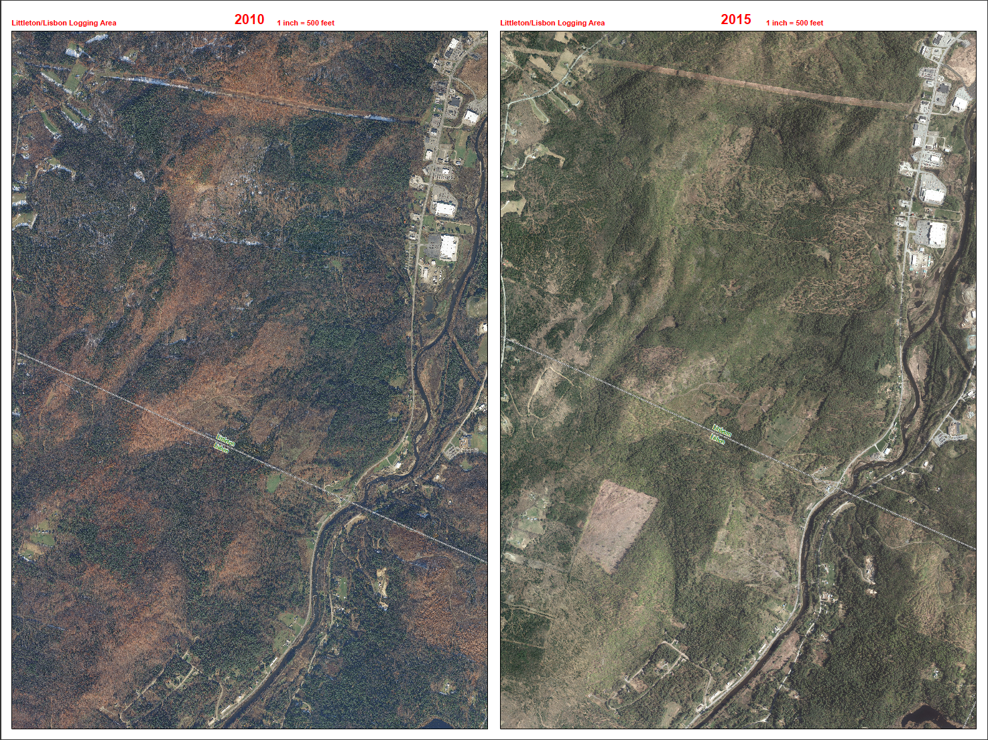

Slide 9
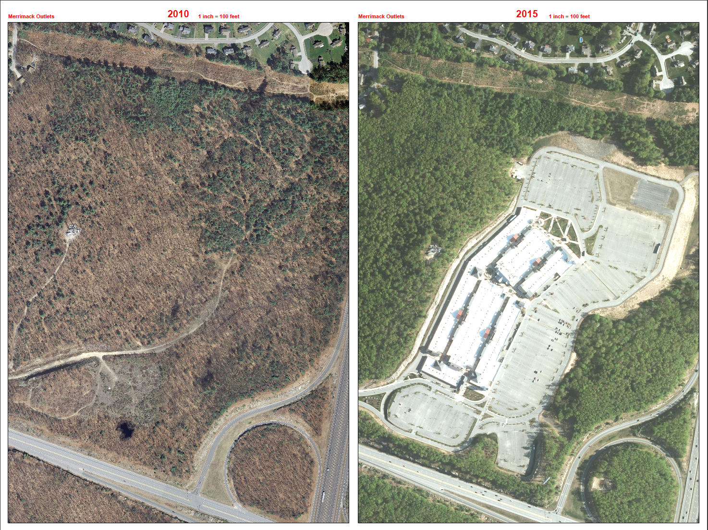

Slide 10
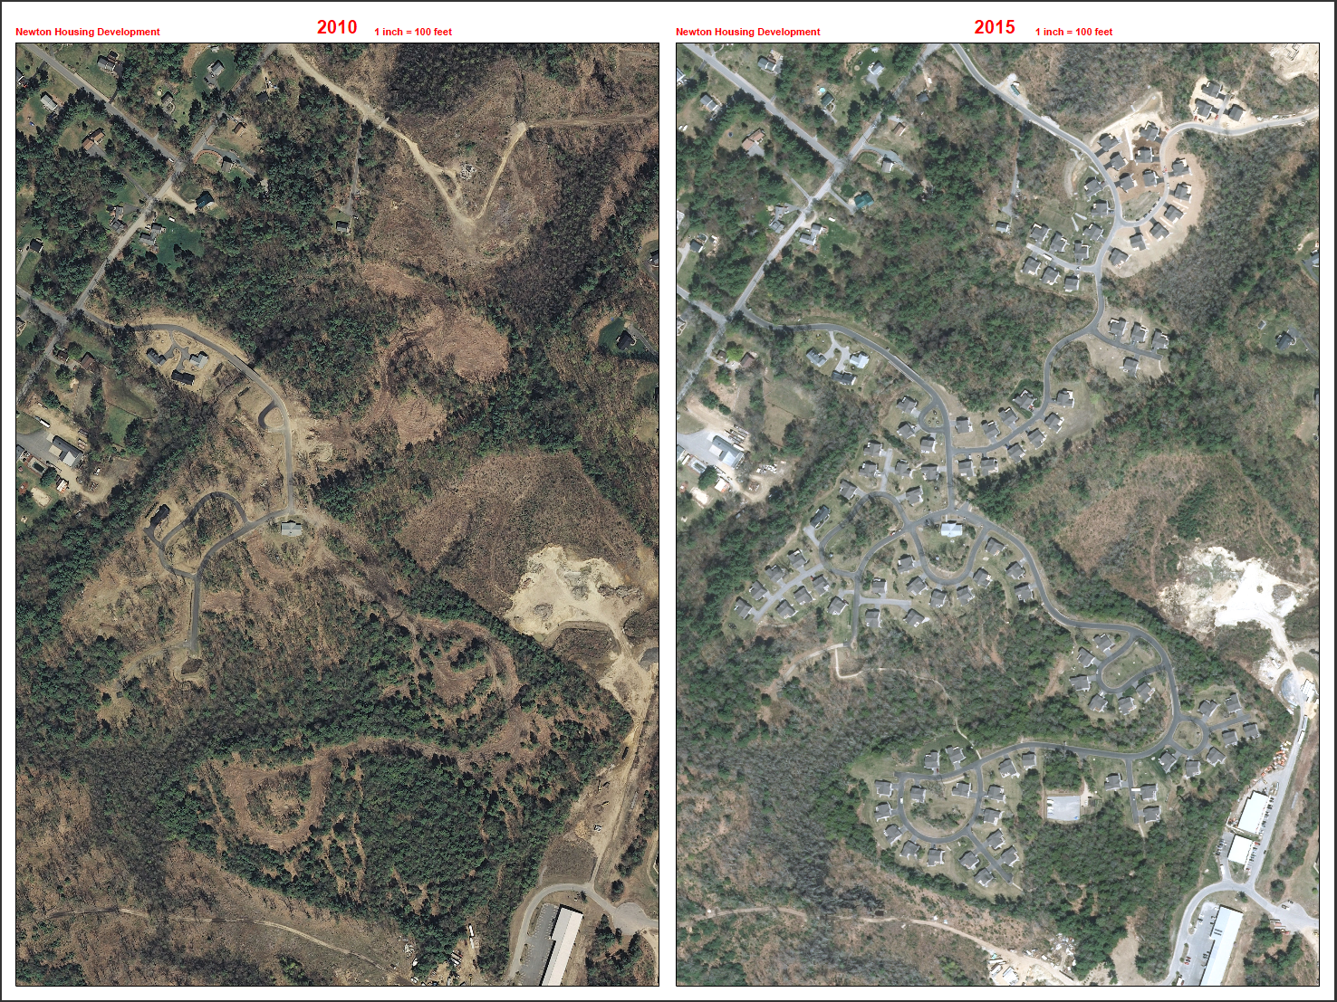

Slide 11
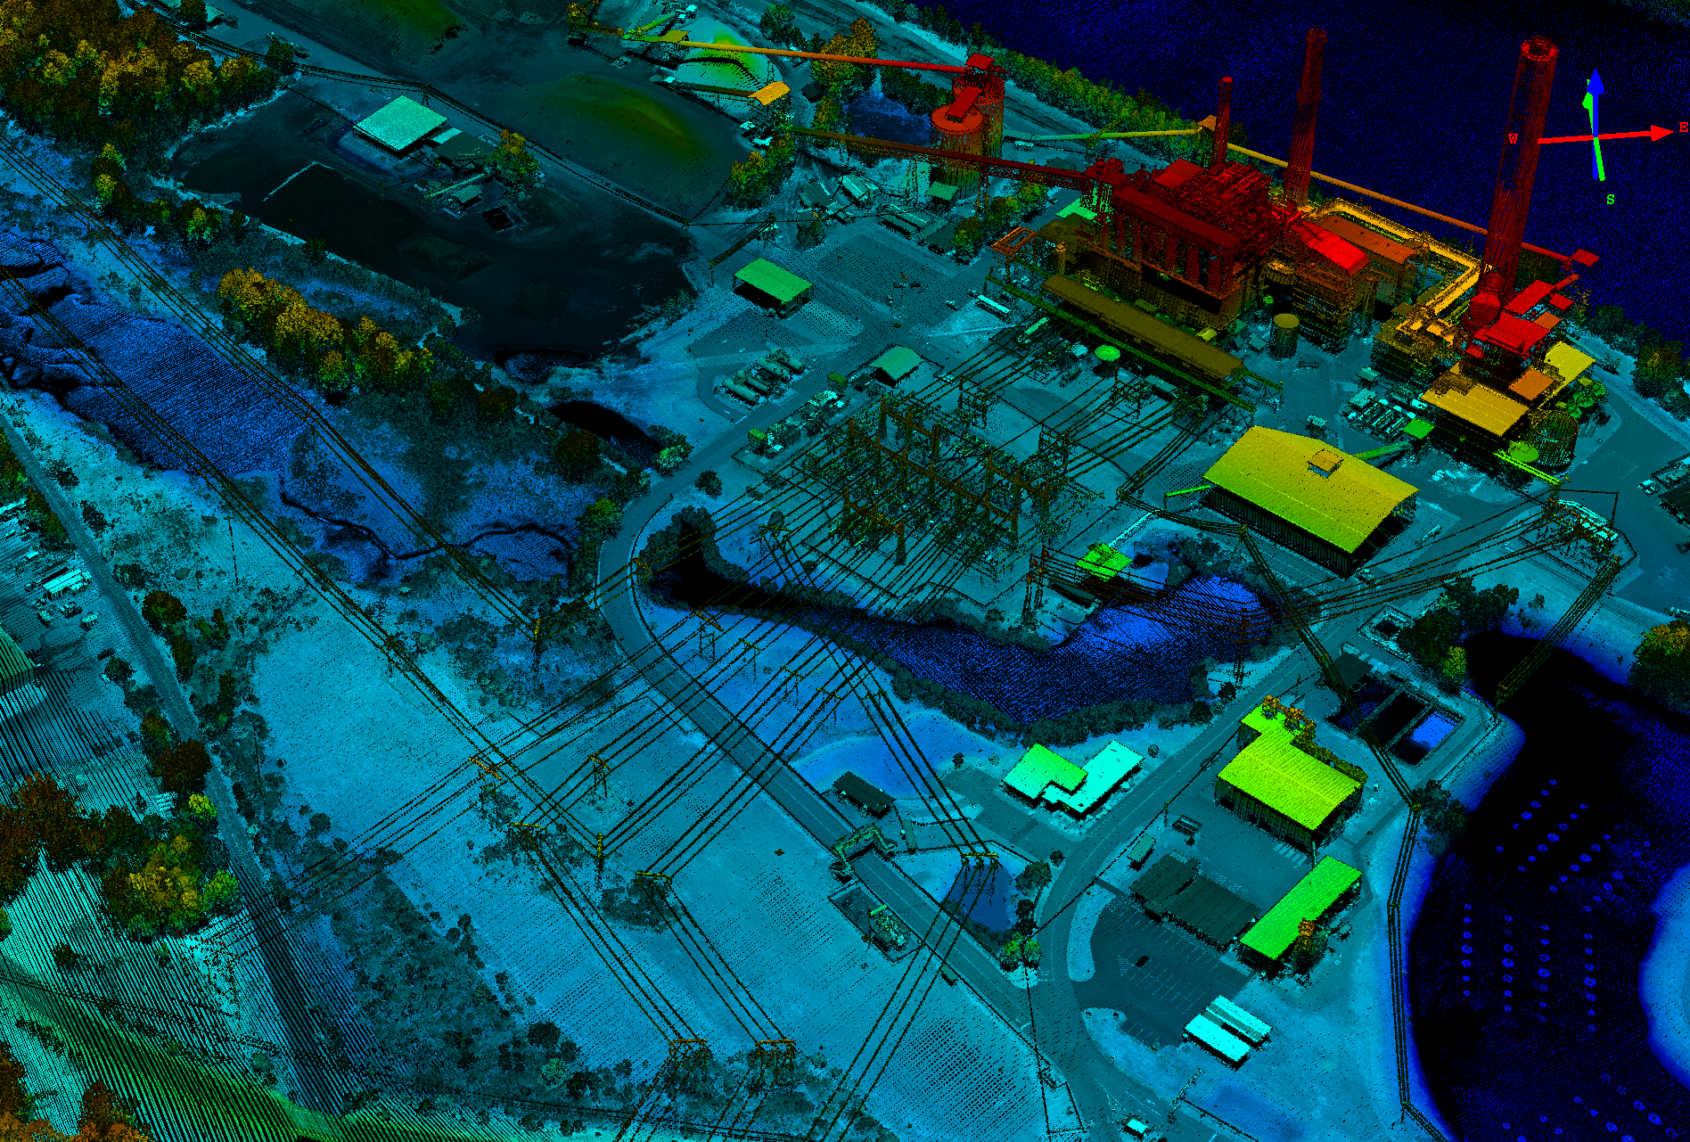
Hi Resolution Lidar-Bow Power Plant

Slide 12
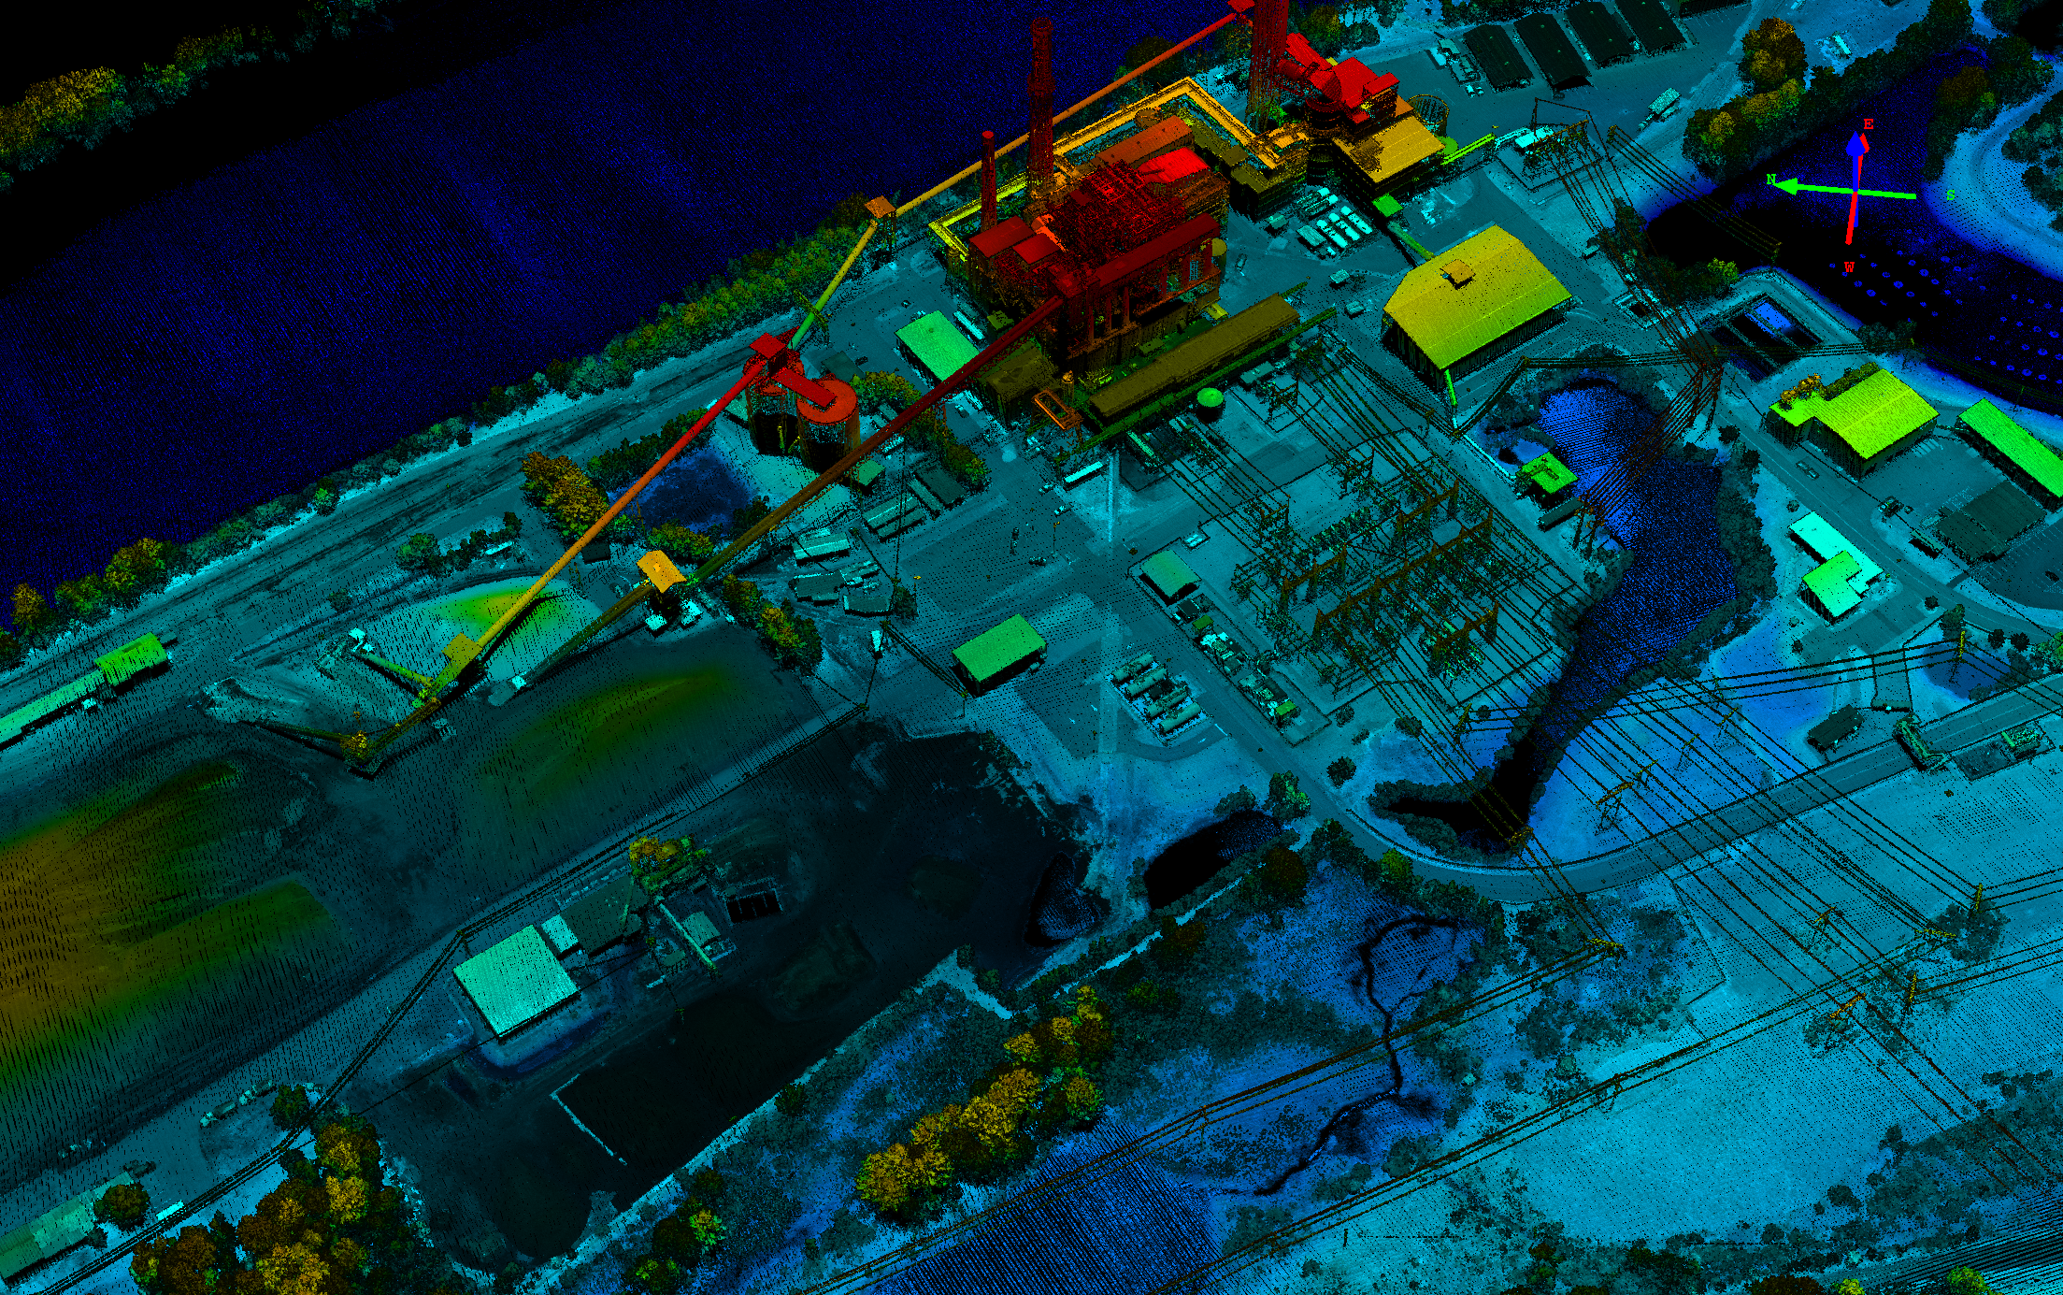
Bow Power Plant

Slide 13
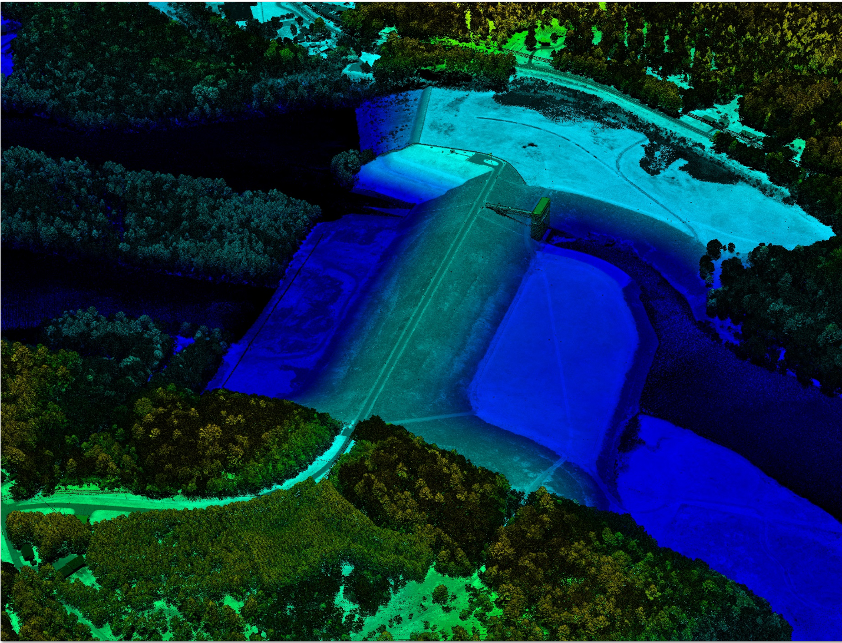
Franklin Falls Dam

Slide 14
Franklin Falls Dam

Slide 15
STRATEGY #2
Elevate GRANIT to the official NH State GIS Clearinghouse
Continuous
Improvement
Objectives –
Promote common awareness of & accessibility to enterprise GIS data sets
Research & promote task & cost-appropriate analytical tools
Provide common GIS presentation tools & platform
Increase outreach to state, regional, local governments & private stakeholders
Notes:
HAM ?
GLENN?
Strategy - To fully realize GRANIT’s potential to better support state agency operations
Promote common awareness of and accessibility to enterprise GIS data sets e.g. Making users aware of what GIS data is available and how to get access to it
Research and promote task & cost-appropriate analytical tools e.g. Identify and promote use of the same GIS software and tools for managing and editing GIS data
Provide common GIS presentation tools and platform e.g. Web Viewers like Google Earth; NHDES One Stop
Increase outreach to state, regional, local governments, and private stakeholders e.g. Large unmet need for GIS educational and technical support aimed at the municipal government level.

Slide 16
STRATEGY #3
Ensure that access to GIS technology is equitable and affordable to all state agencies
Continuous
Improvement
Objectives –
Develop best practice guidelines for data collection, storage, & management
Identify software & managerial solutions
Consider existing industry standards and apply when possible
Notes:
Strategy - Access to GIS technology is equitable and affordable to all state agencies
Develop best practice guidelines for data collection, storage, and management – Adopt official geographic data indexing system as a common way to locate geospatial features of interest e.g. US National Grid as a master index for enterprise level data sharing
Identify software & managerial solutions - to improve license management within & across agencies.
Pursue collaborative partnerships with strategic software vendors.

Slide 17
STRATEGY #4
Enhance statewide GIS governance and policies to guide best practices
Objectives –
Renew GTAC charge and outreach plan
Elucidate uniform legal guidance with respect to GIS and NH public records law
Notes:
HAM ?
GLENN?
Strategy #4 - Enhance statewide GIS governance and policies to guide best practices.
Renew GTAC charge and outreach plan
Elucidate uniform legal guidance with respect to GIS and NH public records law – to facilitate greater data sharing

Slide 18
Summary of Recommendations:
Two-Year GIS Action Plan
Outputs
A sequence of steps or activities that must be taken for each objective to support respective strategy.
Three major components:
Specific tasks & by whom
Time horizon
Capital & human resources needed
Required outcomes
GIS Committee review, amend & adopt
Identify available resources to implement
Report to Legislature
Resource requirements
Assigned point of contact for overall coordination
GTAC working group or outside resources
Availability of agency staff resources or funding of outside resources
Notes:
HAM
GLENN

Slide 19
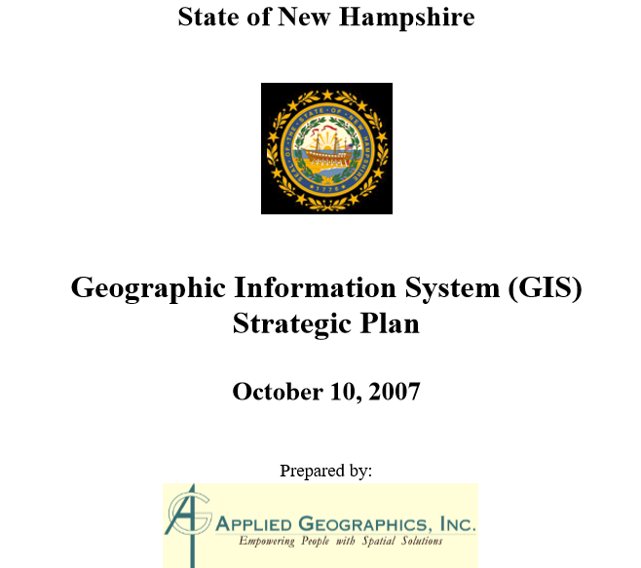
Questions ?
NH GIS Strategic Plan (2007)
https://www.nh.gov/oep/planning/services/gis/documents/strategic-plan.pdf
GRANIT
http://granit.unh.edu/
http://granitviewii.unh.edu/
Notes:
WHO?

