Slide 1
STRATEGY #1
Develop and maintain NH statewide base map and derivative data products
Objectives
(GTAC Level) Develop a plan for the regular acquisition, maintenance, and dissemination of statewide base map imagery and derivative data products. Plan to include:
Needs assessment
Technical specifications
Funding model(s)
(GAC/Executive Level) Explore the feasibility of a New England-wide consortium to achieve cost efficiencies in the acquisition of orthophotography
Notes:
GLENN
Strategy …that meet the operational needs of stakeholder agencies.
Develop a statewide data acquisition plan for updates of aerial imagery, LiDAR, and derivatives on a regular schedule tied to the biennial budget.
Recommend a formalized protocol for data collection and aggregation similar to successful statewide projects such as Statewide Asset Data Exchange Service (SADES) & T² Parcel Mosaic, that may be used by other agencies to maintain local-scale authoritative data.
Implement a common way to locate geospatial features of interest to a location on the earth e.g. US National Grid as a master index for enterprise level data sharing

Slide 2
Appointed Stakeholders
Adjutant General
Agriculture
Corrections
Cultural Resources
Education
OEP
DES
F&G
DHHS
DOIT
DRED
DRA
DOS
DOT
Granit
Municipality

Slide 3
Adjutant General
Mission Planning and Response
Wildfire Response
Safety and Security Planning-Readiness Centers

Slide 4
Pembroke National Guard Training Facility
2010
2015

Slide 5
Land Use Agencies
Agriculture
Quantifying change in agricultural lands over time
Agricultural land use in proximity to water
Cultural Resources
Covered Bridges
Cemeteries
Archeological Sites
Historic Sites
Fish and Game
Habitat Management
Current Search and Rescue visualization
Regional and Local Planning Agencies

Slide 6
Land Use Change State (OEP, DES, DOT, DOS, DRA, DOE) Local(Planning, Assessing, Public Safety, Conservation)
2010
2015
Kingswood Regional High School, Wolfeboro

Slide 7
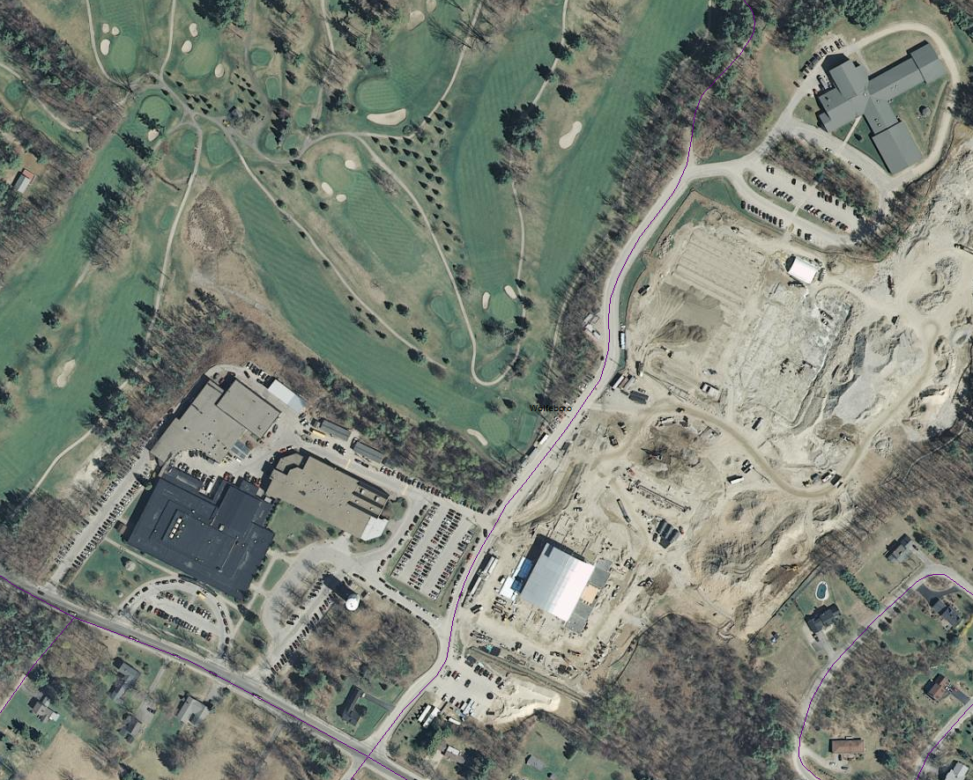
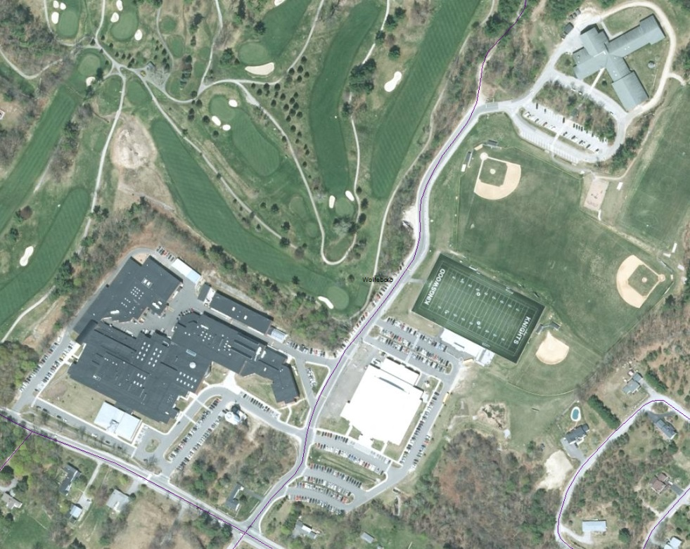
Department of Education 2010 2015
DOE Facility Management
Safety and Security Planning
State and Local

Slide 8
Office of Energy & Planning/Economic Development Energy Infrastructure
Berlin 2010
Berlin 2015

Slide 9
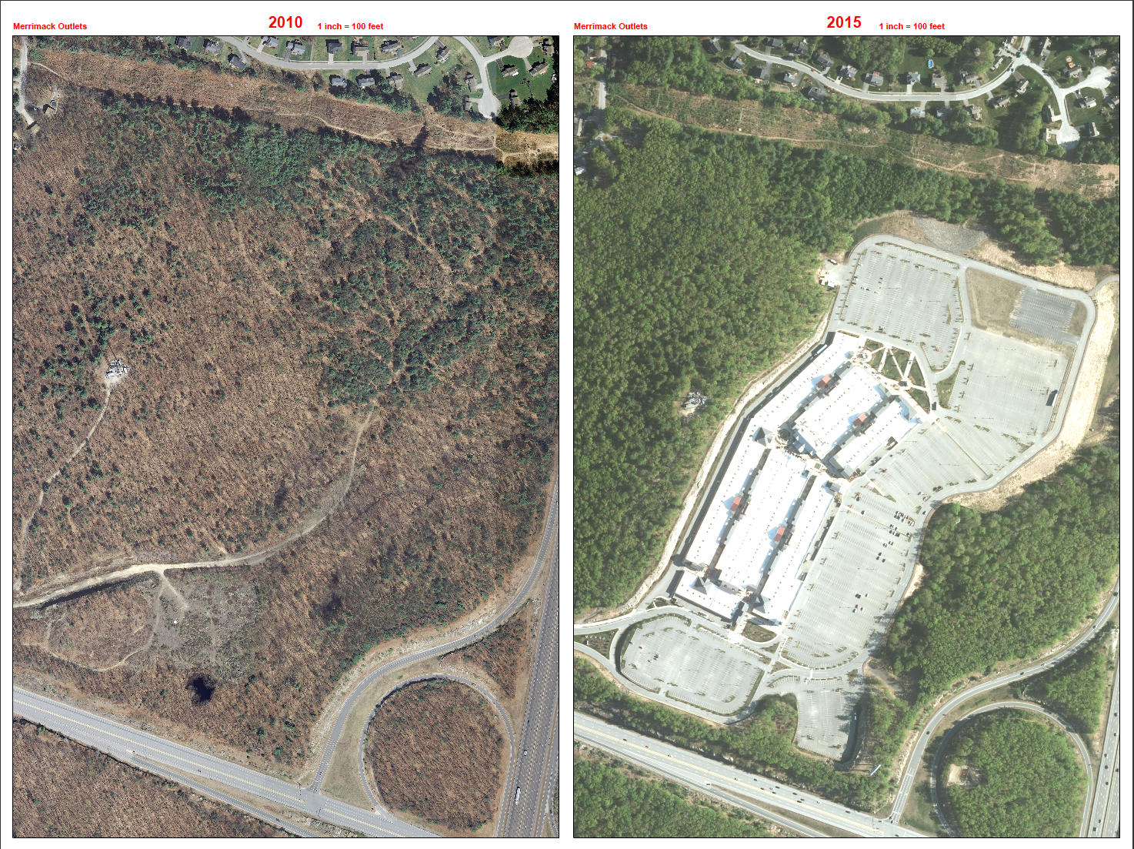
Multi Agency Utilization

Slide 10
DHHS
Change in vector born disease habitat
Mosquitoes
Tick
Shelter locations in Flood Plain/Hazard Areas
Other derivative products

Slide 11
Forestry Operations Tuftonboro

Slide 12
Forestry Operations Interested Parties
DRA/Municipalities
Timber Tax Collection
Forest Lands
Safe and lawful forestry operations
Environmental Services
Alteration of Terrain
Wetlands
DOS/HSEM
Storm related disaster assistance

Slide 13
DOS
Address Collection management
Special Events
Disaster Response
Tactical operation planning
Hazard Mitigation

Slide 14
2010 Newington 2015
Agencies
DOT
DOS
DES
Local

Slide 15
Stormwater Runoff/Change in Impervious Surface
SNHU

Slide 16
Culvert Management
6 Inch Resolution
1 Foot Resolution
50 foot variance from
collected location vs actual

Slide 17
Concord Housing
2015
2010

Slide 18
Imagery Comparison 2010-2015 Using DRA Statewide Parcel as Reference Analysis provided by Hexagon Geospatial

Slide 19
Comparative Statistics Possible using NH Parcel, Consistent Imagery and software
Percent parcels with change
Identify parcels with probable change
Assessment changes
added a deck, pool, barn etc.
Spectral change-forest
Environmental Change
Manmade vs Environmental Change
Filter on paved surface change by community
Algae Blooms
Leaf on collections required

Slide 20
Derivative products/analysis with high quality imagery

Slide 21
Rooftop Analysis/Building Footprints

Slide 22
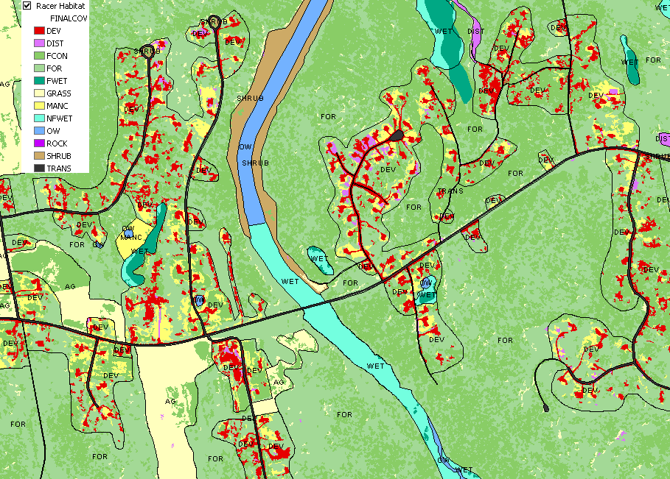
Image classification: Wildlife habitat

Slide 23
Collective Benefits
Regular High resolution imagery collection enables State, Regional and Local agencies to achieve their missions with greater detail and operational efficiencies
Reduces the need for field visitations with highly accurate and expensive GPS equipment as well as back office processing time
Provides a common operating base layer to assist inter agency location data standardization of other base map layers
Shorelines, Footprints, Utility Right of Ways etc.

Slide 24
Draft Standards
Resolution-6 inch, minimum
Leaf off
4 band, Orthorectified
Frequency-Biennial acquisition
Distribution plan for State, Regional, Local Agencies
Upcoming work sessions
!Please complete and return the survey sent out by Fay Rubin on Imagery Needs!

Slide 25
Funding?
The Legislatively formed Geographic Committee will be reviewing appropriate continuing funding mechanisms under the leadership of Commissioner Goulet, Chair of the Committee
Seek a long term reoccurring acquisition process
Agency Budgeting across the biennium's

Slide 26
Questions/Comments ?

