Slide 1


GIS Advisory Committee
Imagery Project Working Group Overview
1/10/2018
Joe Oddi
Regional Technical Manager: New York/New England/Eastern Canada
Nick Rozaklis
Program Manager – Enhanced Projects
Jon Langstaff
District Manager: New York/New England

Slide 2

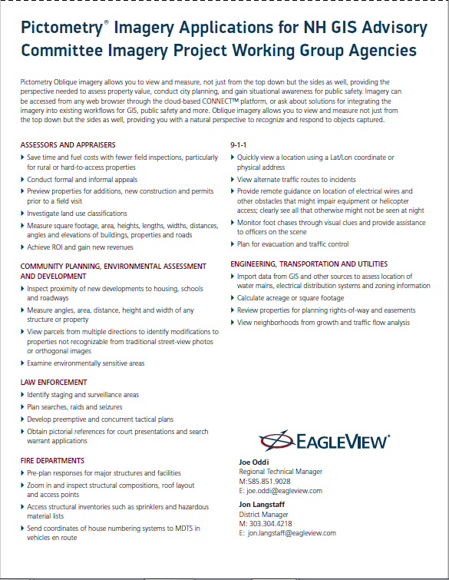

Slide 3



Quick Facts
118
HQ Rochester, NY
Established in 2000
50K+ Annual Flight Hours
Over 50 Million Images processed/Yr
Current Sensor Inventory:
500+ RGB Cameras
12 IR Cameras
3 LiDAR systems

Slide 4
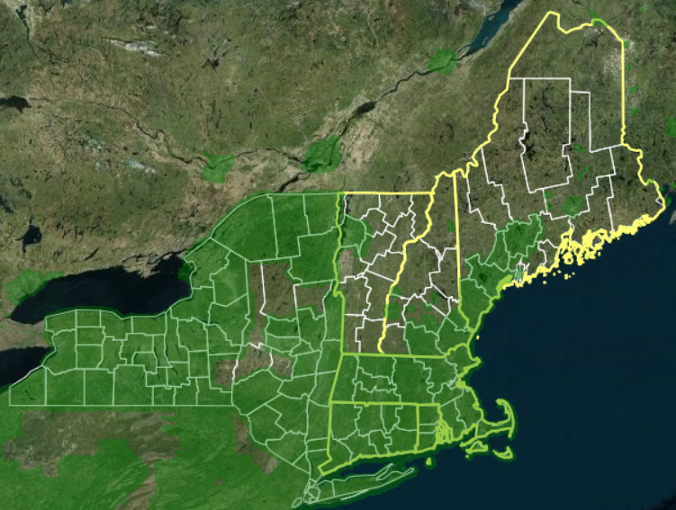
New England Capture Areas

Slide 5
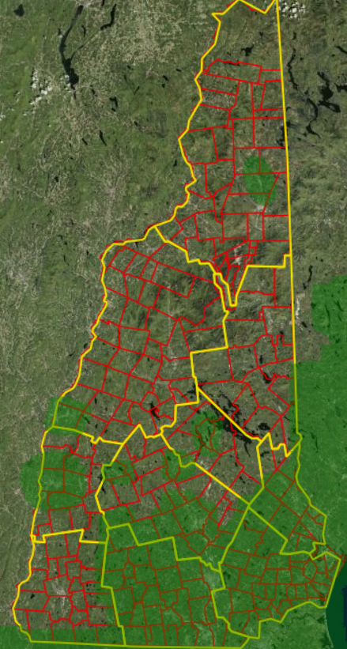
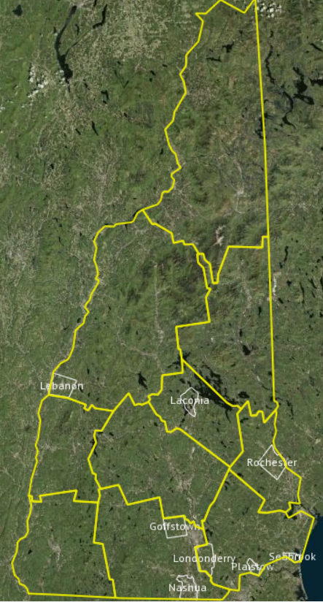
New Hampshire Capture Areas

Slide 6
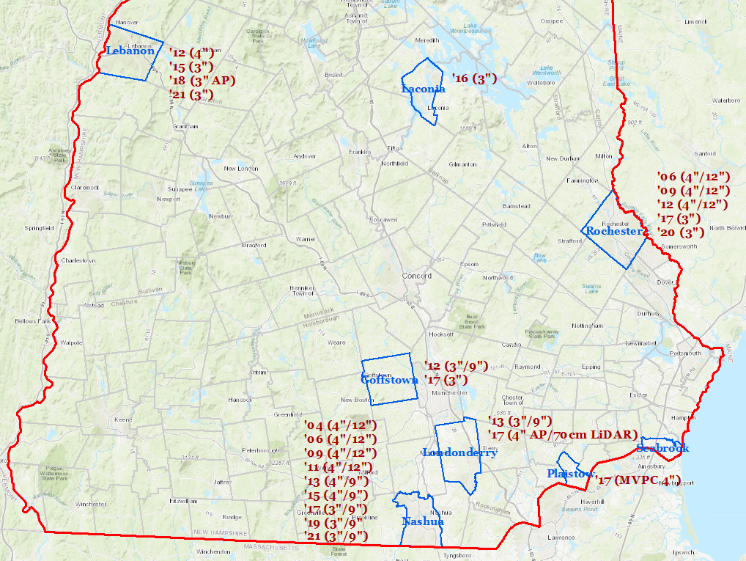
New Hampshire Capture Areas

Slide 7
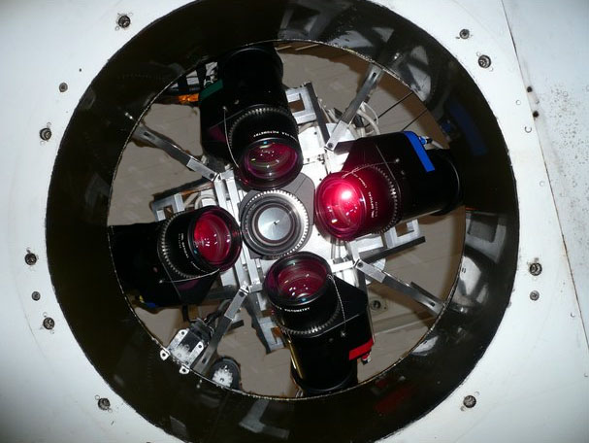
PentaView Digital Sensor System
USGS Certification Fall 2010
  Year-long process
  Pictometry AccuPlus Imagery Approved by USGS
  Only oblique certified system
Latest version deployed 2012
  29MP sensor
  Improved lenses
  3” and better GSD

Slide 8
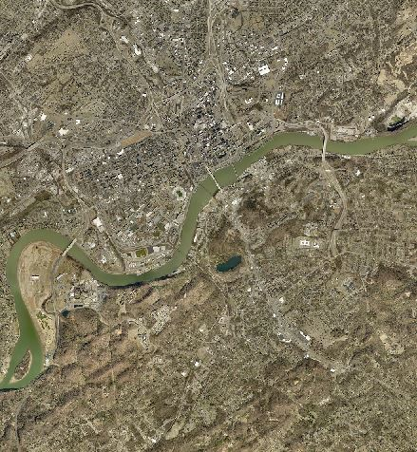
AccuPlus Orthomosaics
Pictometry’s Authoritative Ortho Imagery Offering
  Meets various (USGS, state) accuracy standards
  Produced using traditional photogrammetric techniques
  Full manual correction to seams and radiometry
First project in 2008
  Los Angeles County
  > 4,000 square miles; ~400,000 source frames!
  LA now mapped three times
Final delivery in approx. 90-150 days
Full QC prior to delivery
Ideal for your own planimetric work

Slide 9
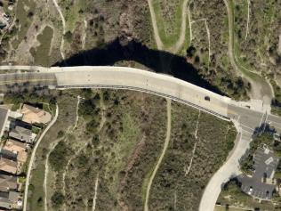
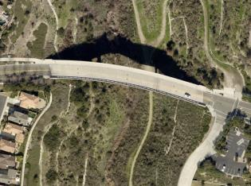
AccuPlus – Highlights
Manual Corrections
Seam Editing
Local color corrections
Bridge & Road Correction
  Orthorectification to proper elevation
Utilizes…
Ground Control Points
Aero-Triangulation (AT)
Double the flight lines
  Necessary for AT
  Nearly eliminates building lean

Slide 10
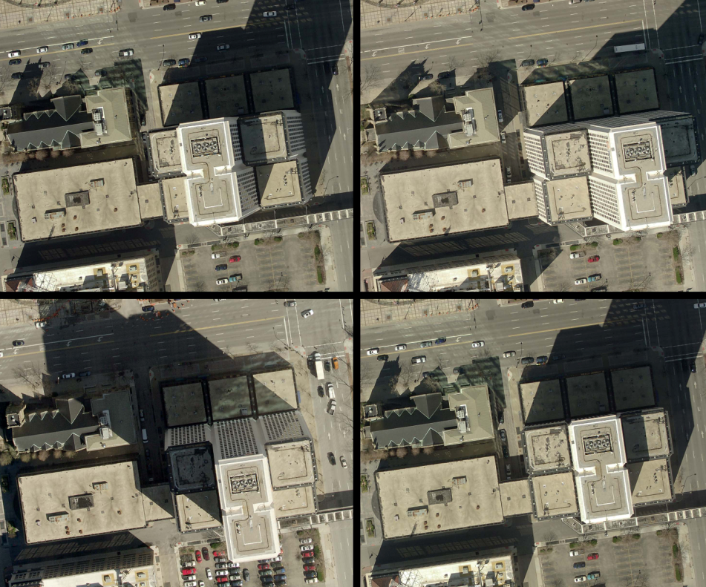
AccuPlus – Next to Zero Building Lean

Slide 11
Field of View
Pictometry
PentaView
Sensor System
Typical Large- Format Mapping Camera
Notes:
Why is this important? Because this is a key differentiator between Pictometry and traditional ortho flyers.

Slide 12
Field of View
Maximum FOV is corner point at anywhere from 38 ° - 55° from Nadir Point
17° from Nadir Point
10° from Nadir Point

Slide 13
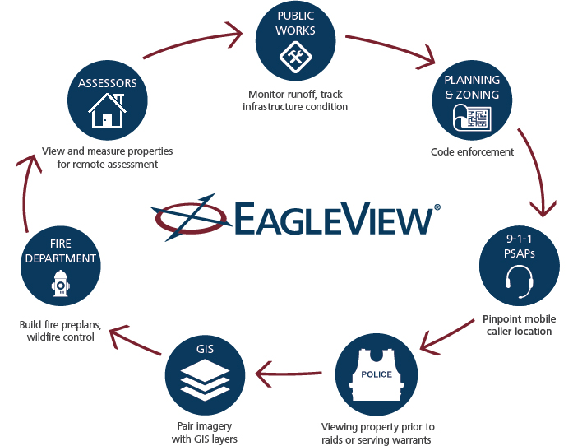
Benefits of Oblique Imagery

Slide 14
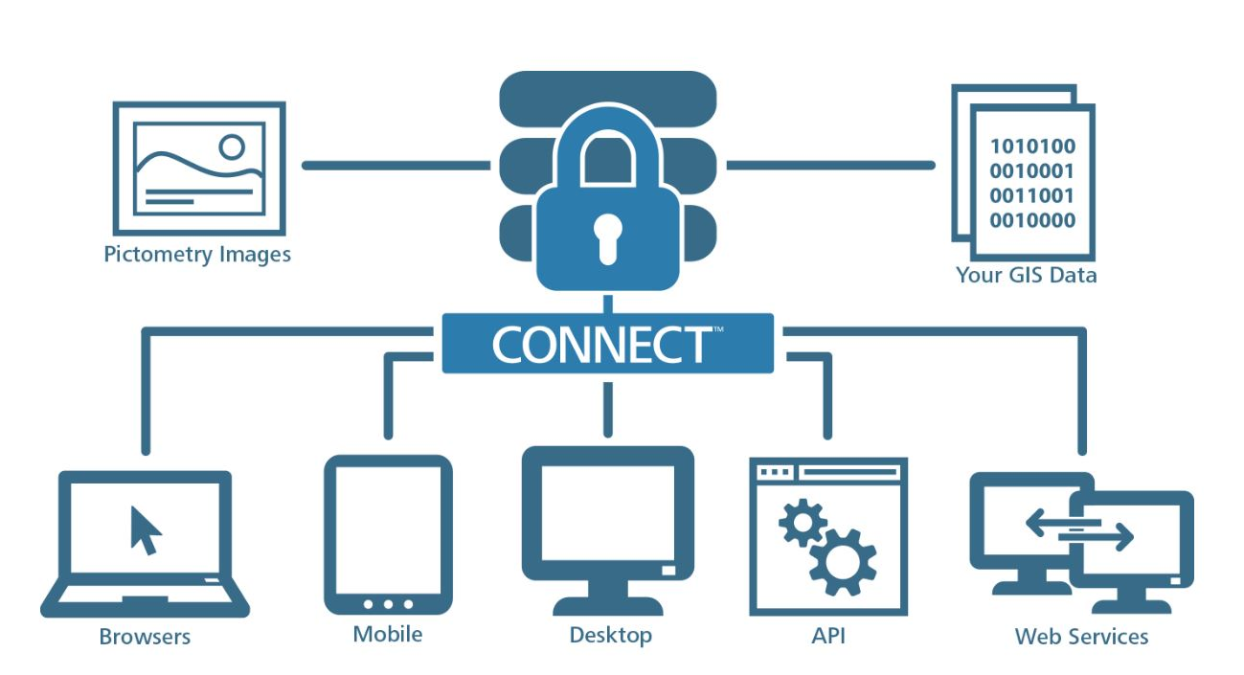
CONNECT Overview

Slide 15
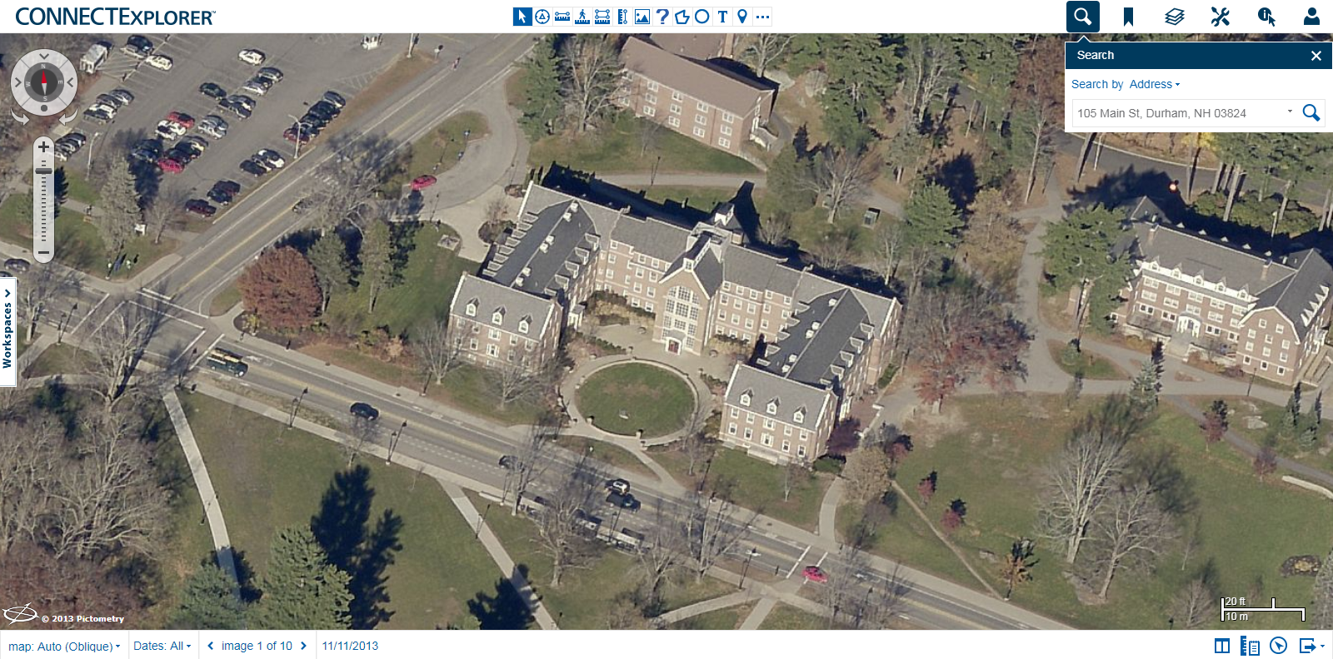
CONNECTExplorer

Slide 16

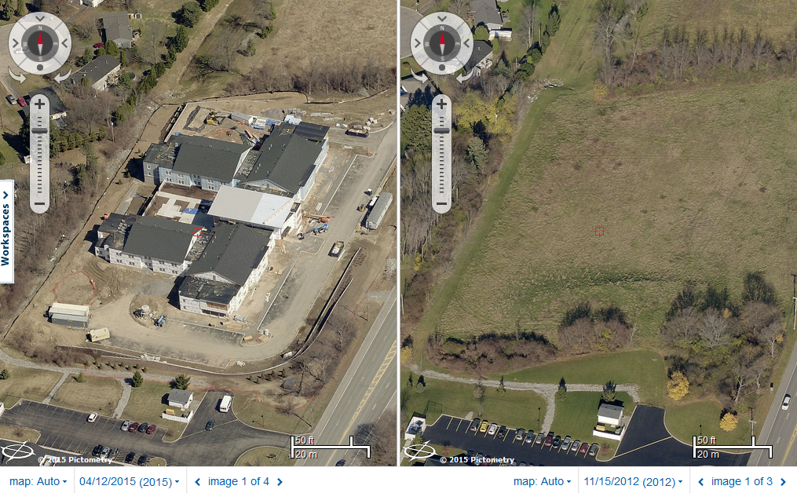
Dual Pane
Creates two image panes, allowing for easy comparison

Slide 17
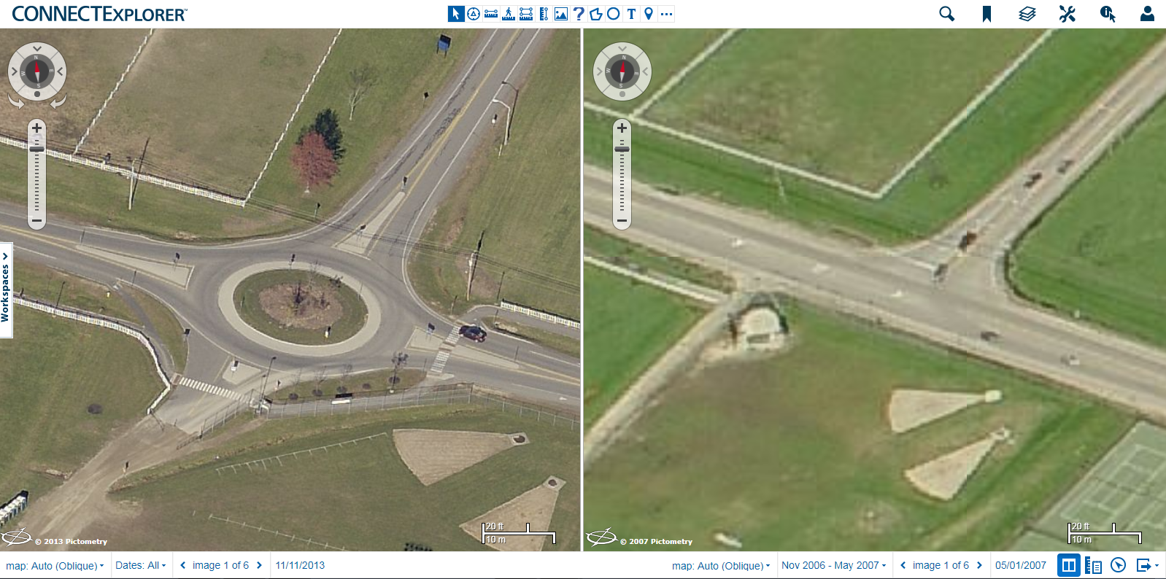
Dual Pane
UNH Campus – 2013 vs 2007

Slide 18
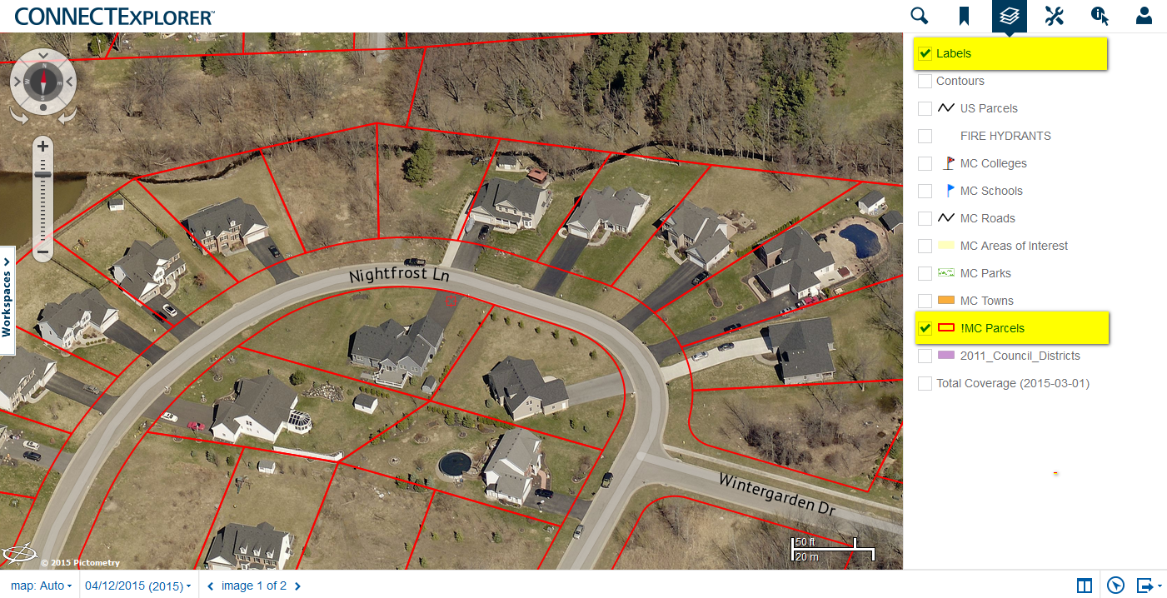
GIS Layers

Slide 19










Measurement Tools
Location: click a location to view Lat/Long coordinates
Bearing: click a point to start measuring, double click the end point to perform bearing measurement; or click a second point and then double-click a third point to measure bearing difference
Distance: click to measure, double-click to end measurement
Distance Ground: click to measure, double-click to end measurement (this considers elevation)
Area: click each corner of an area to measure, double-click to end measurement
Vertical Area: click the lower point to start measuring, click the upper point to determine height, then click a third point to complete the measurement
Height: click the lower point to start measuring, then click the upper point to complete the measurement
Elevation: click the point to receive elevation data
Ground Slope: click a point and then a second point to view the ground slope and elevation difference between the two points

Slide 20
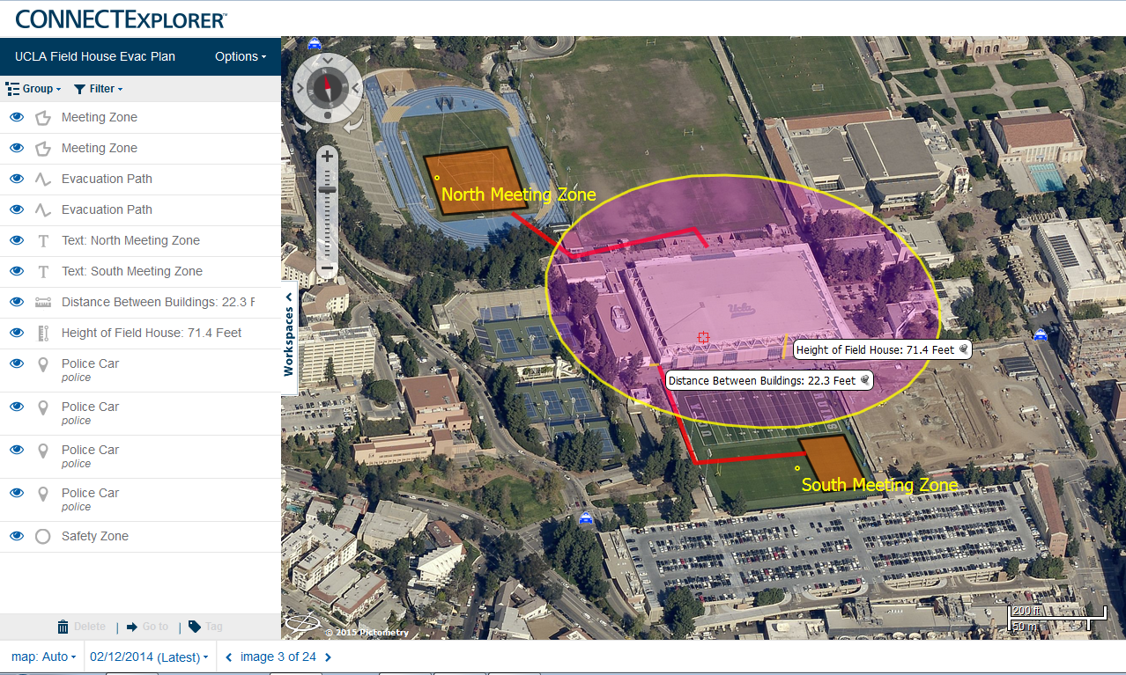
Sample Annotation Projects

Slide 21
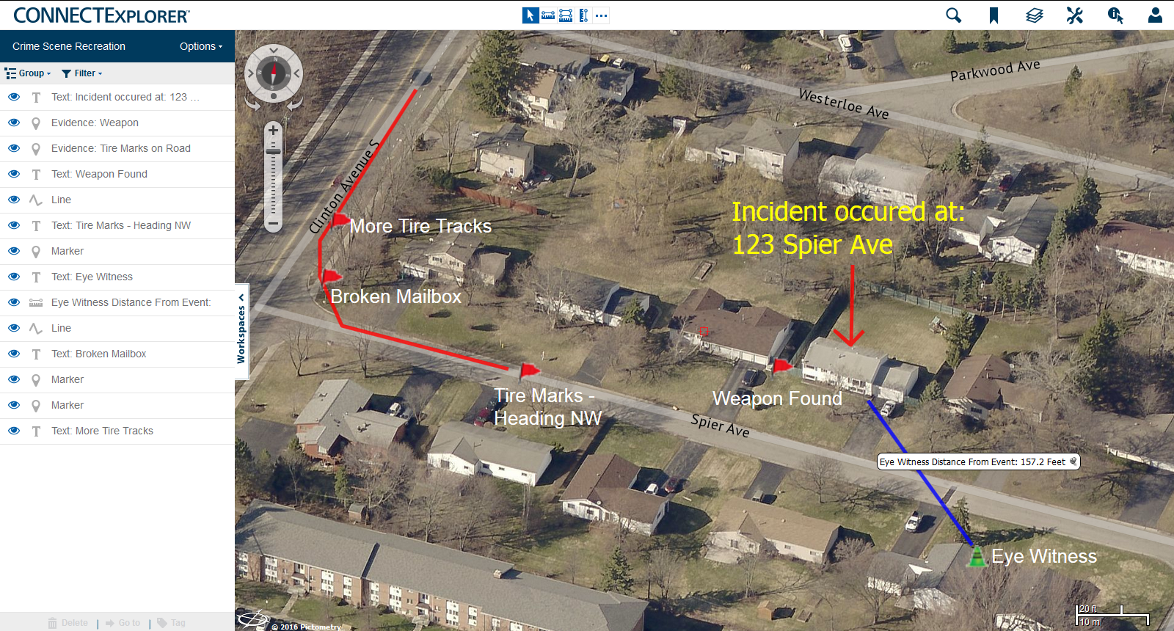
Sample Annotation Projects

Slide 22
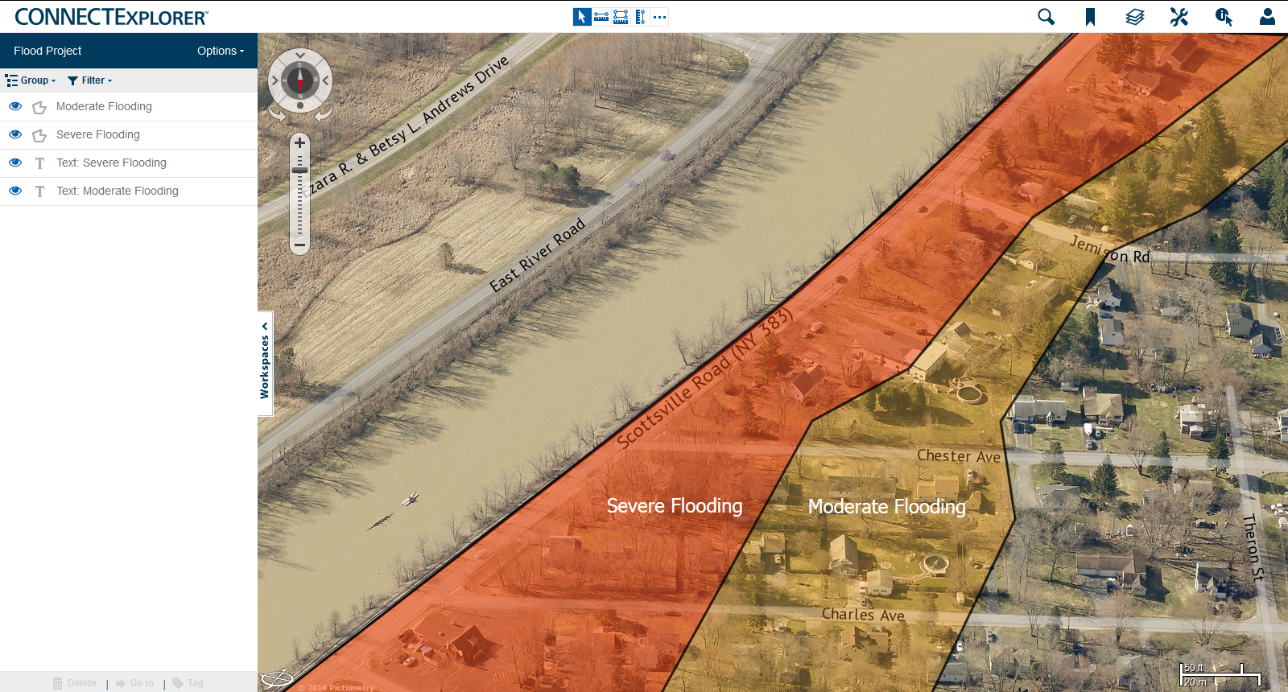
Sample Annotation Projects

Slide 23
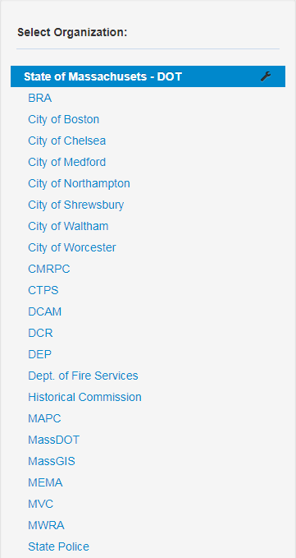
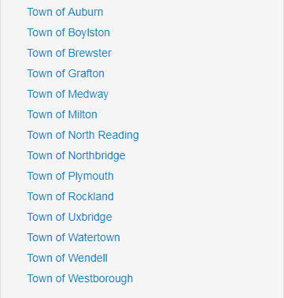
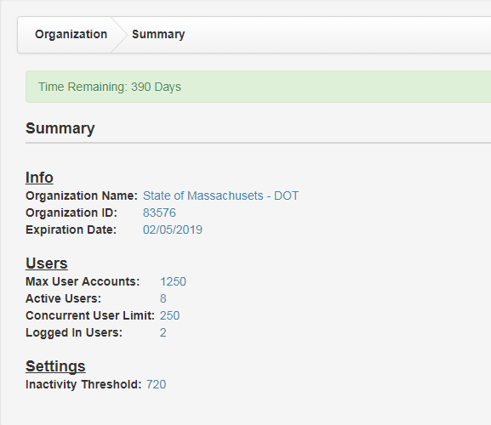
CONNECT – MassDOT

Slide 24
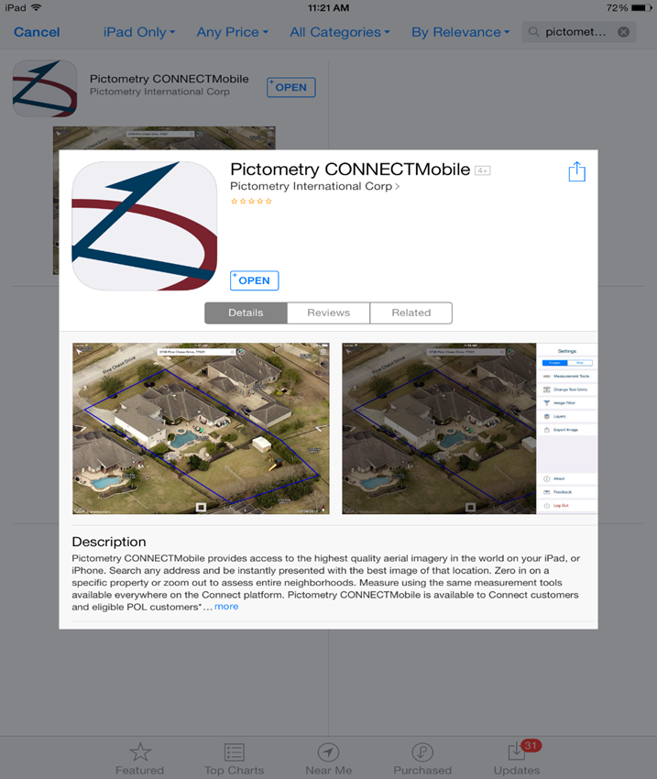
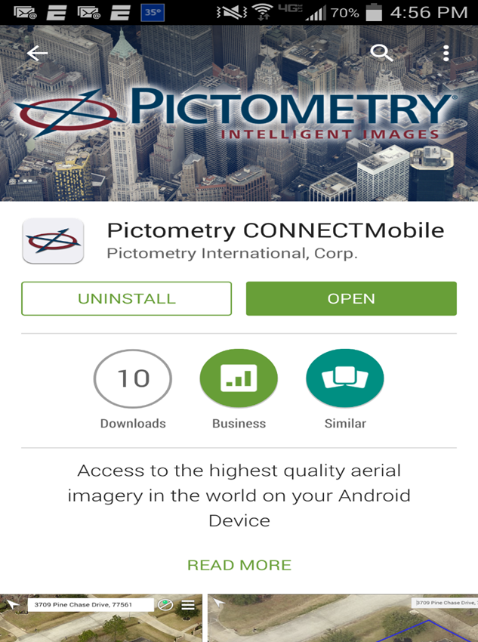
Mobile Apps
Notes:
This easy-to-use mobile application allows you to pan and zoom around the imagery, view and query GIS data, overlay GIS data and use a comprehensive measurement tool set to gain valuable knowledge and detail about a property or parcel.
Download the app today at iTunes or Google Play.

Slide 25
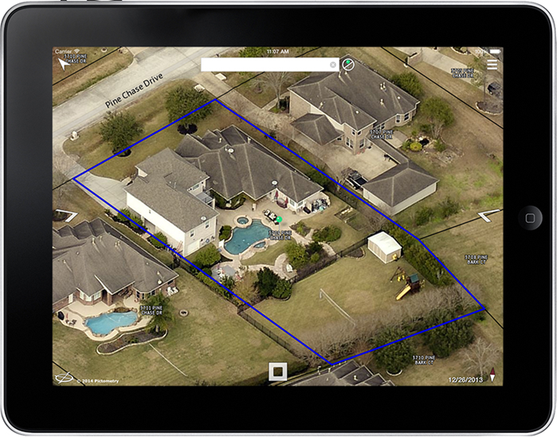
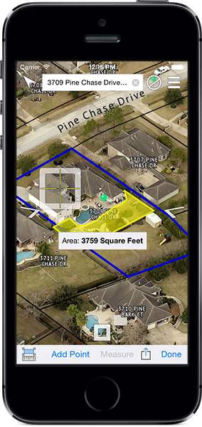
Mobile Apps

Slide 26
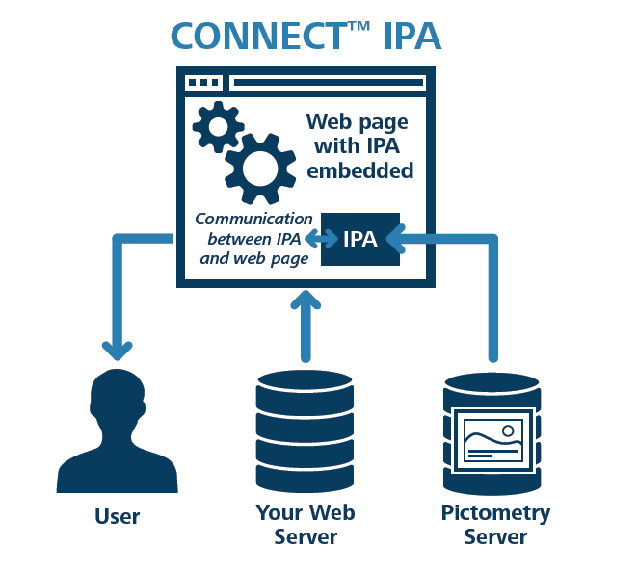
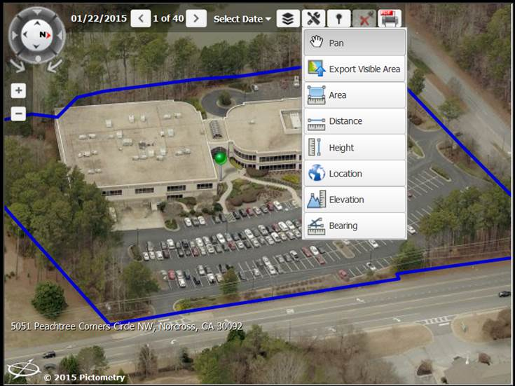
Integrated Pictometry Application (IPA)
Embed Pictometry into an existing application to streamline workflow
Notes:
Thirsty
Cloud-based
Fits into existing workflow – no need to learn new software/viewer

Slide 27
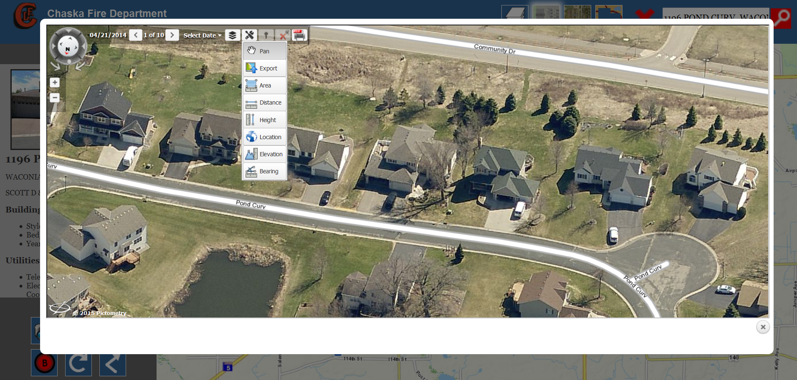
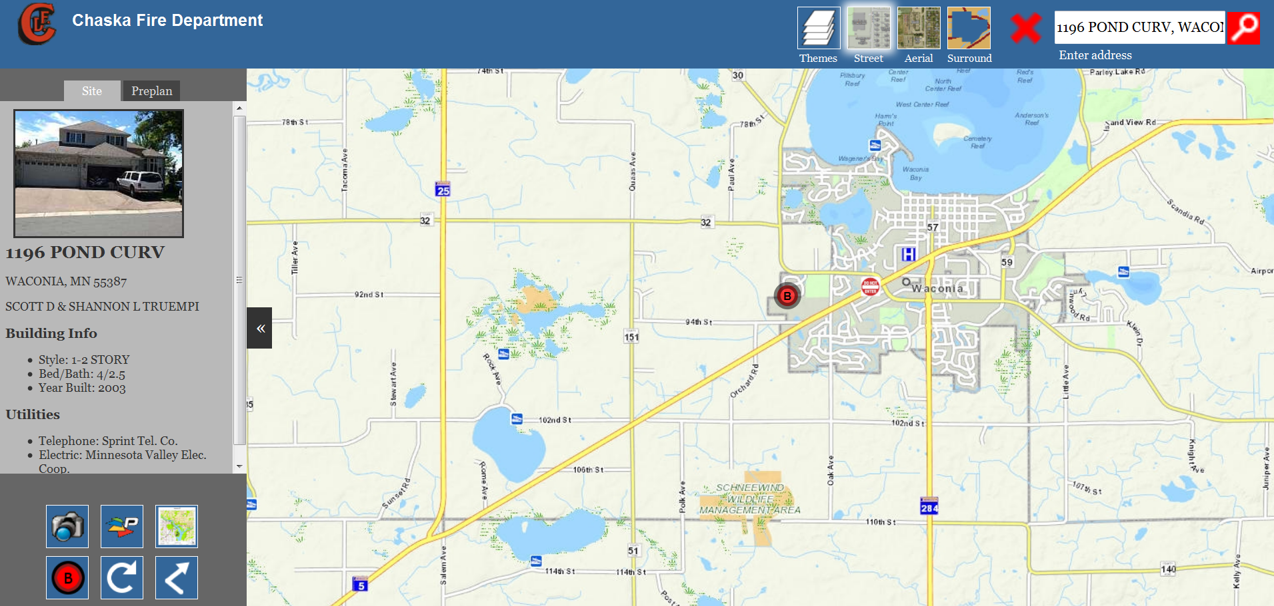
Integration Solutions
A customer example of Pictometry IPA (analytic)

Slide 28
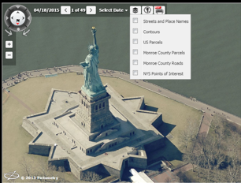
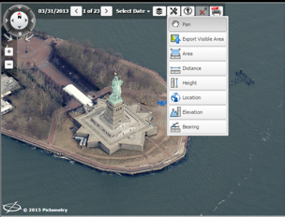
Integrated Pictometry Application (IPA)
Two Options:
Visualization and Analytic
(Public-facing) (Internal only)

Slide 29
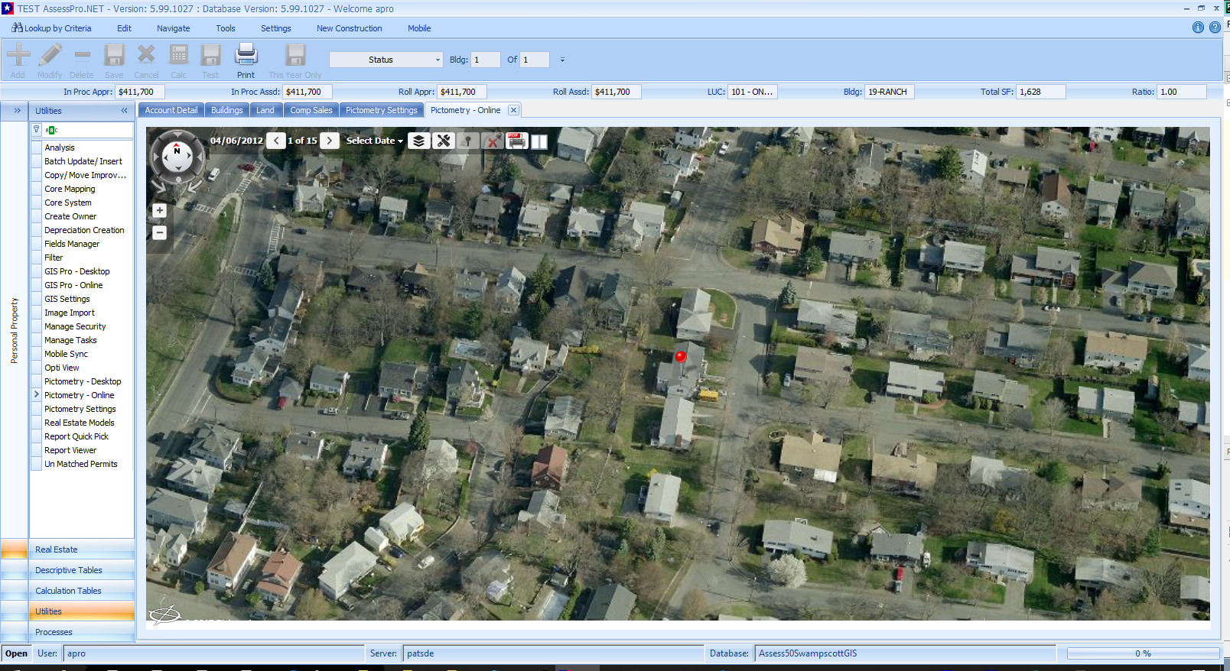
IPA Integration – Patriot AssessPro
Notes:
Flex, Silverlight and JavaScript/HTML (IPA) web integration options

Slide 30
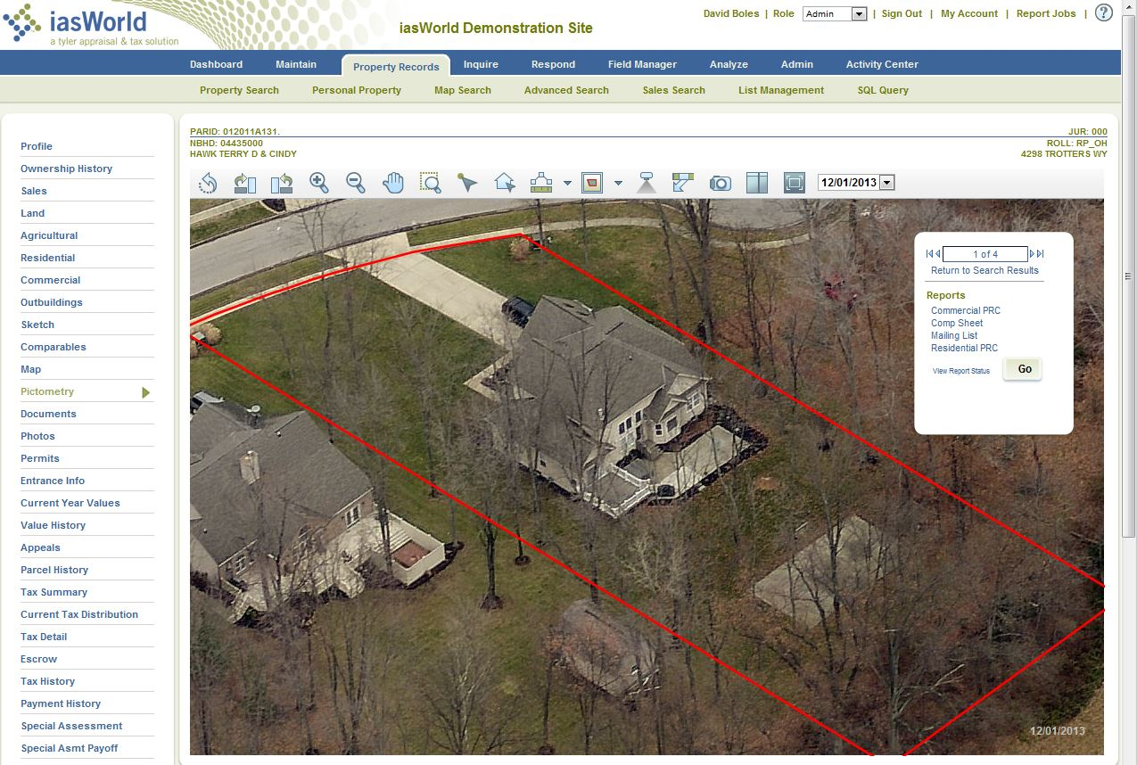
IPA Integration – Tyler’s iasWorld
http://www.clermontauditor.org/_web/search/CommonSearch.aspx?mode=OWNER
Notes:
Flex, Silverlight and JavaScript/HTML (IPA) web integration options

Slide 31









Add Pictometry to a Program You Use Everyday
Local GIS & CAMA Vendors With a Current Pictometry Integration

Slide 32
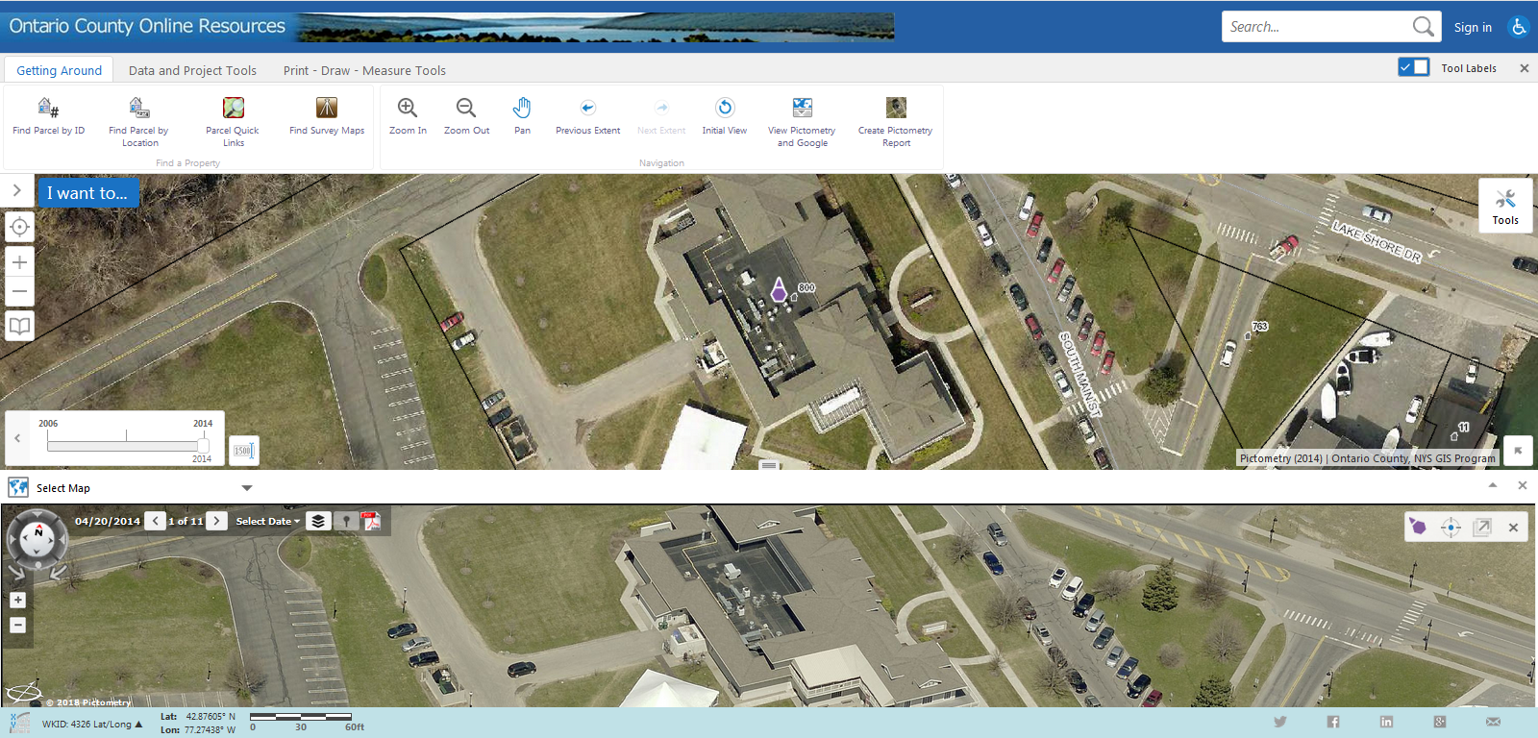
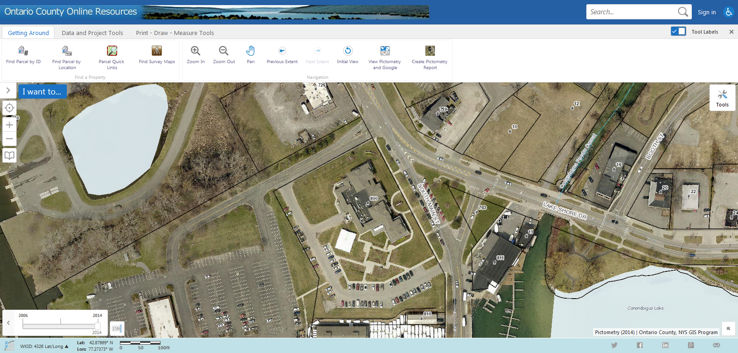
Integration Solutions - IPA
Example of Pictometry IPA with Latitude Geographic’s GeoCortex

Slide 33
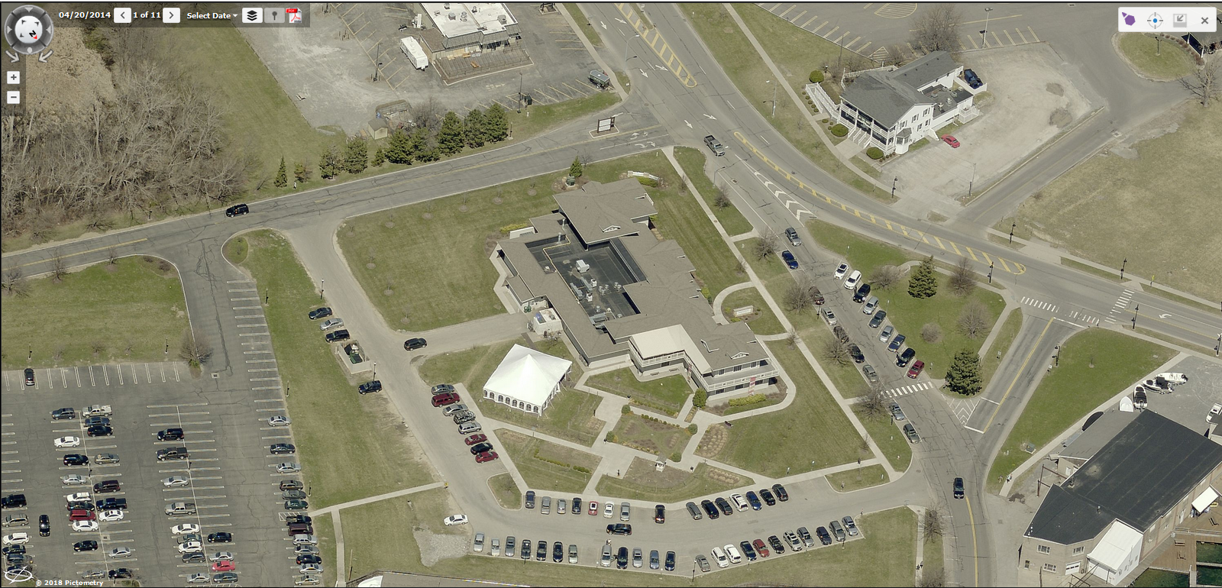
Integration Solutions - IPA
Example of Pictometry IPA with Latitude Geographic’s GeoCortex

Slide 34
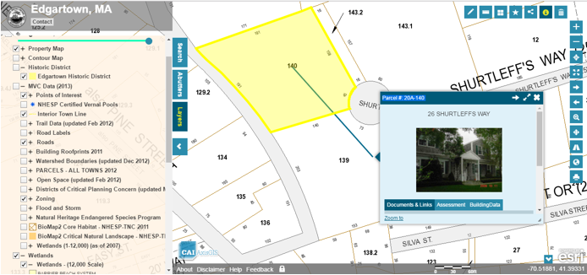
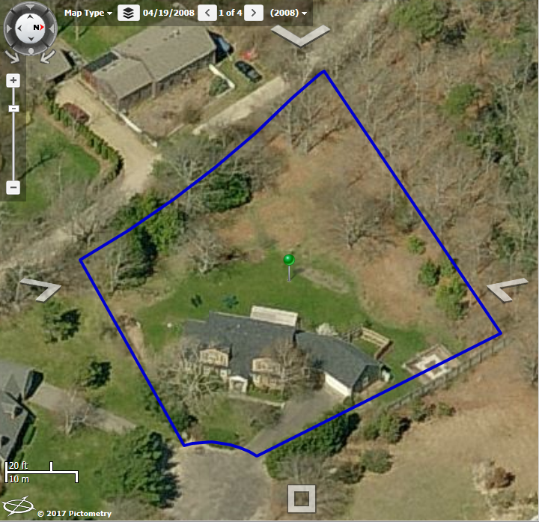
Integration Solutions - IPA
Example of Pictometry IPA with CAI Technologies’ AxisGIS

Slide 35
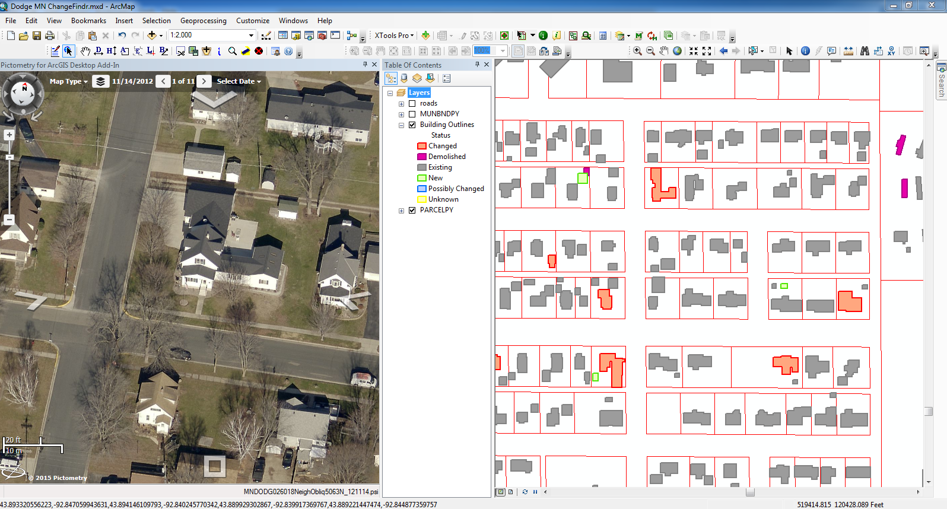
View your oblique library from within ArcMap
Pictometry for ArcGIS Desktop

Slide 36
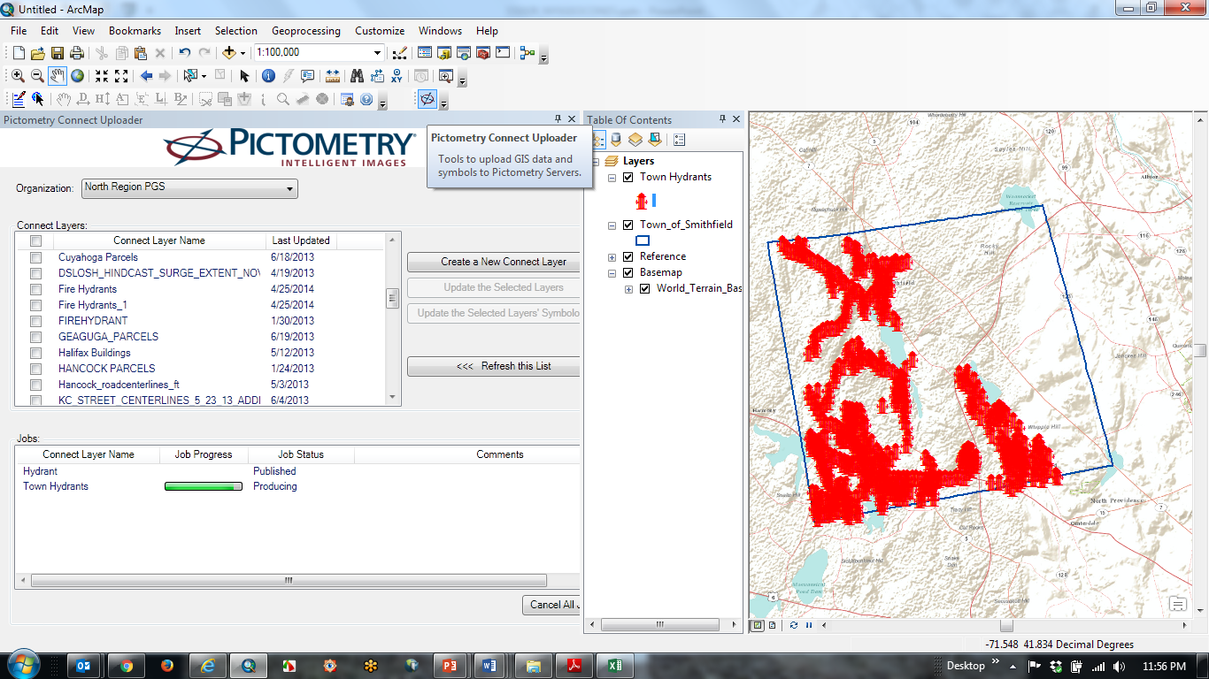
Pictometry’s ArcMap Uploader
Upload GIS data to your CONNECT account directly from ArcMap

Slide 37
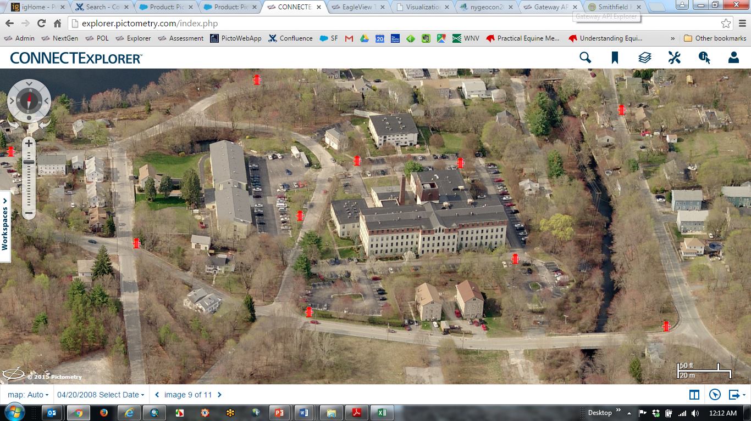
Pictometry’s ArcMap Uploader

Slide 38
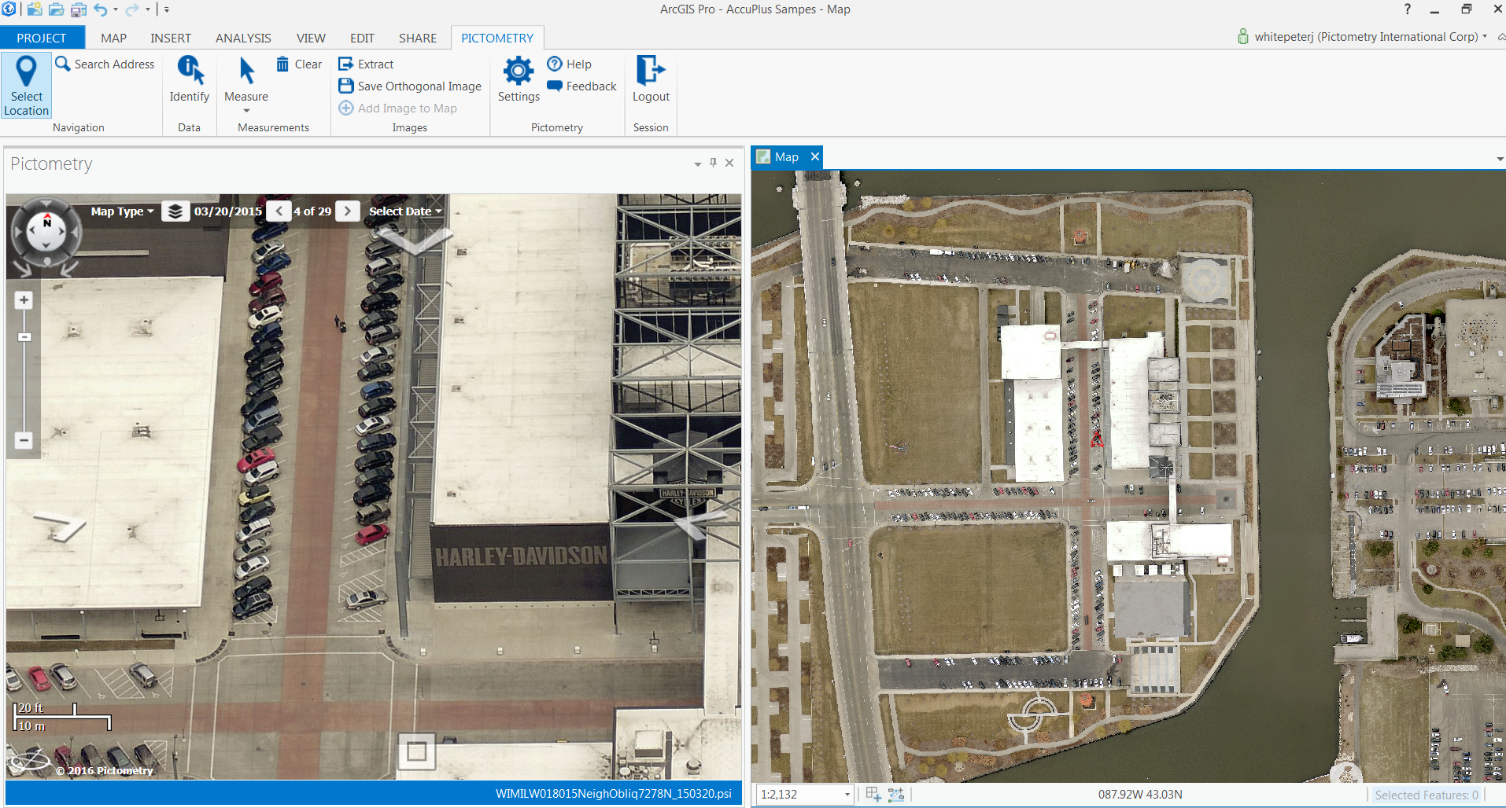
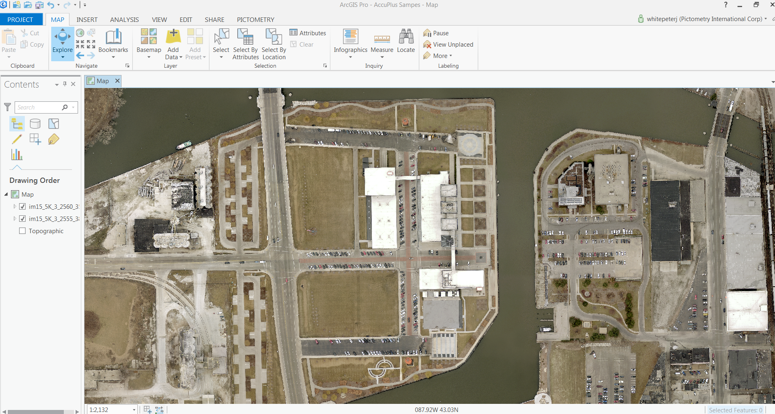
Pictometry for ArcGIS Pro

Slide 39
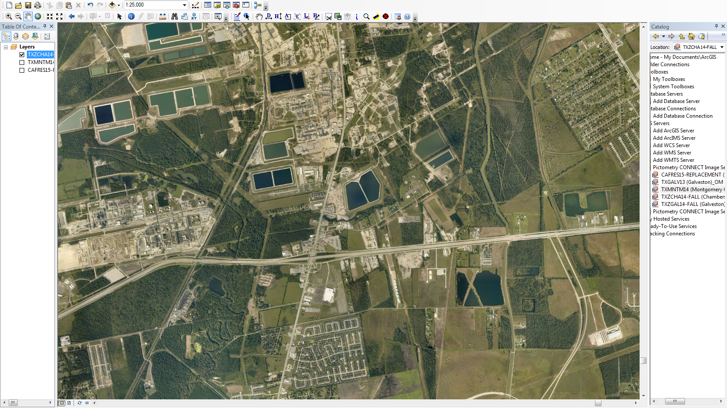
Orthomosaics

Slide 40

Orthomosaics
Delivery includes tiles and area-wide mosaic
Base layer in ArcGIS Desktop
Send to CAMA/GIS vendor to be used as a base layer
Create your own web mapping service and push to AGOL
http://oncorng.co.ontario.ny.us/Html5Viewer/index.html?viewer=oncor.OnCOR_HTML5

Slide 41
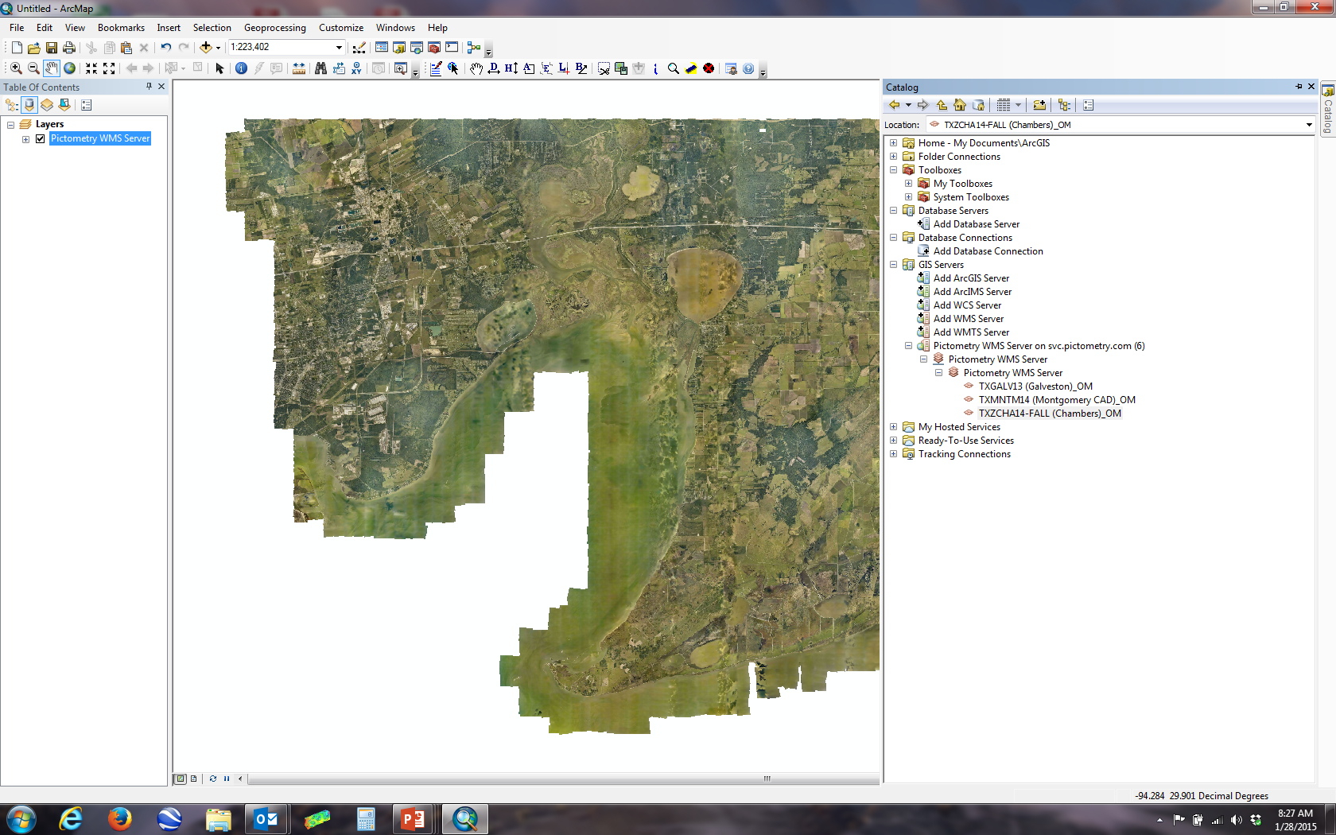
CONNECT Image Service: WMS/WMTS/TMS
For ArcGIS Desktop or any of your other web mapping applications
WFS Services Also Available Across All
Applications!
Notes:
WFS Totally Free

Slide 42
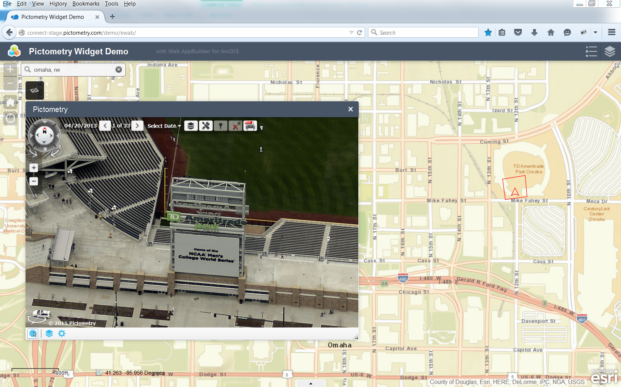
AGOL – Pictometry for WebApp Builder
Pictometry for Esri Web AppBuilder – a new “widget” available from Pictometry for
Integrating with Web AppBuilder for ArcGIS (Developer Edition)
Notes:
Works very much like the IPA

Slide 43
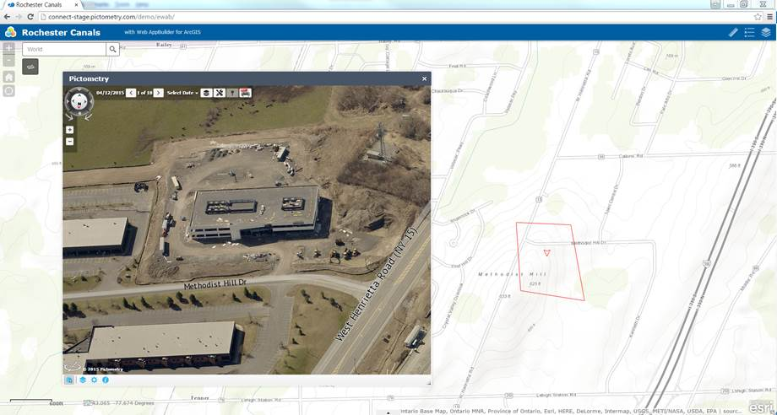
AGOL – Pictometry for WebApp Builder
Demonstration Site: An online live demo site for this new widget can be found here: http://connect-stage.pictometry.com/demo/ewab/
Example Customer Sites: http://scgis.siouxcounty.org/parcelsearch2.0/
http://citygisweb3.nashuanh.gov/housing/
http://webdmz.starkcountyohio.gov/propertyviewer/
Documentation Site: Pictometry has built an excellent documentation reference site, http://pol.pictometry.com/PictometryForWebAppBuilder/v1/

Slide 44
Local Integration into 911 CAD Software
Helps Locate Callers
Verify Addresses
An “eye in the sky,” conveying pertinent information to those on the scene

Slide 45
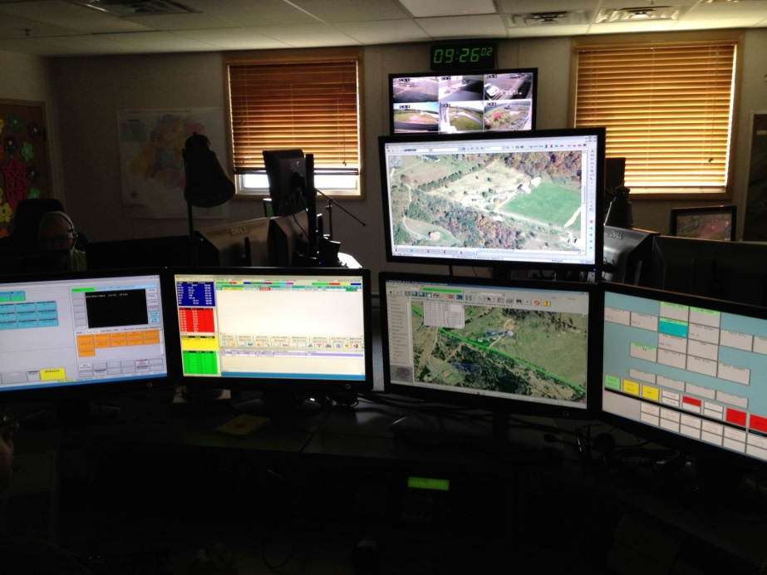



CAD Integration Options
Electronic Field Study (EFS) installed on each station
Need second/dedicated monitor
Imagery/data housed on local server or on individual stations
CAD passes X,Y to display appropriate image
Can be automatic or manual
1. COM Interface to EFS

Slide 46
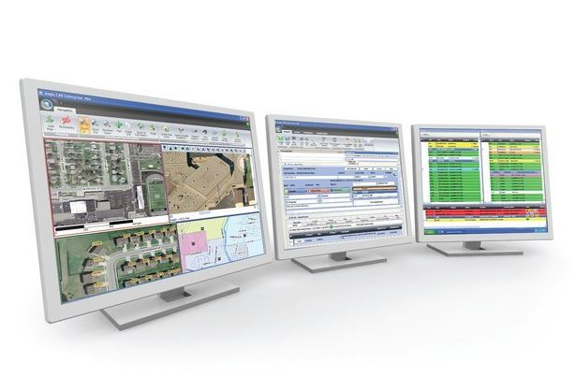



CAD Integration Options
2. Active-X Control
EFS not required
No separate monitor needed.
Accesses local imagery/data
CAD passes X,Y to display appropriate image
Can be automatic or manual

Slide 47




CAD Integration Options
3. IPA
JavaScript-based Integration
Internet reliance
Extremely easy to develop, deploy and use
Tied to county’s CONNECT account → access to historical imagery & uploaded GIS data

Slide 48

CAD Integration Options
NEW!
Released June 2017 after successful beta trial
“IPA-feel” but accesses local imagery & data
Seamless panning
GIS-capable
Utilize custom search and identify functionality
Flexible code for easy implementation
4. LINK Offline SDK
IMC??

Slide 49
Gateway
An API that delivers high resolution Pictometry imagery through a high-speed machine-to-machine portal.
Static.
Location Based.
Search and Retrieve.
Without a GUI.
Flexible.
Easy to Program.

Slide 50

Gateway – Ontario Co, NY

Slide 51

Gateway – Ontario Co, NY

Slide 52


Gateway – Populating a Report or Database
ELECTRONIC FORM
<Insert image here>
Location pulled via:
Address
X,Y, Lat/Long

Slide 53





Gateway
“Frontage Finder”
ELECTRONIC FORM
AUTOMATIC

Slide 54

Gateway – Similar Ideas

Slide 55

Gateway – Fire Map, RMWB
http://firemap.rmwb.ca/

Slide 56

Gateway - Fire Map, RMWB
http://firemap.rmwb.ca/

Slide 57


Marketing Material

Slide 58

Training & Support
Completely covered within your contract!
  No “limit” to training or support hours available
Dedicated Technical Trainer – Laura Mondo – Rochester, NY
On-site Visits
Web-based
  Custom Webinars
  Monthly Generic
  Recording available
Self-paced
  Training Website
  Documentation
  Videos
Custom documents
RTM Outreach

Slide 59
Questions?

Slide 60
Thank you!

